Slide 1
THE RED PONY

Slide 2
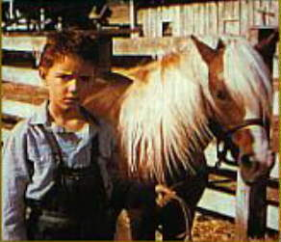
The main character of the story is Jody Tiflin, a ten year old boy. His father sees that he isn’t responsible enough so he decides to buy him a pony. Jody is very happy when he is given the present and he names the pony Galiban after the nearby Galiban mountain range.

Slide 3
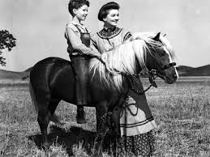
Jody takes good care of his pony. Soon his father buys him the equipment so that Jody could ride Galiban. One day it is raining, when he is in school and Galiban on the pasture, so the animal gets sick. Billy Buck, father’s servant, promises to Jody that Galiban will be good in few days. But unfortunately it is not so, Galibans health gets worse and worse.

Slide 4
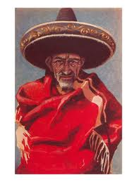
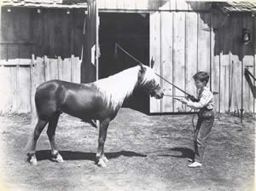
Billy has to cut the Galibans windpipe so he can breathe. All night Jody sleeps in the stable with the pony. In the morning pony disappears and Jody finds him dead on the nearby hill. During this time a Mexican named Guitano comes to the ranch and says that he was born here and that he wants to stay here.

Slide 5
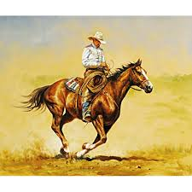
Carl Tiflin does not accept him. At night Guitano steals a mare and runs away. Then the father gives some money to Jody so that the boy can take mare to the neighbour’s ranch to a stallion. When the colt should be born an incident happens. Billy kills the mare to save the colt. Jody again trusts Billy.

Slide 6
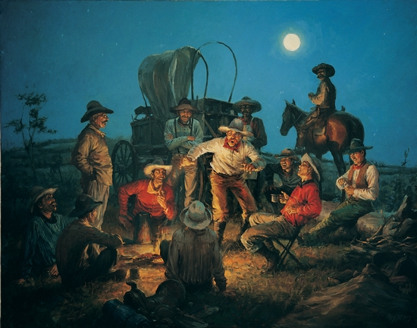
Jody’s grandfather arrives to the farm and tells stories about his life. Jody's father doesn’t like him and his stories and he is angry at him. But anyway he feels a lot of respect for him so he apologizes.

Slide 7
Barn-skedenj
Saddle-sedlo
Stalls-hlev
Examined-pregledati
Porch-veranda
Stern-krma
Crowd-množica
Uncertainty-negotovost
Cypress-cipresa
Bunkhouse
Buzzards-kanje
Smoothly-gladko
Rough-grobo
Wondered-spraševati
Anxiously-zaskrbljeno
Shyly-sramežljivo

Slide 8
Doom-poguba
Calm-miren
Embarrassed-osramotiti
Admiring-občudovati
Footman-pešec
Horseman-konjenik
Coat-krzno
Mysterious-skrivnosten
Noisily-hrupno
Exact-točen
Shine-sijati
Chin-brada
Lump-oteklina
Hay-seno
Thickly-debelo
Rushed-planiti

Slide 9
Strength-moč
Brush line
Wide-širok
Increased-izboljšati
Smooth-gladek
Gate-vrata
Responsibility-odgovornost
Cruel-kruto
Sack-vreča
Demanded-zahtevati
Marched-korakati
Slightly-nekoliko
Prisoner-zapornik
Wise-pameten
Bucket-vedro
The mare-kobila
Stallion-žrebec

