Slide 1
THE PRO‘S AND CON‘S OF CANNABIS
SERŠ 2016/2017

Slide 2
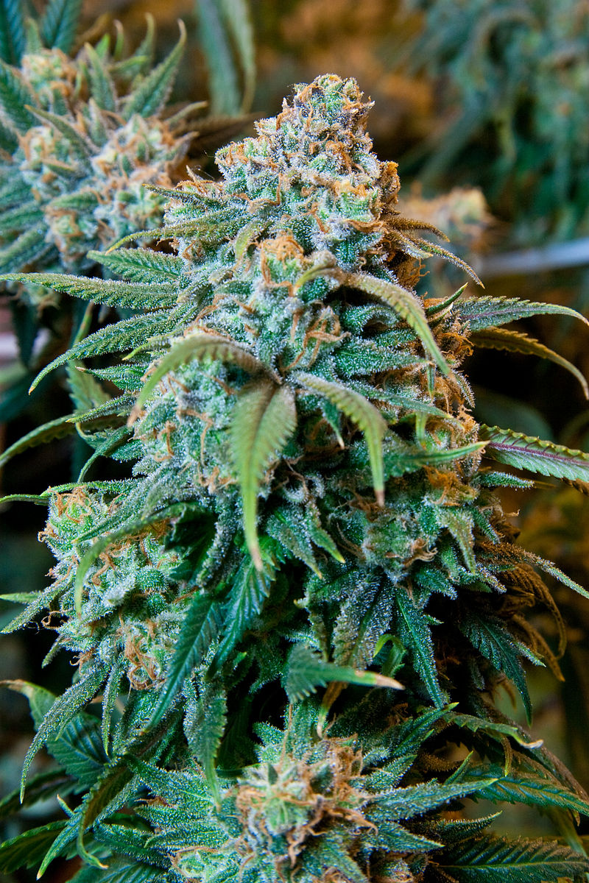
GENERAL
Cannabis aka. marijuana
Effects
Uses
Legalization

Slide 3
PRO‘S
Treat glaucoma
Control epileptic seizures
Stop cancer from spreading
Decrease anxiety
Maintain your figure
Increase creativity
Eliminate nightmares
Other pros of Cannabis

Slide 4
CON‘S
Affect your body negatively in short-term
Make you paranoid
May make you feel depressed
Impair memory
Get addicted
Other cons of Cannabis

Slide 5
VIDEO
https://www.youtube.com/watch?v=WKPBLI5xnMg

Slide 6
SOURCES
https://en.wikipedia.org/wiki/Cannabis_(drug)
http://www.newhealthadvisor.com/Pros-and-Cons-of-Weed.html
https://www.google.si/search?q=marijuana&espv=2&biw=1102&bih=642&source=lnms&tbm=isch&sa=X&ved=0ahUKEwiPqb_G18nQAhVBExoKHXZ2AWYQ_AUIBigB#tbm=isch&q=weed+tumblr&imgrc=4A9Dd1ImF9LnjM%3A
https://www.google.si/search?q=marijuana&espv=2&biw=1102&bih=642&source=lnms&tbm=isch&sa=X&ved=0ahUKEwiPqb_G18nQAhVBExoKHXZ2AWYQ_AUIBigB#tbm=isch&q=joint+tumblr&imgrc=Uz9vQCLsozO8oM%3A
https://www.youtube.com/watch?v=WKPBLI5xnMg

