Slide 1
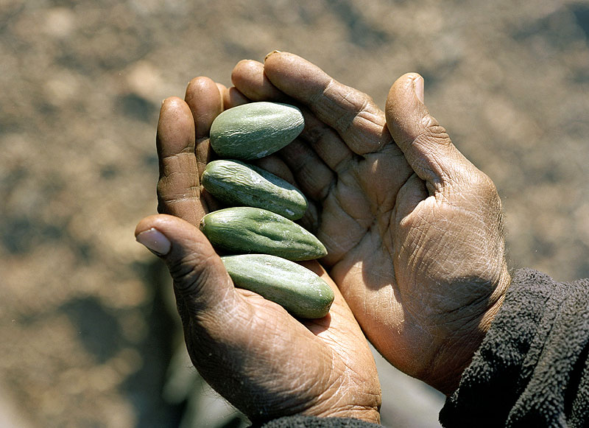
ABORIGINAL MEDICINE

Slide 2
less central
emphasis on patient’s environment
folk remedies
holistic mind, body
medicine distinguished from healing
based on series of virtues
more routes to healing

Slide 3
MEDICINE WHEEL
interconnection of life cycles
sacred number four
4 parts of a person
4 seasons
4 medicines
4 kingdoms
values and decisions
imbalance affects health

Slide 4
THE FOUR SACRED MEDICINES
Sweet Grass; ritual cleansing, injustice can be returned by kindness
Tobacco; connection to spirit world, used for thanking the Creator
Cedar; purification, attracts positive energy
Sage; purifying, repels negative energy

Slide 5
SMUDGING
ritual cleansing
sacred medicines burned in shell
person puts their hands in the smoke and carries it to their body
possible production of beta-endorphins, promote healing

Slide 6
healing circles
meetings
healing physical, emotional, spiritual wounds
symbolic object given to the person who wishes to speak
shamans conduct the ceremony

Slide 7
sweat lodge
ceremonial sauna
healing and cleansing
hot stones placed in the centre of the lodge poured with water
offerings, prayers, reverence
sometimes negative health effects appear

Slide 8
sun dance
celebration of the harmony between a man and nature
practiced at sun solstice
usually also a buffalo is involved
preparations of dancers in sweat lodge
dance lasts for 4 days
drumming, singing, dancing, fasting, self inflicted pain
symbolizes rebirth

Slide 9
pipe ceremony
used for prayer, ceremonial purposes
burned braid of Sweet Grass used to purify the place and participants
Tobacco is smoked, prayers can be made to the Great Spirit
also smoked when opening other meetings
pipe holder

Slide 10
sources
Aboriginal bush medicine (online). Accessible <http://www.bri.net.au/medicine.html>
Aboriginal bush medicine (online). Accessible <http://www.bri.net.au/medicine.html>

