Slide 1
CHRISTINA AGUILERA
MAY, 2008

Slide 2
Born on 18. December 1980 in New York
27 years old
1.58 height
Very small person like me
Short blond hair and blue eyes
Quite small nose and big lips

Slide 3
HOBBIES
Shopping
Cinema
Baseball
Volleyball

Slide 4
FAMILY
- Mother Shelly Kearns and Father Fausto Aguilera are very important contractors
- 2 sisters Rachel and Stephanie and 2 brothers Michael and Casey
- 2 beautiful dogs - Chewy and Stinky

Slide 7
As you now is Xtina a singer.
Christina’s musical career began when she was six years old. She began competing in local talent shows.
http://www.youtube.com/watch?v=Mucj7hHJ_uQ

Slide 8
the new mickey MOUSE CLUB
In 1992, she joined “The New Mickey Mouse Club.” This show was created by Walt Disney and it presented a lot of things. One of those is a funny commercial. In this funny commercial are playing: Xtina, Britney and Justin.
http://www.youtube.com/watch?v=emWxQF_uAaM&feature=related
As you could see in this show wasn’t collaborate only Xtina, there were Britney Spears, Justin Timberlake and a lot of others famous people too. And with this show they all get famous.

Slide 9
Today is Christina one of the most popular pop star in the world.
Christina Aguilera is not only a singer, she writes songs too.
She is idol for many teenagers around the world. She has got an amazing and powerful voice.
She won a lot of Awards. Some of them are:
Grammy for Best New Artist
Best Female Pop Vocal Performance
Best Pop Vocal Album
Best Female Pop Vocal Album ( Spanish award)

Slide 10
INTERESTING THING
She loves piercings, because the girl has got 11 piercings, but we can see just some of them. We can see piercings in her nose, chin and in her belly button. I know for one piercing which she has got on her body, because I saw it on the picture, but I think it is not good that I tell you where, but you can ask me this after the lesson.

Slide 11
ALBUMS
Christina revealed five albums till today.
First album was called Christina Aguilera and on this CD is her super hit Genie in the bottle.
Next two albums My kind of Christmas and Mi Reflejo (Latin CD) didn't get big attention.
Christina's last but one album was Stripped and it’s her the best. On this CD are really very good songs, which are repressing on whole world. Titles of those songs are: Dirty, Beautiful, Fighter, Can't hold us down (with singer lil'kim) and The voice within.
And her last album was Back to Basic which is very good too.

Slide 12
Christina Aguilera 3 years ago married a man. His name is Jordan Bratman and he is 30 years old. On her wedding was she wearing a very long weeding dress and the cake has got 5 floors.

Slide 13
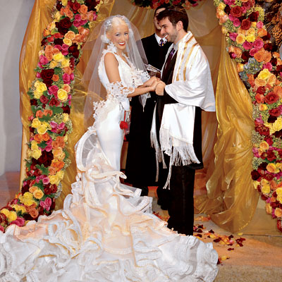

Slide 15
Few months ago she got a baby. It is a boy and his name is Max.
She has now a happy family

Slide 16
The end

