Slide 2
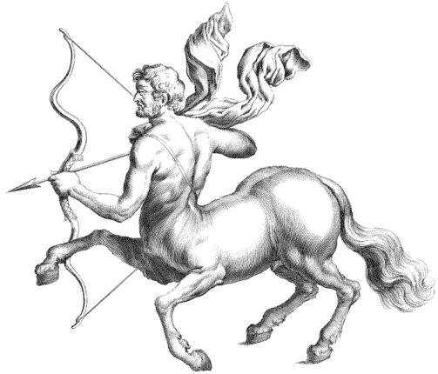
INDEX
EARLY LIFE
NOW
ALBUMS
AWARDS
PRIVATE LIFE
QESTIONS

Slide 3
EARLY LIFE
born on 18 december 1980 in New York
28 years old
as little girl she was singing a lot
decide to be a singer
began with six years old; local talent shows

Slide 4
NOW
one of the most popular popstars in the world
she writes songs too
one of the most fascinating women of the year 1999

Slide 5
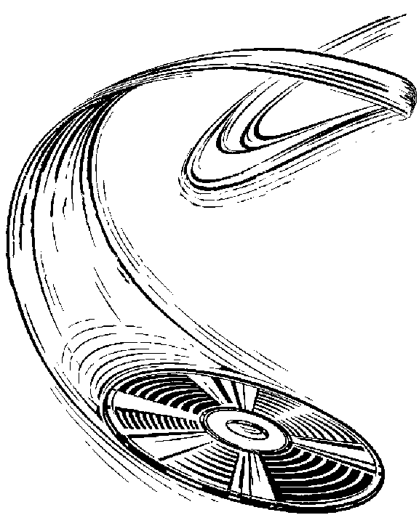
ALBUMS
five albums till today.
first album was called Christina Aguilera (1999)
next two albums My kind of Christmas, Mi Reflejo (2001)
Other albums:
2002:Stripped
2006:back to basics
2008: keeps getin better

Slide 6
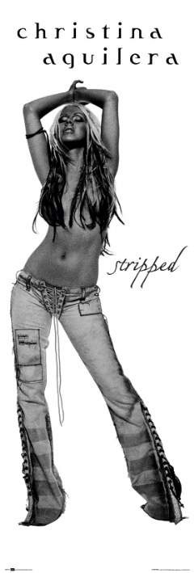
AWARDS
first single, “Dirty” showed her as a much different singer than before
February 2000, she won a Grammy:Best New Artist
Her video “Lady Marmalade” won the the Best Video of the year

Slide 7
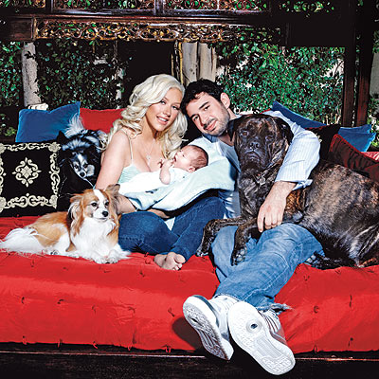
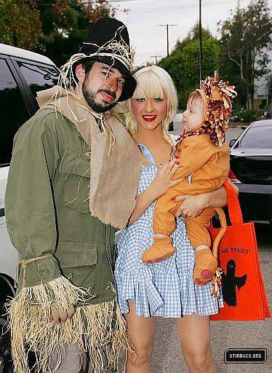
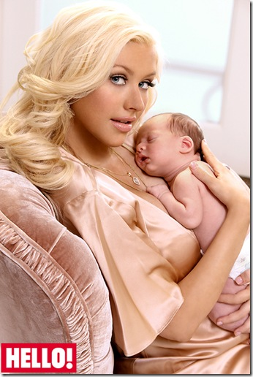
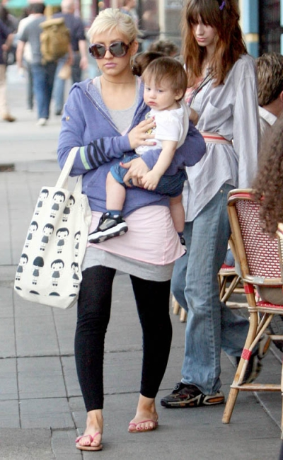
PRIVATE LIFE
Married with Jordan Bratman
19 November 2005
One child named:Max borned 2009

Slide 8
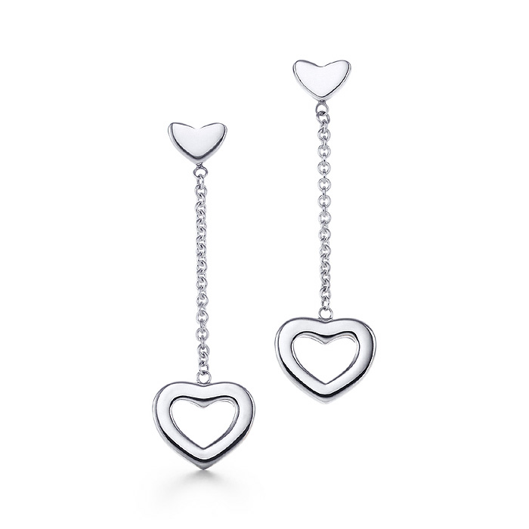
Christina Aguilera is not only a singer and big lover of food, she loves piercings, becouse she has eleven piercings, but we can see just some of it

Slide 9
QUESTIONS
WHEN WAS SHE BORN
WHERE WAS SHE BORN
HER ALBUM STRIPPED CAME OUT IN WHIC YEAR
HER FIRST ALBUM IS

Slide 10
HER VIDE LADY MARMELADA WON…
SHE IS MARRIED WITH WHO
SHE IS BIG LOVER OF THE…
HOW MANY PERCINGS DOES SHE HAVE

