Slide 1
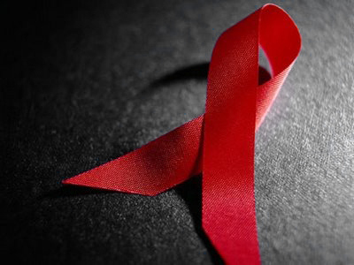
& HIV
AIDS

Slide 2
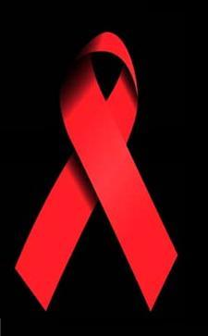
What is AIDS?
It’s a sexual transmitted disease which has spread all over the world
There is no cure that could heal the infected people
It has killed millions of people so far, that’s why it is also called the black death.

Slide 3
History of AIDS

Slide 4
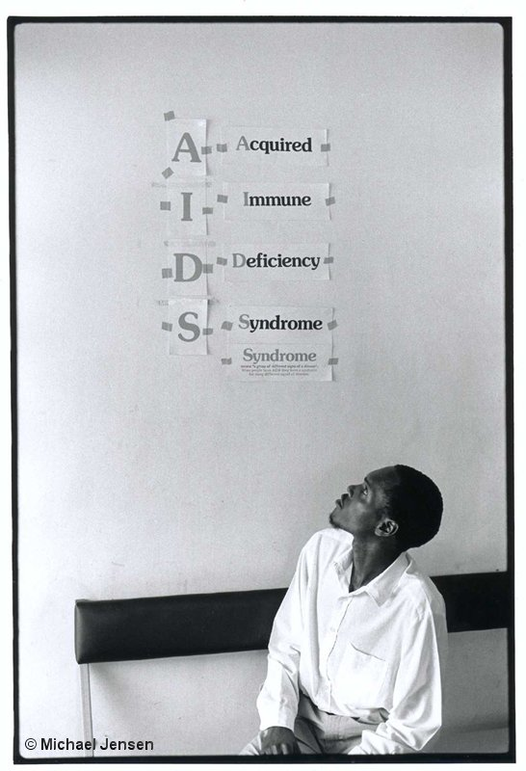
What does the name mean?
Acquired Immune Deficiency Syndrome

Slide 5
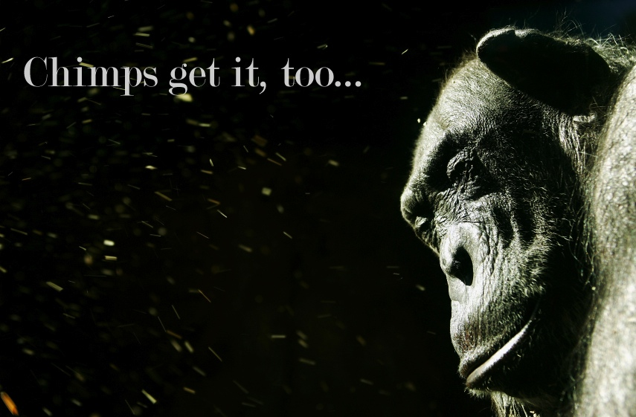
What is HIV?
HIV stands for Human Immunodeficiency Virus and subsequently leads to AIDS.
’’crossed over’’ into human population from a particular species of chimpanzee

Slide 6
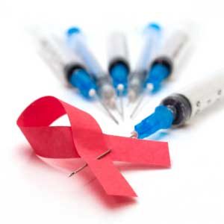
How long does it take for HIV to become AIDS?
The average time is 8 – 11 years
Medical treatments can slow down the rate at which HIV weakens the immune system

Slide 7
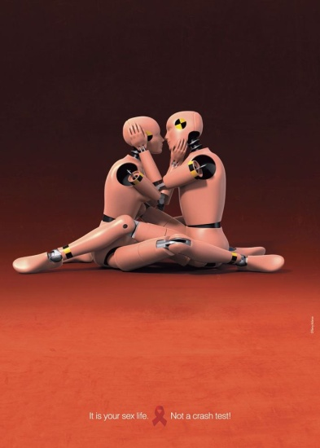
What happens with HIV inside our body?
HIV is a retrovirus
Activities that allow HIV transmission are:
unprotected sexual contacts
direct blood contact with the infected person
injection of drug needles
blood transfusions
mother to a baby

Slide 8
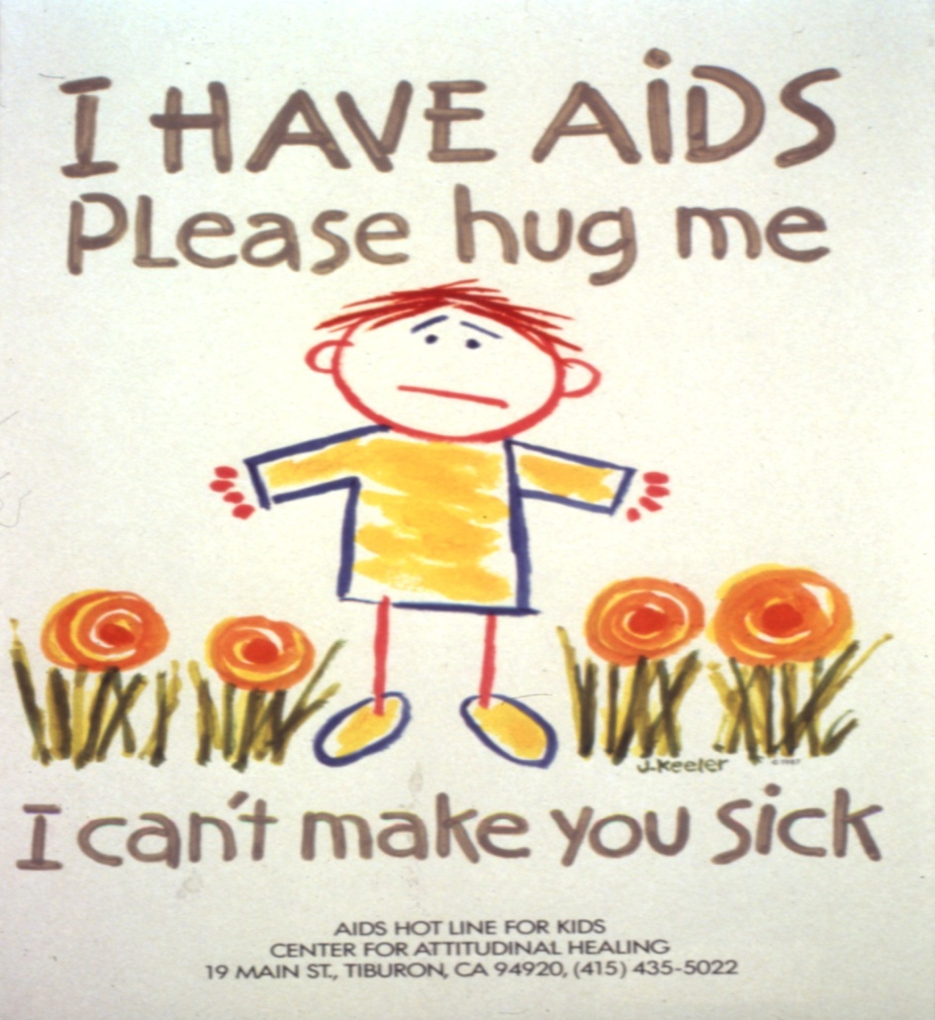
You can’t get AIDS from:
kissing,
tears,
shaking hands,
hugging,
using a toilet,
sneezing,
coughing,
urine,
sweat …

Slide 9
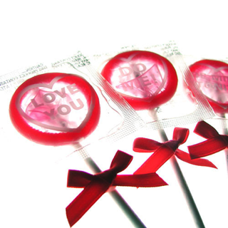
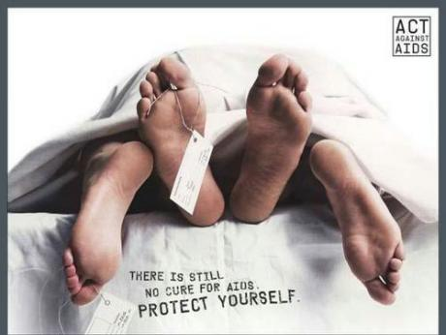
The biggest problem with AIDS
The fact you can’t really know that you have it until it’s too late
Infected people are more vulnerable and exposed to other diseases.

Slide 10
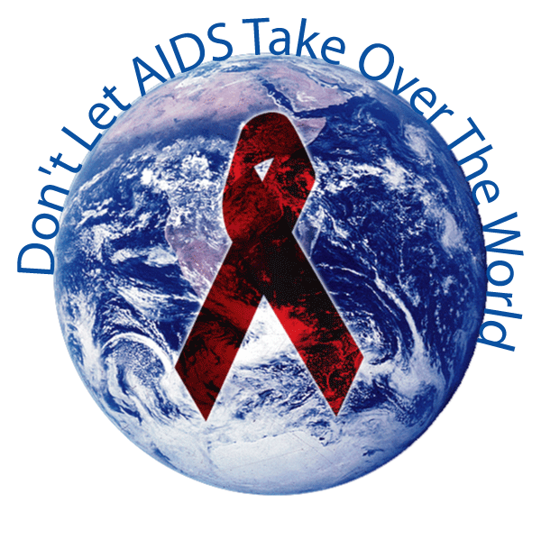
Statistics:
36,1 million people living with AIDS
AIDS has killed 21,8 million people
In Slovenia we have
more than 200 known cases
of AIDS

Slide 11
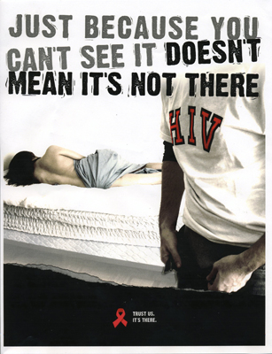
Open your eyes widely tomorrow might be too late. Don’t die of ignorance!

Slide 12
New words:
Pneumonia – pljučnica
Vulnerable – ranljiv (biti občutljiv na kaj)
Treatment – zdravljenje
Cure – zdraviti, zdravilo
Disease - bolezen

