Slide 1
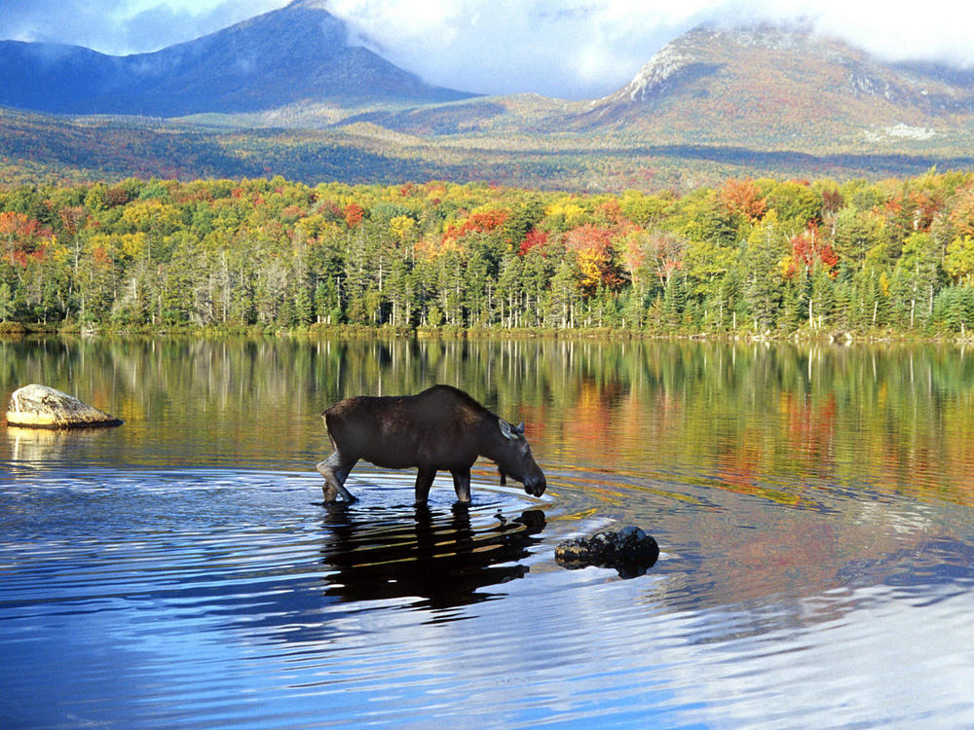
ALASKA

Slide 2
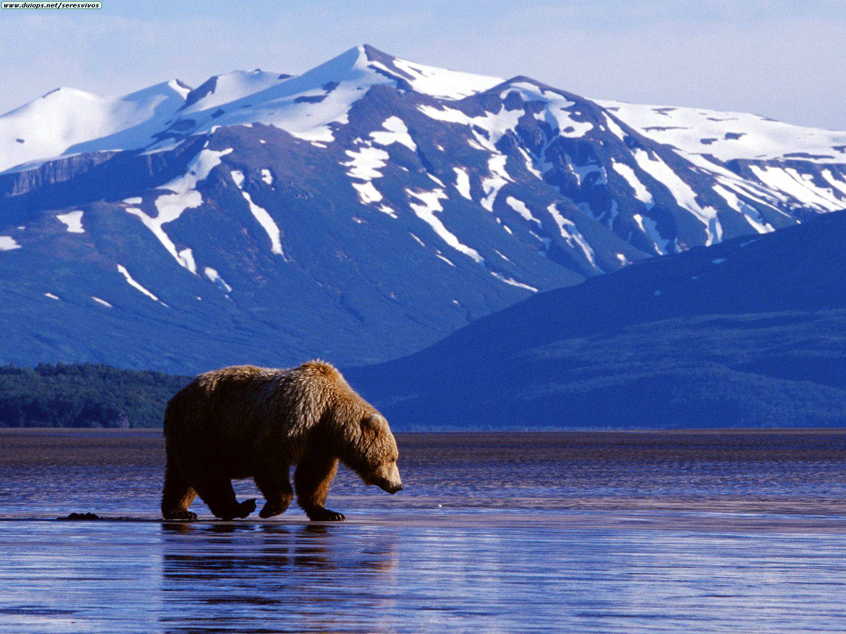
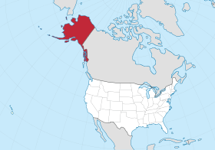
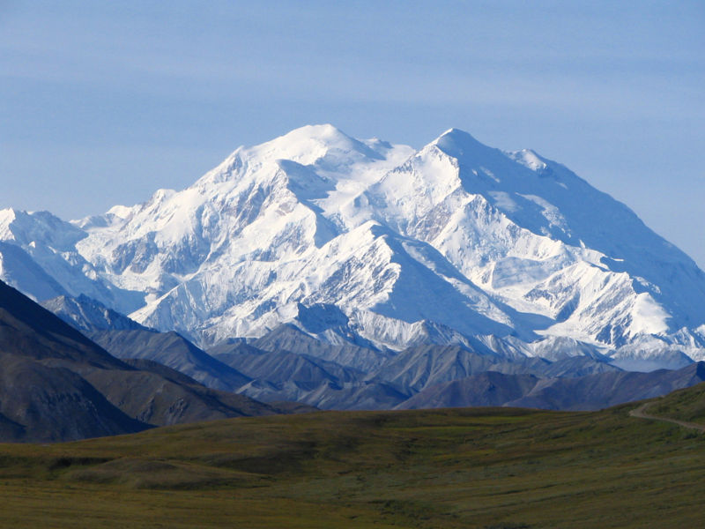
Alaska is the largest state in the USA.
It lies on the continent of North America.
The capital city is Juneau, the largest city is Anchorage.
Denali is the highest mountain in Alaska.
The official language is English.

Slide 3
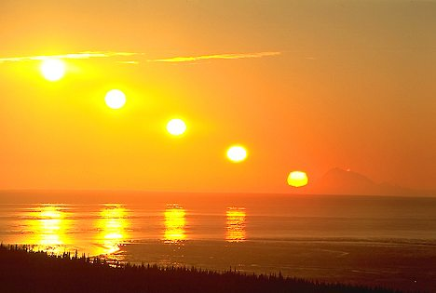
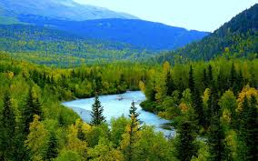
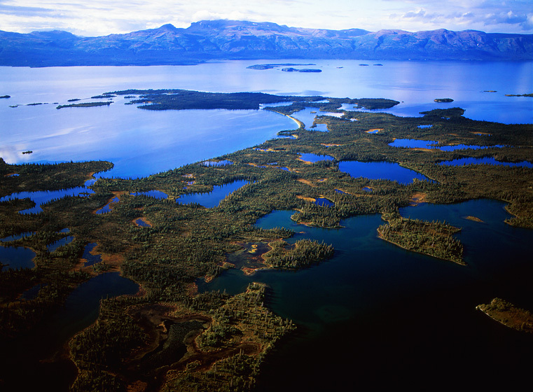
Alaska is covered with forests and mountains.
It has more than 3 million lakes and 3000 rivers.
The nickname of Alaska is the Land of the midnight Sun.

Slide 4
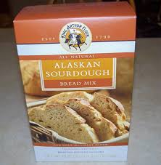
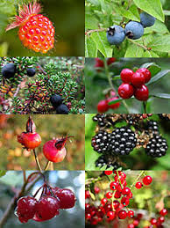
ALASKA’S FOOD
People in Alaska enjoy a wide variety of food.
Alaskans enjoy eating meat from moose, elk and bear.
They also eat a lot of fruits. Mostly wild blueberries, wild strawberries and raspberries.
Also very popular in Alaska is Sourdough bread.

Slide 5
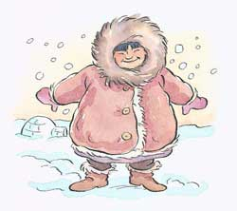
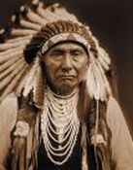
In Alaska live the Alutians, Eskimos and Indians.

Slide 6
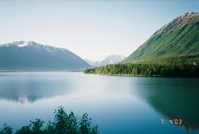
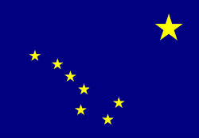
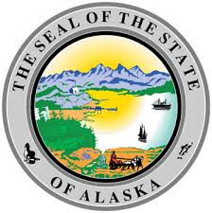
FLAG
Blue with yellow stars of the Big Dipper and the North Star in the right corner.

Slide 7
ALASKA’S MONEY

Slide 8
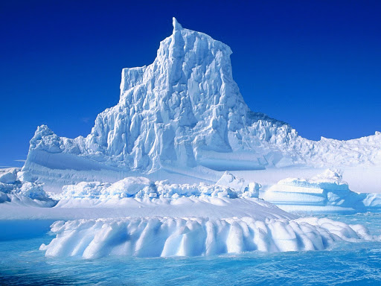
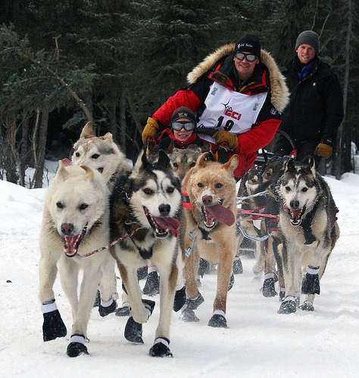
SPORT
The most popular sport in Alaska is dog sledding.
Dog sleds were important for transportation in arctic areas...

Slide 9
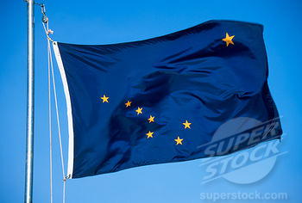
ANTHEM
Eight stars of gold on a field of blue Alaska's flag. May it mean to you The blue of the sea, the evening sky, The mountain lakes, and the flowers nearby; The gold of the early sourdough's dreams, The precious gold of the hills and streams; The brilliant stars in the northern sky, The "Bear," the "Dipper," and, shining high, The great North Star with its steady light, O'er land and sea a beacon bright. Alaska's flag to Alaskans dear, The simple flag of a last frontier.
https://www.youtube.com/watch?v=NJeWLMFKwcU

Slide 10
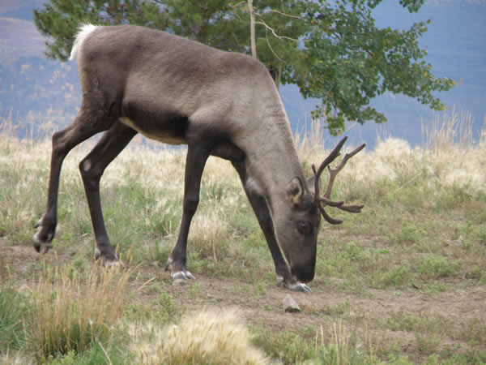
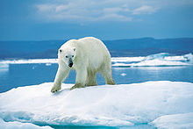
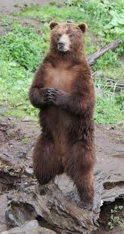
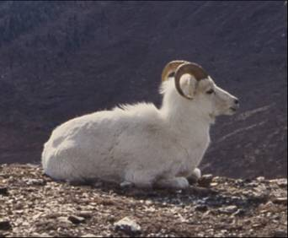
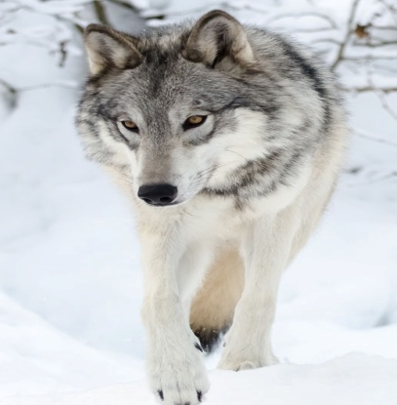
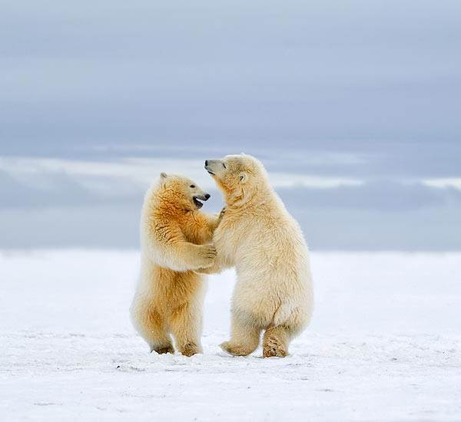
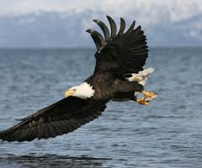
In Alaska live a lot of different animals.
For example: bears, bisons, elk and eagles…

Slide 11
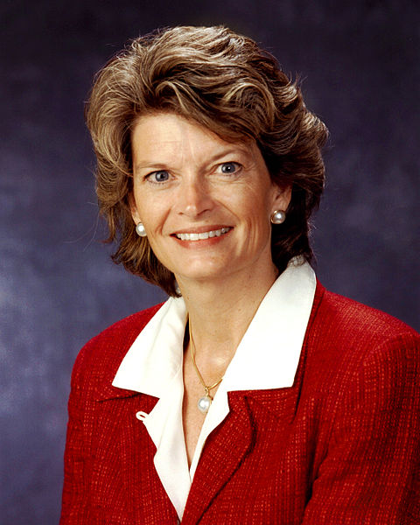
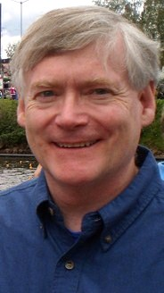
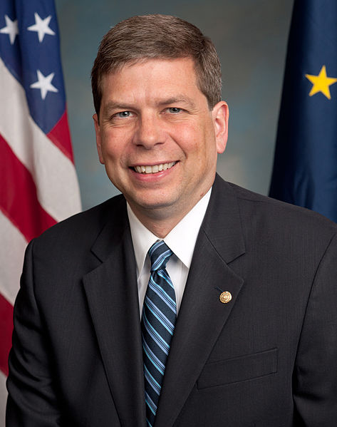
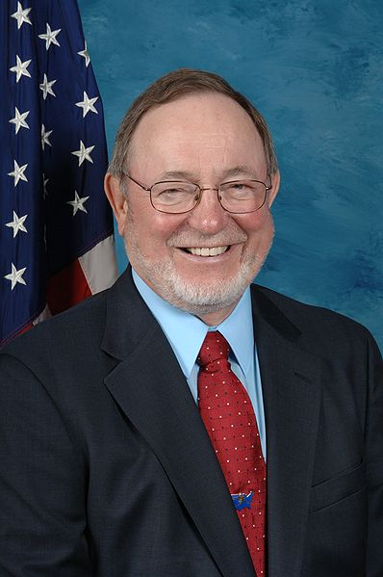
ALASKA'S CURRENT STATEWIDE OFFICIALS
Sean Parnell
Lisa Murkowski
Mead Treadwell
Mark Begich
Don Young

