Slide 1
(TOP 10)
America˙s
national parks

Slide 2
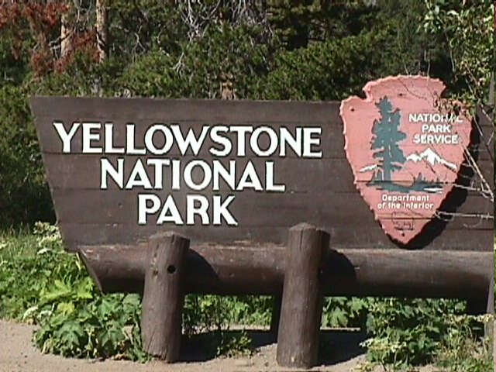
Yellowstone NP

Slide 3
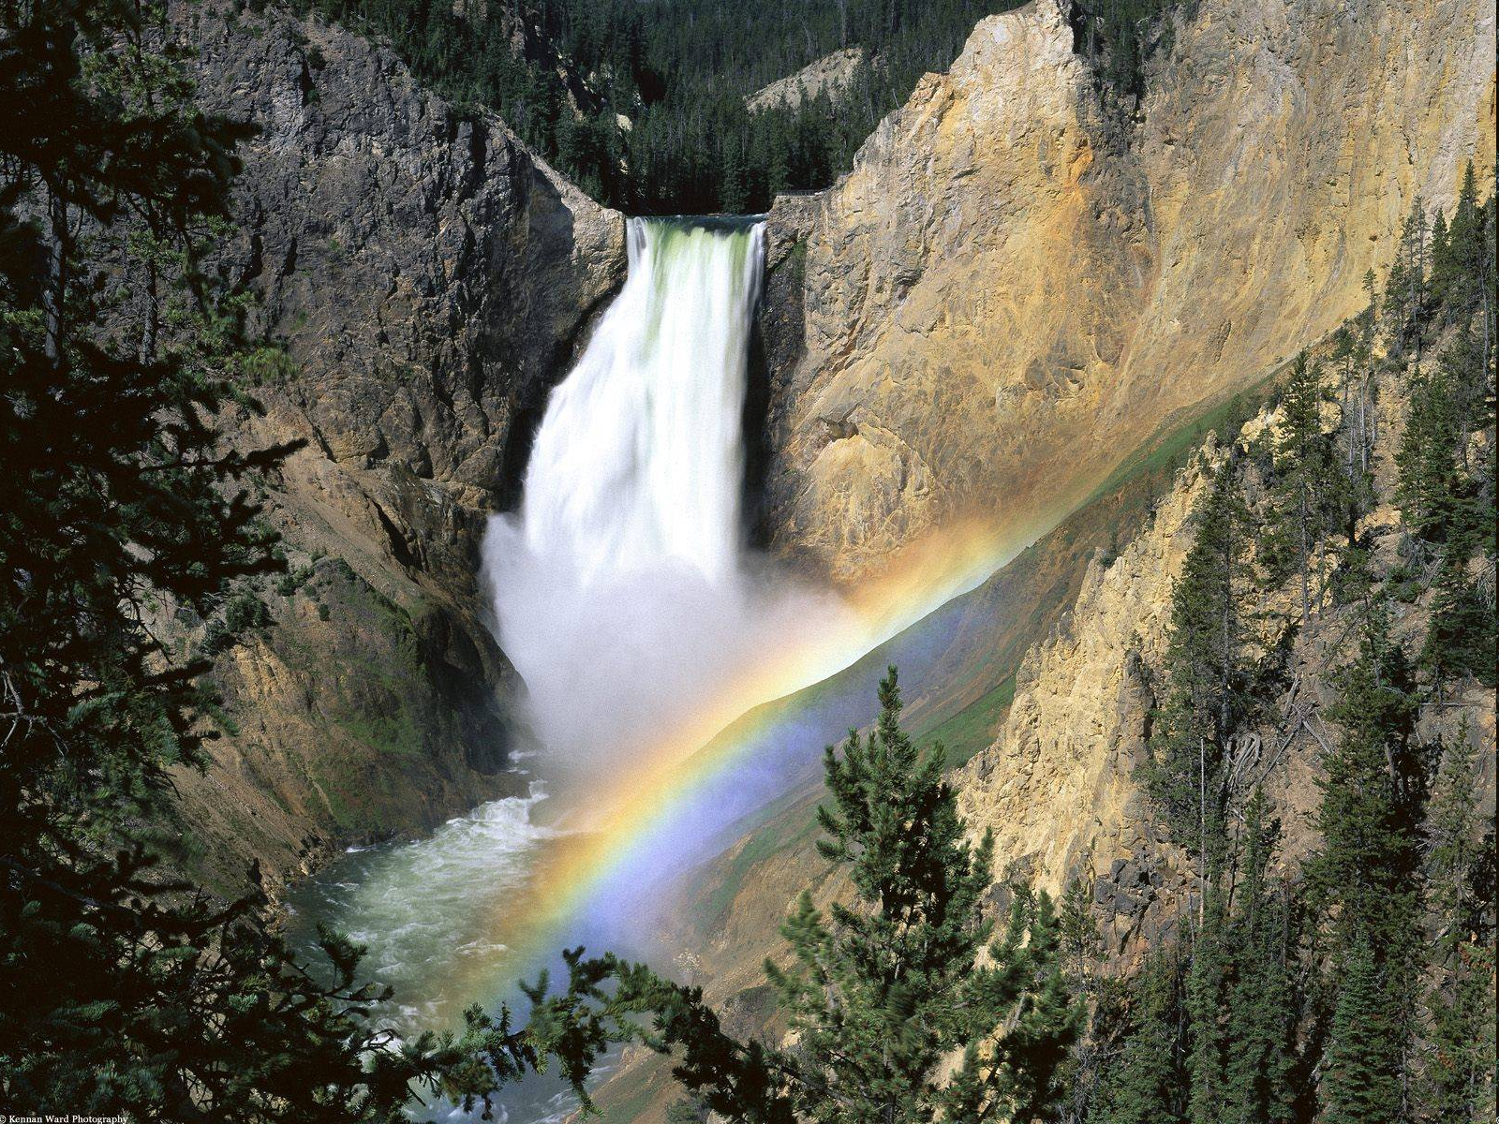
Established in 1872, Yellowstone National Park is America's first national park. Located in Wyoming, Montana, and Idaho, it is home to a large variety of wildlife including grizzly bears, wolves and bison.

Slide 4
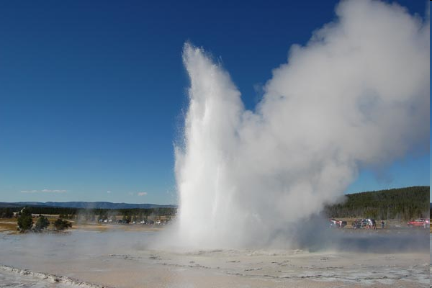
Yellowstone National Park is interested in Old Faithful (the most popular geyser in the world) and a collection of the world's most extraordinary geysers, hot springs, and the Grand Canyon of the Yellowstone.

Slide 5
Death Valley NP

Slide 6
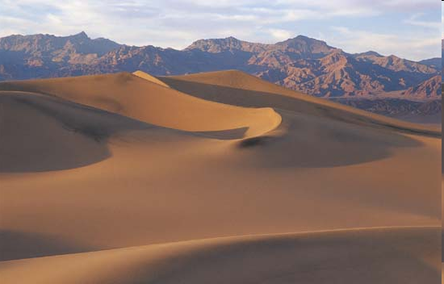
Hottest, Driest, Lowest: A superlative desert of streaming sand dunes, snow-capped mountains, multicolored rock layers, water-fluted canyons and three million acres (120000 ha) of stone wilderness.

Slide 7
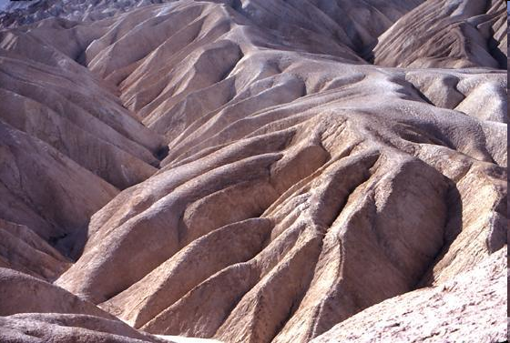
Home to plants and animals unique to the deserts.
A place of legend and a place of trial. Death Valley National Park is usually considered a winter park, but it is possible to visit here all year.

Slide 8
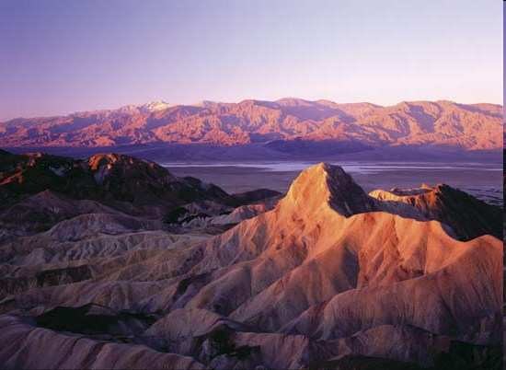

Slide 9
Grand Teton NP

Slide 10
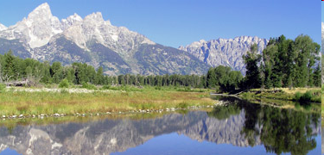
Located in northwestern Wyoming. Grand Teton National Park preserves a spectacular landscape rich with mountains, lakes and extraordinary wildlife. Park attracts nearly four million visitors per year.

Slide 11
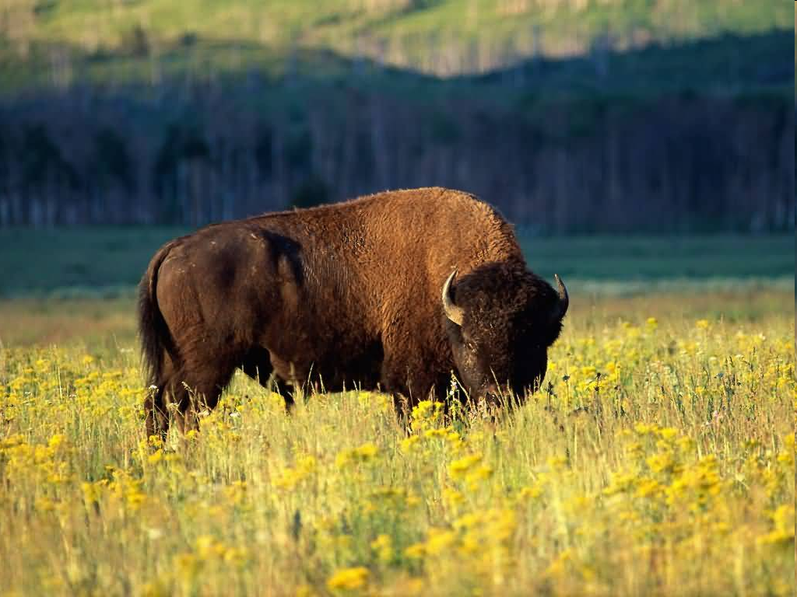
Grand Teton National Park is home to one of the most recognizable mountain landscapes in the world. It is often in the national and international spotlight. Many special events and activities happen in this high profile park.

Slide 12
Rocky Mountain NP

Slide 13
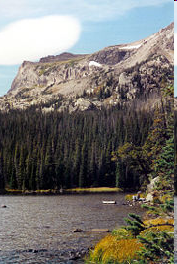
Is a National park located in the north-central region of the U.S. State of Colorado. It features majestic mountainviews, a variety of wildlife, varied climates and environments - from wooded forests to mountain tundra and easy access to back-country trails and camp sites.

Slide 14
Olympic NP

Slide 15
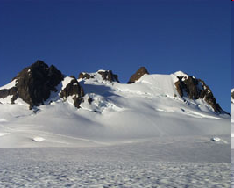
Olympic National Park is located in the U.S. state of Washington, in the olympic peninsula. The park can be divided into three basic regions: the Pacific coastline, the olympic mountains, and the temperate rainforest.

Slide 16
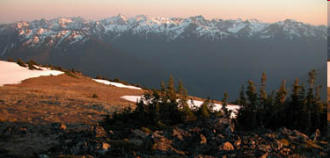
Here you will find Pacific Ocean beaches, rain forest valleys, glacier-capped peaks and plants and animals. Roads provide access to the outer edges of the park, but the heart of Olympic is wilderness.

Slide 17
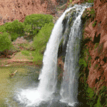
Grand Canyon NP

Slide 18
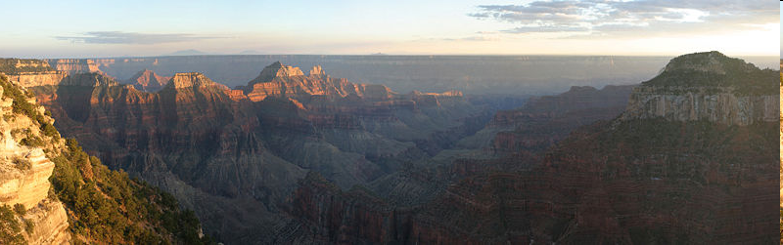
Grand Canyon National Park is one of the United States' oldest national parks and is located in Arizona. Within the park lies the Grand canyon, a gorge of the Colorado river, considered to be one of the major natural wonders of the world.

Slide 19
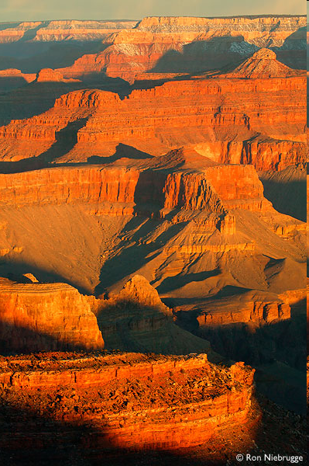
A powerful and inspiring landscape, the Grand Canyon overwhelms our senses through its immense size; 277 river miles (446km) long, up to 18 miles (29km) wide, and a mile (1.6km) deep.

Slide 20
Yosemite NP

Slide 21
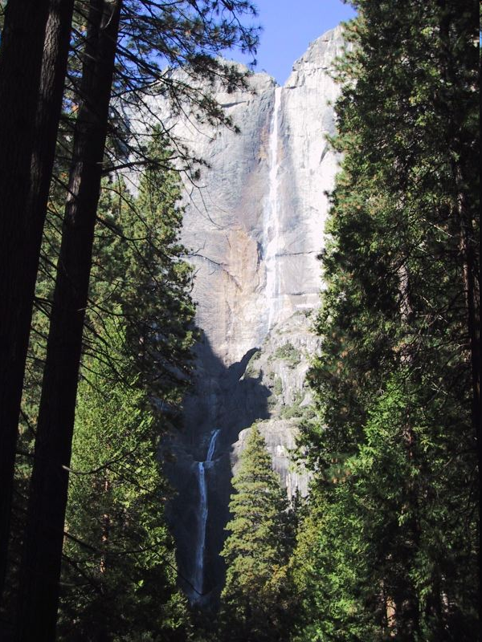
Yosemite National Park, one of the first wilderness parks in the United States, is best known for its waterfalls, but within its nearly 1,200 square miles, you can find deep valleys, grand meadows (travnik), ancient giant sequoias, a huge wilderness area, and much more.

Slide 22
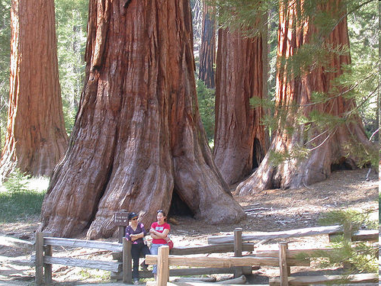
Not just a great Valley...but a shrine to human foresight, strength of granite, power of glaciers, the persistence of life, and the tranquility of the High Sierra.

Slide 23
Glacier NP

Slide 24
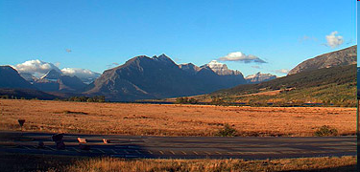
In Glacier's NP you can experience pristine forests, alpine meadows, rugged mountains, and spectacular lakes. With over 700 miles of trails, Glacier is a hiker's paradise for adventurous visitors seeking wilderness and solitude.

Slide 25
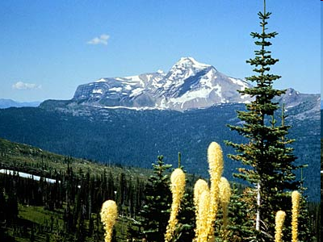
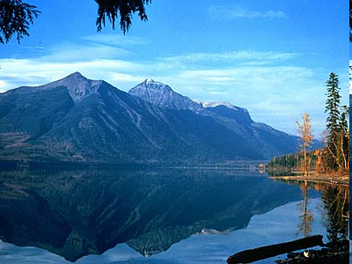
Relive the days of old through historic chalets, lodges, transportation, and stories of Native Americans. Glacier National Park is located in the U.S. state of Montana, bordering the Canadian provinces of Alberta and British Columbia.

Slide 26
Sequoia NP

Slide 27
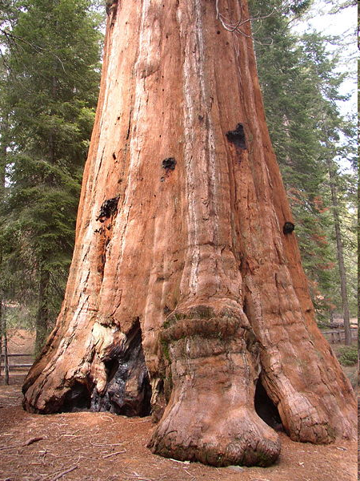
Sequoia National Park is a national park in the southern Sierra Nevada, east of Visalia, California in the United States of America. It was established in 1890 as the second U.S. national park, after Yellowstone National Park

Slide 28
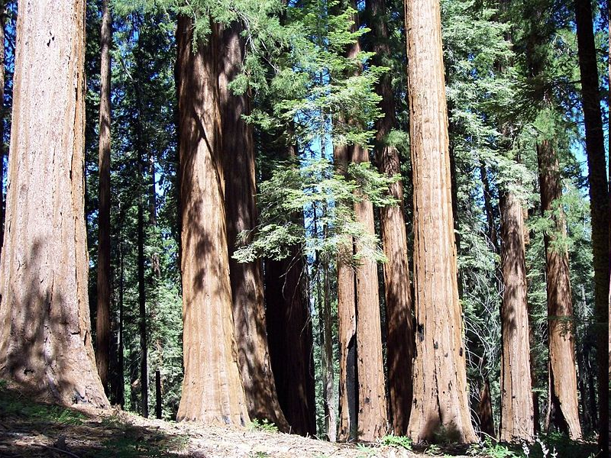
The park is most famous for its Giant Sequoia trees, including the General Sherman tree, the largest tree on Earth. The General Sherman tree grows in the Giant forest, which contains five out of the ten largest trees in the world

Slide 29
Mammoth Cave NP

Slide 30
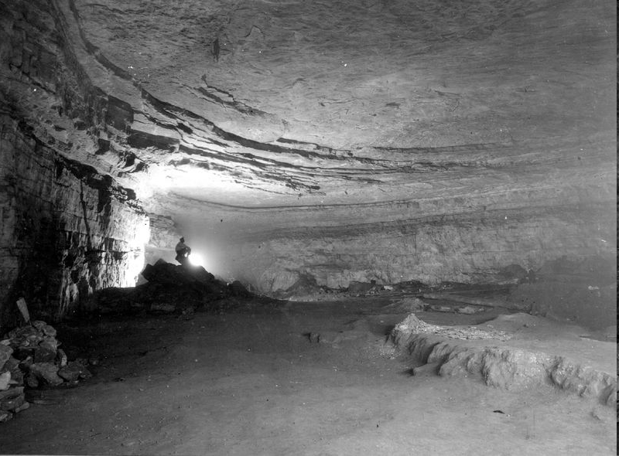
Mammoth Cave National Park is a U.S. National park in central Kentucky, encompassing portions of Mammoth Cave, the longest cave system known in the world.

Slide 31
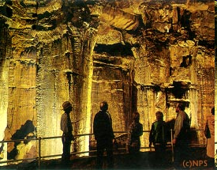
One early visitor recalled his tour of the cave: "No ray of light but the glimmer of our lamps; no sound but the echo of our own steps; nothing but darkness, silence, immensity."

Slide 32
Sources:
www.nps.gov
en.wikipedia.com
www.youtube.com

Slide 33
www.youtube.com/watch?v=zNvxFCrcBh0&feature=related

