Slide 1
Amsterdam :)

Slide 2
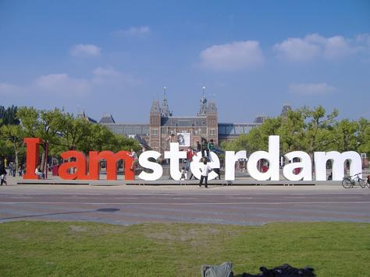
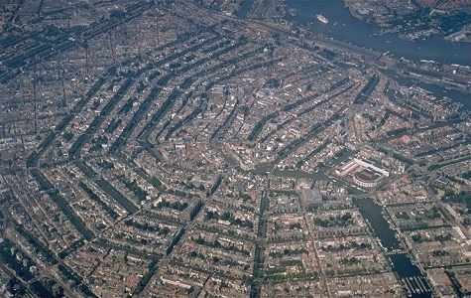
Description
The capital & the largest city of the Netherlands
Population ---> 800,000
The most visited city – 3,5 milion visitors a year
Location – province of North Holland

Slide 3
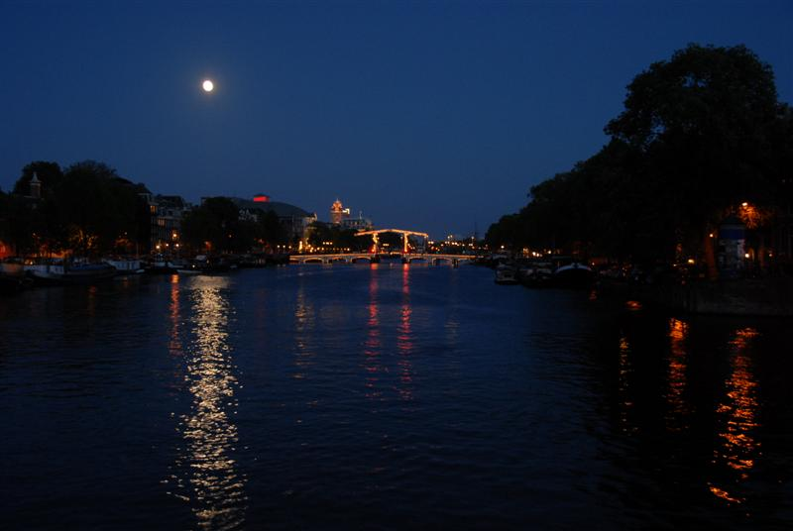
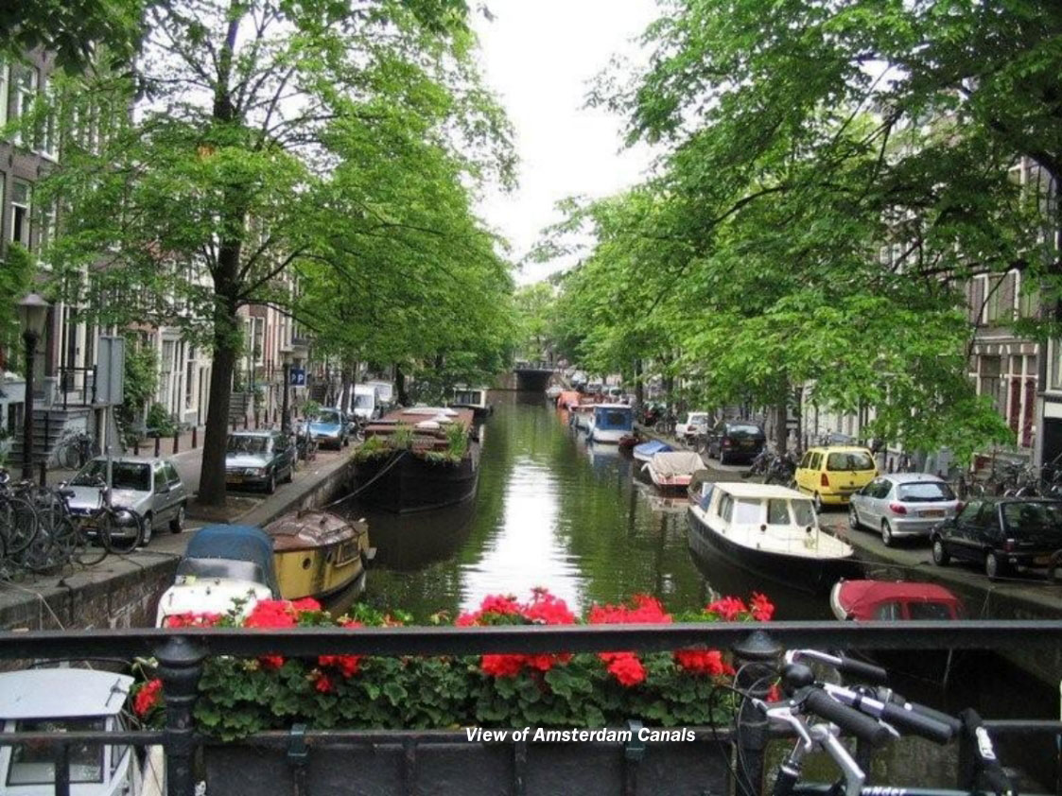
Name comes from river Amstel
Channels ---> UNESCO World heritage List in July
Financial and cultural capital of the Netherlands
Philips,ING

Slide 4
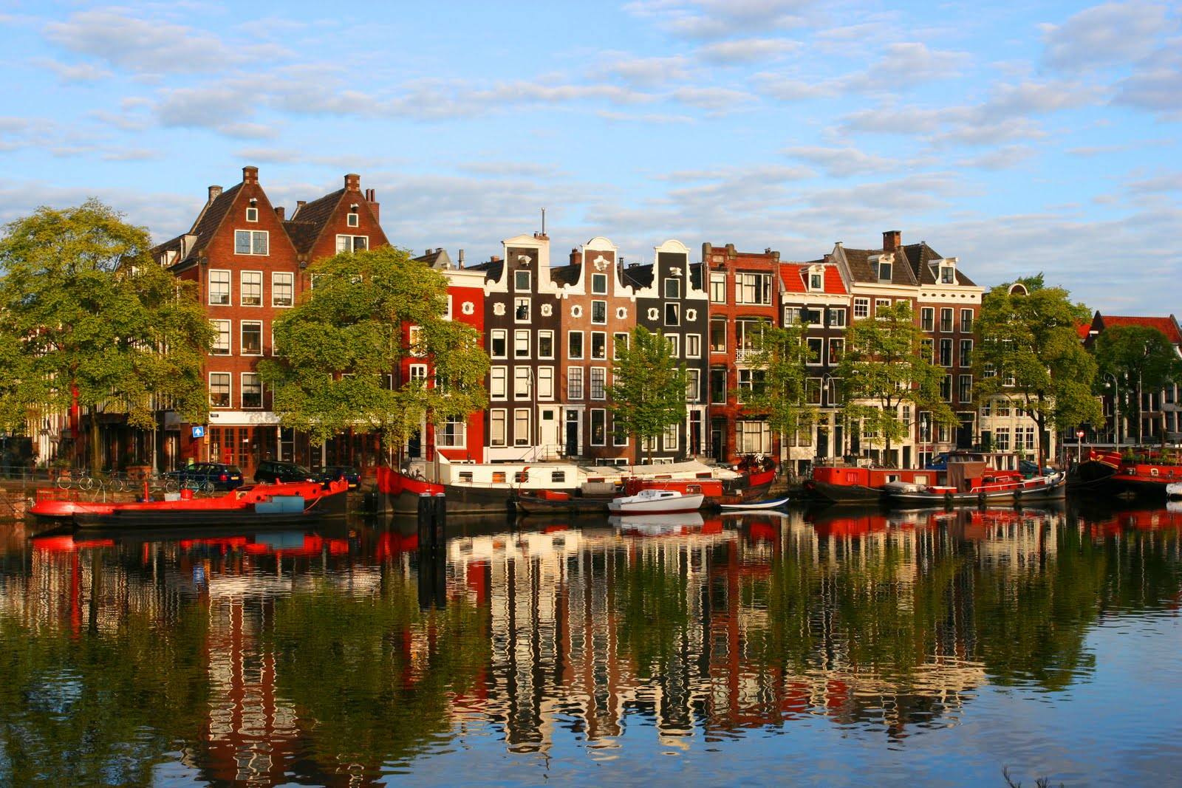
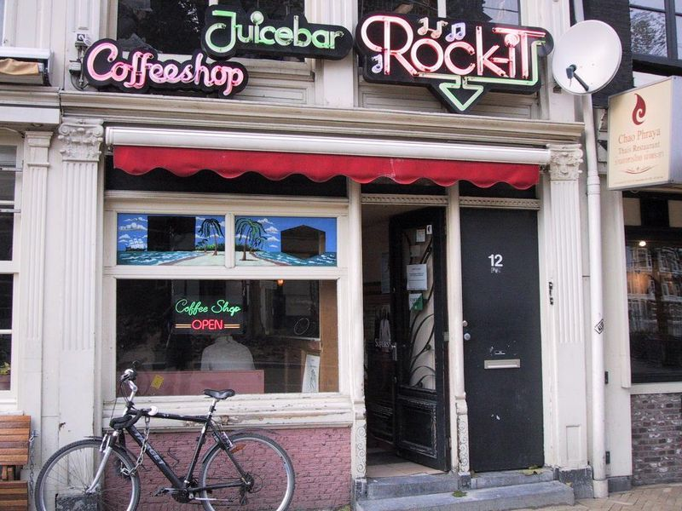
165 chanels
1281 bridges and narrow streets
Coloured houses from wood
Small shops & coffee shops
Coffee shops ---> cannabis

Slide 5
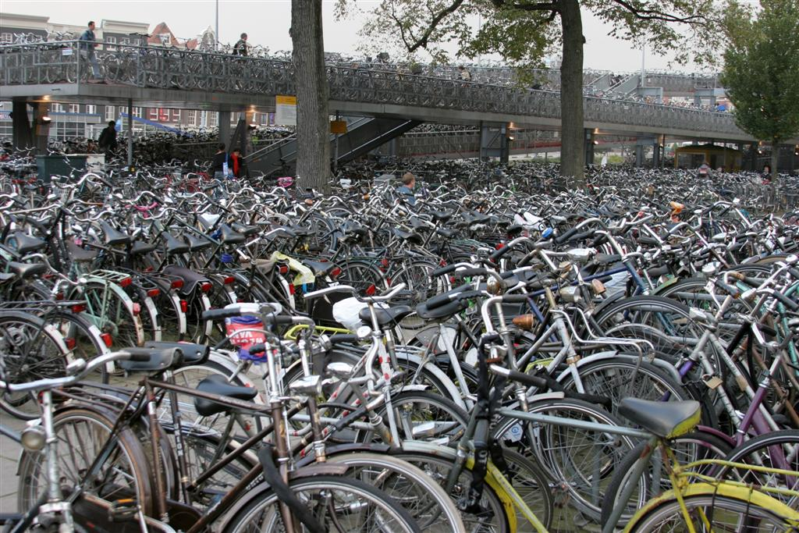
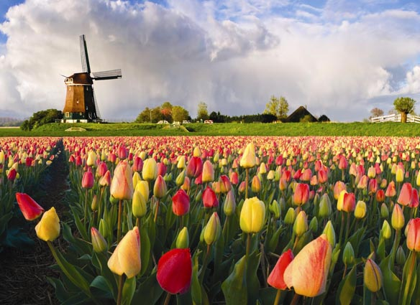
1.000.000 bicycels
More bikes than cars
Tulips,channels,museums,cannabis…
Concerts at the channels
Diamonds
Amsterdam’s Hortus Botanicus

Slide 6
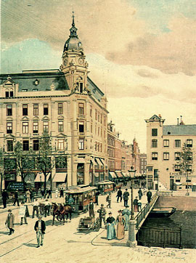
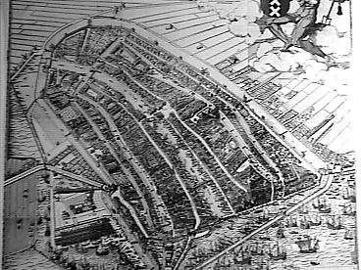
History
German tribes
Merchants,possesors,shipowners, bankers
Farming & fishing
Fishing village
1928 olympic games
1980 become the capital city

Slide 7
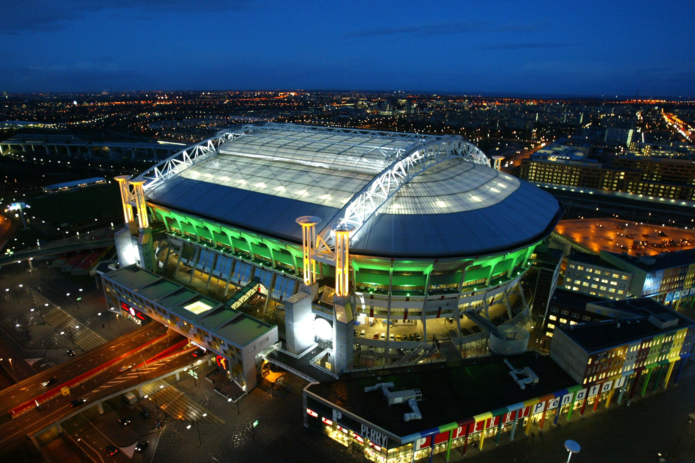
Sport
The most popular sport ---> football
Ajax
Football legends

Slide 8
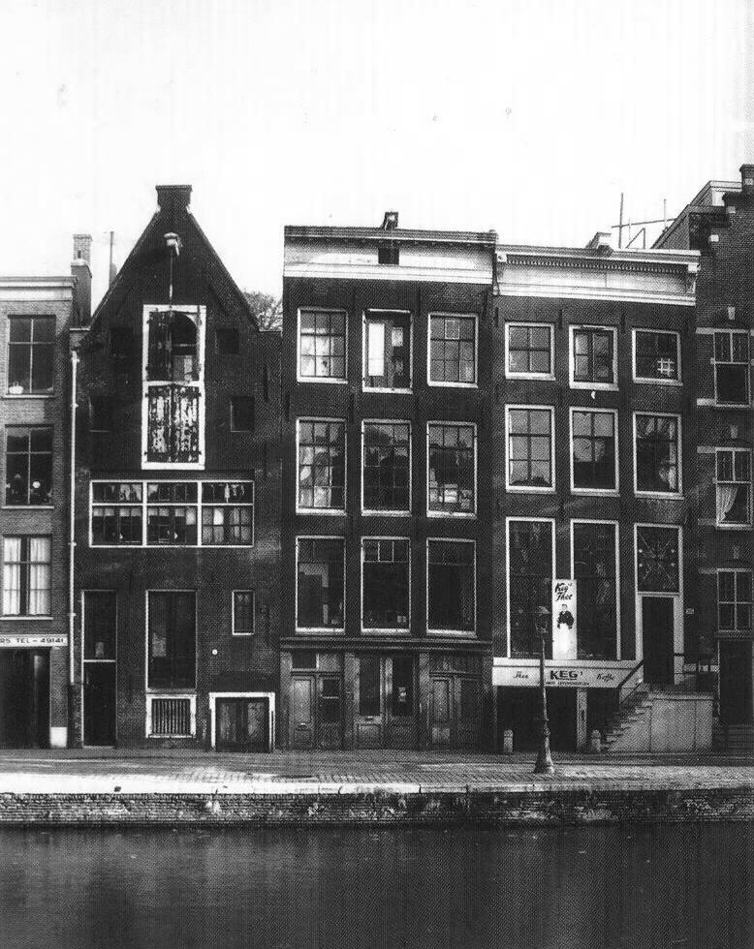
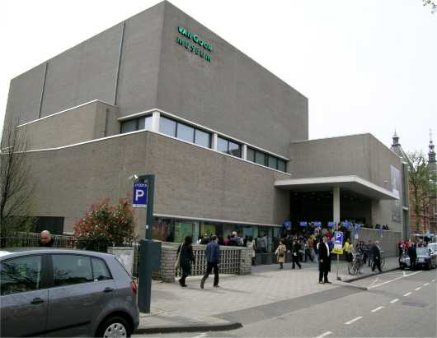
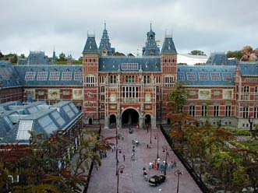
Atractions
Rijksmuseum
Amsterdam canal ring
Van Gogh Museum
Anne Frank House
Oude Kerk
Amsterdam Brown Cafe

Slide 9
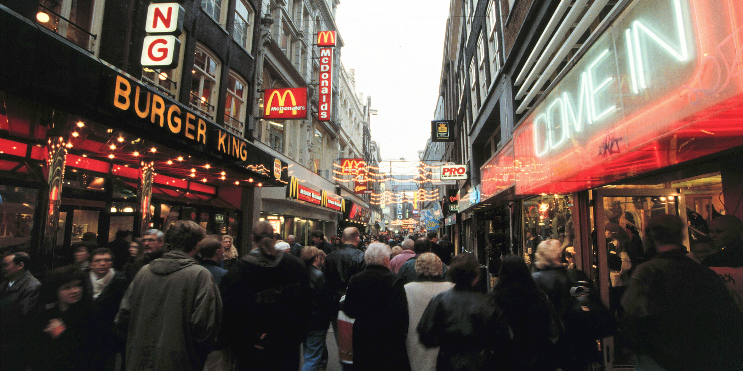
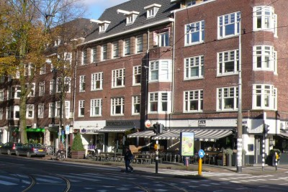
Shopping
Best shopping streets
Kalverstraat
Cornelis Schutstraat
Utrechtsestraat
Beethovenstraat
Haarlemmerstraat

Slide 10
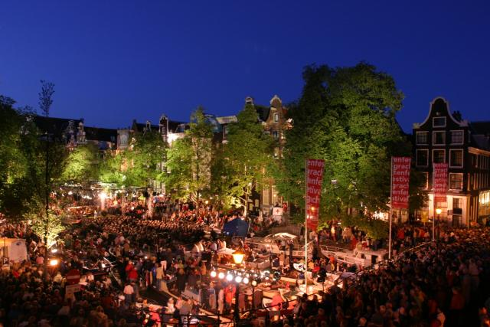
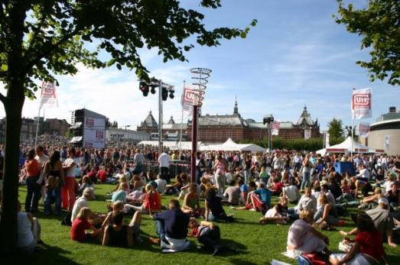
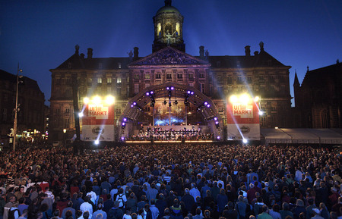
Festivals
75 festivals every year
Broad & powerfull
Grachtenfestival
Uitmarkt
Open Garden Days
Amsterdam Roots Festival

Slide 11
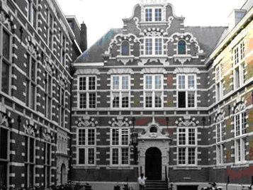
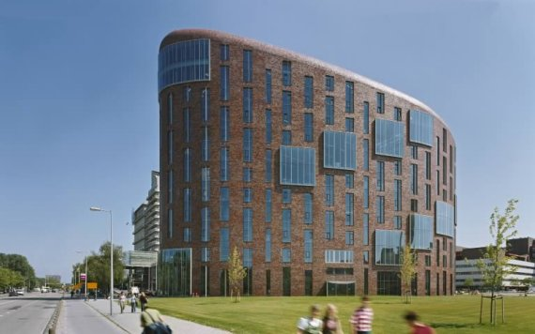
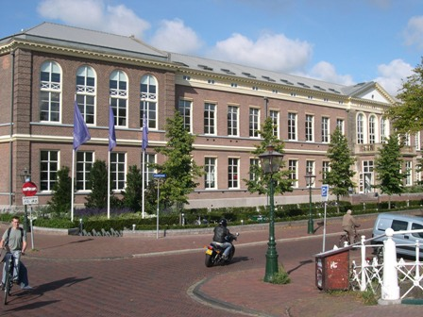
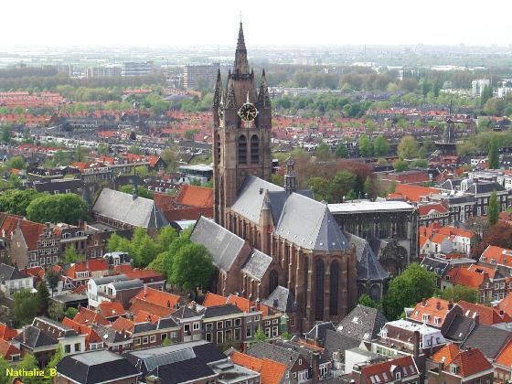

Slide 12
The end :)

