Slide 1
ANIMAL TORTURE
Hunting, slaughter, bullfighting…

Slide 2
Bullfighting
at firs the matadors tease bull with red flag
then he stick in bull lanc to tease him
At the end the matador cut bulls ear

Slide 3
FUR
animales – 2.5 feet square cages
Animales strange, beat, stomp to death
Not 100% affective methods

Slide 4
FOX HUNTING
Red fox
Special trainded foxhounds (dogs)
Followers – on horses, on foot
Originated in the 16. st.
it is practised Australia, Canada, France,Ireland, Italy, Russia, and the United States

Slide 5
WHALE HUNTING
hunt - for oil, made from their fat( blubber), meat
treaty - bans the hunt of some whale species
Hount today for research purposes - Norway, Iceland, Japan

Slide 6
SLAUGHTER
Most widespread
All kinde of animales (for food)
Religious slaughter (Jewish and Muslim)
legislation, requires the pre-stunning of animals before slaughter

Slide 7
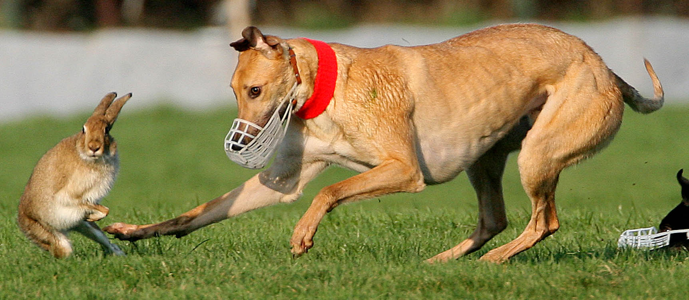
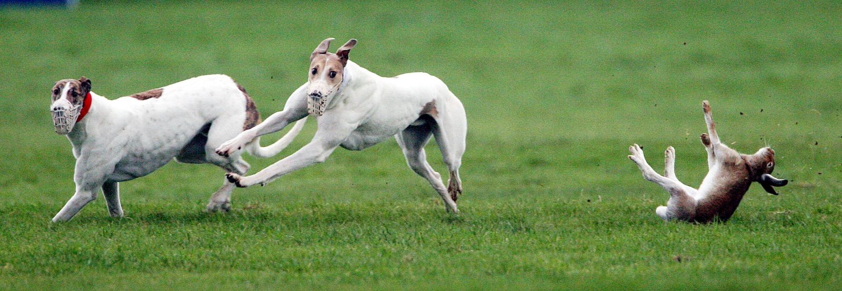
HARE COURSING
Hare coursing - the pursuit of hares
with greyhounds
Modern – doge use muzzle
Hare usually escape

Slide 8
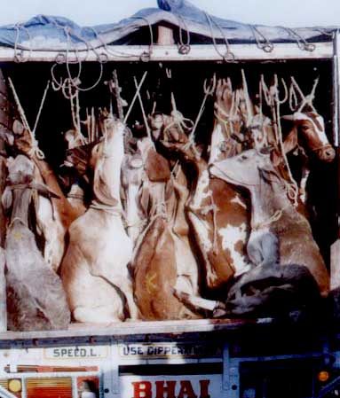
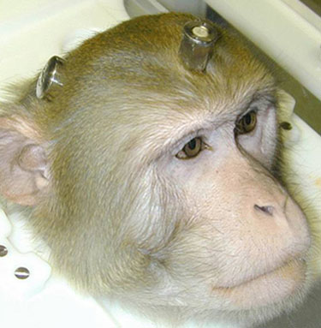
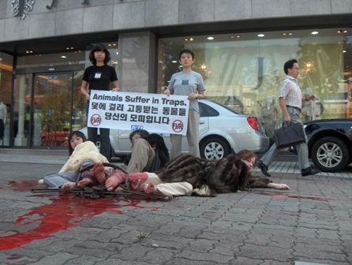

Slide 9
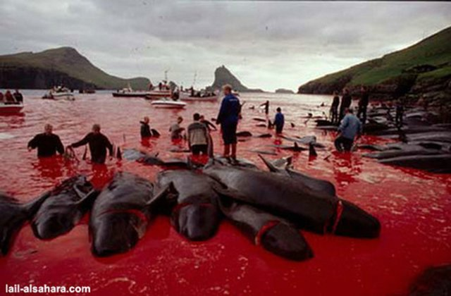
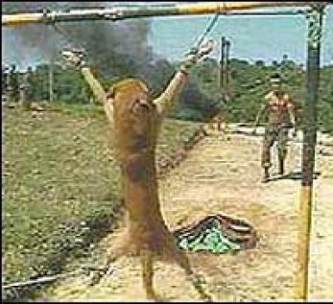

Slide 10
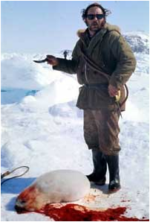
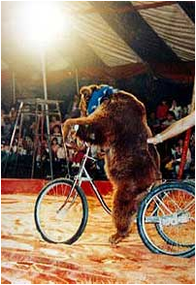

Slide 11
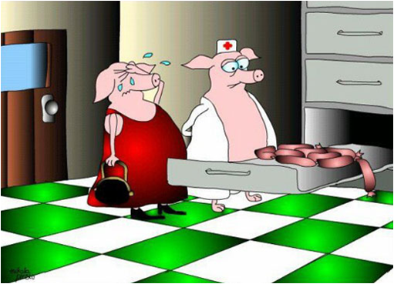
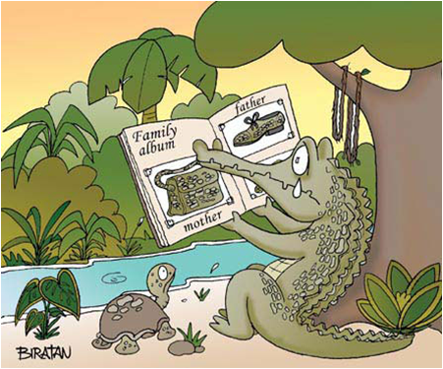

Slide 12
