Slide 1
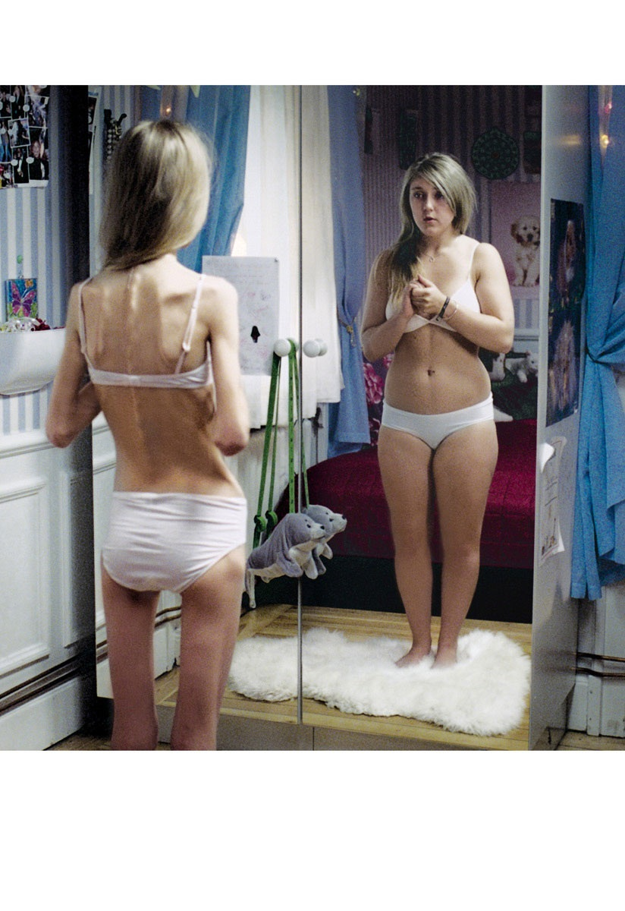
Anorexia
Student:
Teacher:

Slide 2
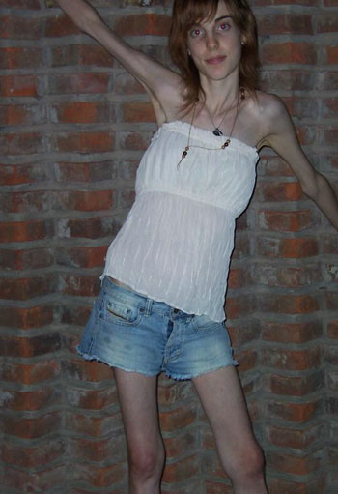
In general
Is a disease that is decreasing the sensation of appetite. Most of the people suffering for the Anorexia are teenager girls, but that doesn’t mean that are suffering for Anorexia just teenagers. There is also a lot of adult people but they are hiding that well, but time to time there comes to disclosure. And then there comes to big truth about Anorexia.

Slide 3
Consequences
- Losing menstruation
- Muscle degeneration
- Weak and thin hairs
Heart failure
Kidney failure
Stomach failure
Panic attacks
Lack of minerals in the bones
Hyperactivity
Small breath
Cold hands and legs

Slide 4
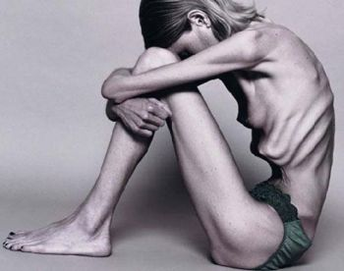
Visibility
Anorexia usually begins in the time when most of the girls wants to be good looking and attractive. At mostly girls are watching on the body line and are most times exaggerating with the weight. Most of them is very thin but they see them self fat. Many of the girls does not get happy with their weight never until they die. Because of that dies every year hundreds of teenagers on the whole world.

Slide 5
Literature
www.wikipedia.org
www.google.com
www.najdi.si
www.yahoo.com
www.dijaski.net
www.mamashealth.com
I hope you guys learned something out of this. :D

