Slide 1
ANTARCTICA

Slide 2
HISTORY
Though writings of the ancient Greeks cryptically refer to a massive southern region of the world, the discovery of the "White Continent" is generally attributed to Edward Bransfield, a British naval officer. Bransfield discovered the northwestern coast of the Antarctic Peninsula on 30 January 1820 and called it Trinity Land. However, the land mass was first touched in the 1840s by a party of Norwegians, and it was the Norwegian Roald Amundsen who, on 14 December 1911, first reached the South Pole. (Robert Scott, an Englishman, reached the Pole just weeks after Amundsen. He never returned.) Not until 1956 did the first tourists - a group of Chileans - make trips to Antarctica.

Slide 3
HISTORY
Roald Amundsen
Since Antarctica's discovery, some 26 nations, including Russia, the U.S., Norway, China, Great Britain, Chile, Argentina, Poland, Australia, South Africa, Belgium, France, Japan and New Zealand, have laid claim to various sections of it. Today the continent is effectively a shared territory, and the occupying countries have agreed to cooperate in protecting Antarctica's many environmental treasures and its pristine beauty.

Slide 4
GEOGRAPHY FACTS
Antarctica is the coldest, windiest, highest and driest continent. During summer, more solar radiation reaches the surface at the South Pole than is received at the Equator in an equivalent period. The continent is mostly uninhabitable. Its ice comprises 90 percent of all the world's ice, and it is 70 percent of all the world's fresh water.

Slide 5
GEOGRAPHY FACTS
LOCATION: continent mostly south of the Antarctic Circle
AREA: 14,2 milion sq km
COASTLINE: 17,968 km
CLIMATE: severe low temperatures vary with latitude, elevation, and distance from the ocean; East Antarctica is colder than West Antarctica because of its higher elevation

Slide 6
GEOGRAPHY FACTS
TERRAIN: About 98% thick continental ice sheet and 2% barren rock, with average elevations between 2,000 and 4,000 meters; mountain ranges up to about 5,000 meters
NATURAL RESOURCES: None presently exploited. Iron ore, chromium, copper, gold, nickel, platinum and other minerals, and coal and hydrocarbons have been found in small, uncommercial quantities

Slide 7
INTERNATIONAL DISPUTES
Antarctic Treaty defers claims; sections (some overlapping) are claimed by Argentina, Australia, Chile, France (Adelie Land), New Zealand (Ross Dependency), Norway (Queen Maud Land) and United Kingdom. The United States and most other nations do not recognize the territorial claims of other nations and have made no claims themselves (the U.S. reserves the right to do so).

Slide 8
Antarctica is shared territory, and the occupying countries are Argentina, Australia, Chile, France (Adelie Land), New Zealand (Ross Dependency), Norway (Queen Maud Land) and United Kingdom.

Slide 9
PEOPLE
Antarctica has no indigenous inhabitants, but there are seasonally staffed research stations. Approximately 29 nations, all signatories to the Antarctic Treaty, send personnel to perform seasonal (summer) and year-round research on the continent and in its surrounding oceans. The number of people doing and supporting science on the continent and its nearby islands south of 60° S latitude (the region covered by the Antarctic Treaty) varies from approximately 4,000 in summer to 1,000 in winter. In addition, approximately 1,000 people are present on ships within the treaty region, including ship's cre and scientists doing onboard research.

Slide 10
Research station on Antarctica

Slide 11
ANIMALS and PLANTS
There is very little plant life on Antarctica. It consists of small amounts of lichen and moss, and some floating plants in the inland seas. Apart from a few insects, all of the animal life feeds from the ocean. The largest animal living entirely on the land of Antarctica is a mite. It is just big enough to be seen without a microscope. It manages to stay alive by producing chemicals very similar to the anti-freeze that we put in our cars in winter! The ocean is full of nutrients. Warm water rising brings the nutrients up to the surface. Those nutrients along with krill, a small shrimp-like animal are the keys to the food chain in Antarctica.

Slide 12
ANIMALS
The most frequent animals on Antarctica are: fish, birds and mammals. More than 80% of birds in the Antarctic region are penguins.

Slide 13
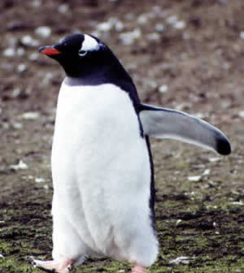
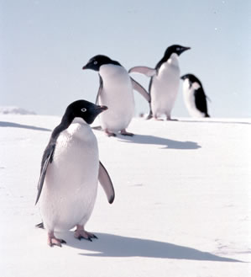
ANIMALS
Gentoo Penguin
Adelie Penguin

Slide 14
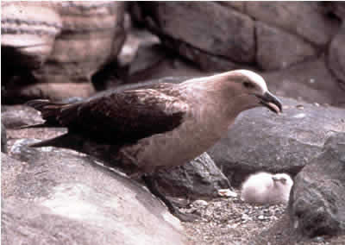
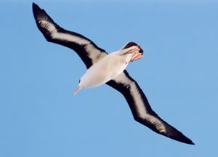
ANIMALS
South Polar Skua
Albatross

Slide 15
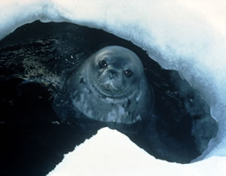
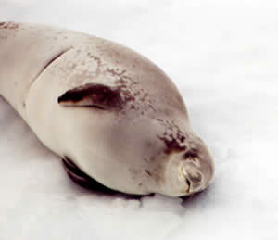
ANIMALS
Weddell Seal
Crabeater Seal

Slide 16
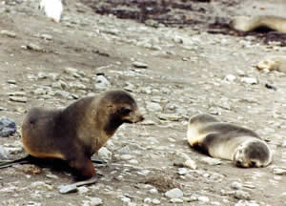
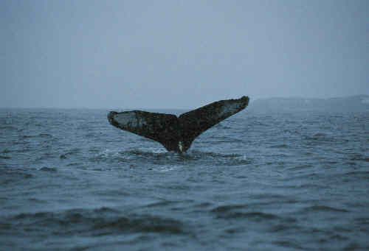
ANIMALS
Antarctic Fur Seal
Whale

Slide 17
Did you know?
Antarctica is actually a desert, receiving about the same precipitation (less than 2 inches a year), as the Sahara Desert.
Dogs have been banned from Antarctica to protect the seal population.
If Antarctica were to melt, the sea level would rise over 80 meters.
The world's record low temperature of -128.5° F was recorded in Antarctica.
The coasts of Antarctica are some of the windiest places in the world, with gusts reaching nearly 200 miles per hour.
Antarctica represents about 9 percent of Earth's continental crust and has been in a near-polar position for more than 100 million years.

Slide 18
Did you know?
The Adelie penguin was named after Jules-Sébastien-César Dumont d'Urville's wife. D'Urville was the first man to set foot in Antarctica.
The temperature in Antarctica once dropped 65° F in 12 minutes.
Because of the extremely cold temperatures and low absolute humidity, dry skin and cracked lips are continual problems in Antarctica. Visitors must drink frequently to replace the water they exhale with every breath.
The Land of the Midnight Sun exists in the south, too: during the summer, the interior of Antarctica enjoys almost continuous daylight.
As sea ice gets older it becomes considerably stronger. In first-year sea ice, most of the salts remain in tiny pockets that prevent a more rigid crystalline ice structure from forming. As the ice ages, the salts slowly leach out, leaving a much stronger crystal.

Slide 19
LITERATURE
INTERNET
www.google.com
/antarctica
/history of antarctica
/animals on antarctica
/antarctica facts
Države sveta 2000, Mladinska knjiga, Ljubljana, 1998

Slide 20
The End of presentation!
Boštjan Kop

