Slide 1
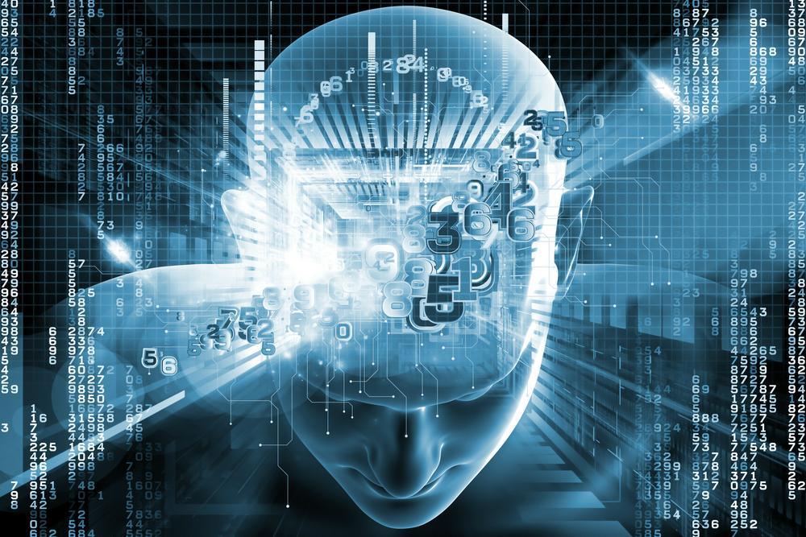
Artificial intelligence
(AI)

Slide 2
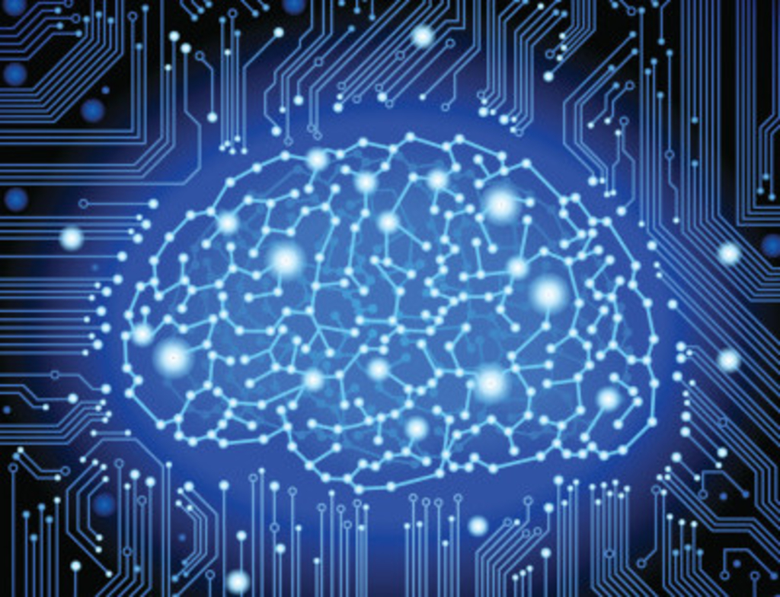
Countents
1 what is AI
2 history of AI
3 how does AI work
4 examples of AI in daily life

Slide 3
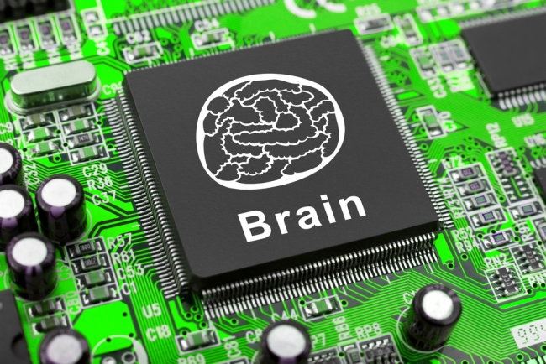
What is AI
it is a program
self-learning

Slide 4
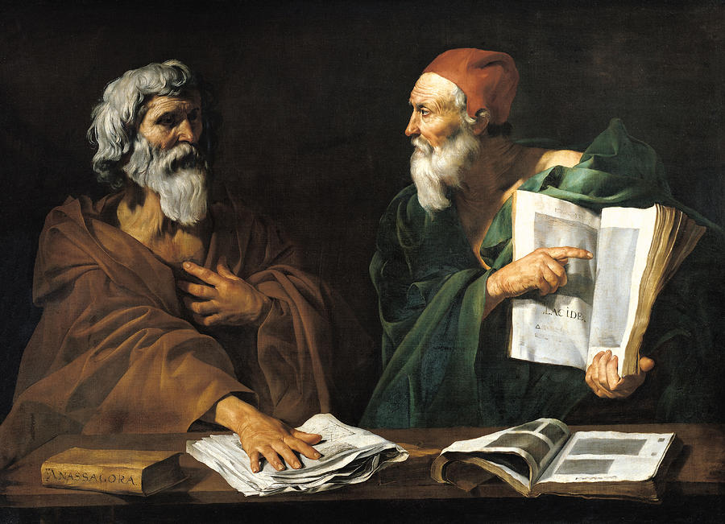
History of ai
anchient Greeks
philosophers
programable digital computers

Slide 5
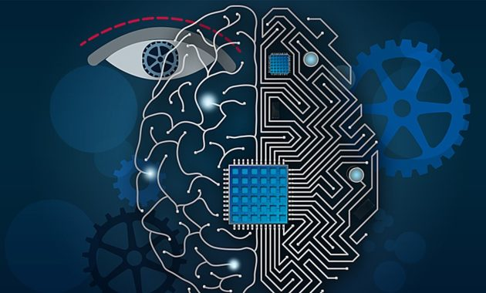
How does ai work
build brains
AI = demanding task
AI far off brains

Slide 6
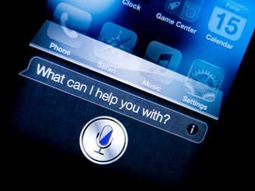
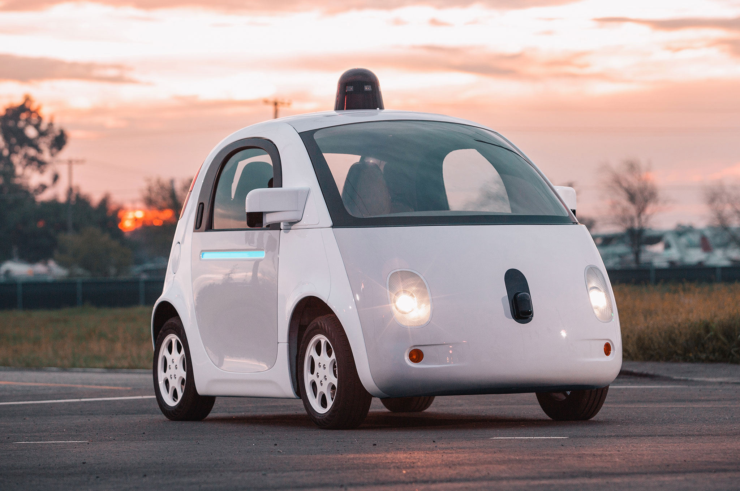
examples of AI in daily life
virtual personal assistants
smart cars
picture1-virtual personal assistants
picture2- smart car

Slide 7
Summary
1 what is AI
2 history of AI
3 how does AI work
4 examples of AI in daily life

Slide 8
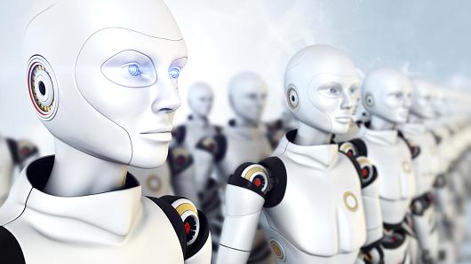
Conclusion
expand
electronic devices

Slide 9
Sources
Date(17.3.2017)
https://beebom.com/examples-of-artificial-intelligence/
http://www.computerworld.com/article/2906336/emerging-technology/what-is-artificial-intelligence.html
https://www.google.si/search?q=artificial+intelligence&espv=2&source=lnms&tbm=isch&sa=X&ved=0ahUKEwje2czQ2OrSAhVmAsAKHX7EAc4Q_AUIBigB&biw=1366&bih=662#imgrc=8iN-hiTd5rdPzM
http://www.geekwire.com/2017/ai-research-artificial-intelligence-ethics-governance/
https://www.quora.com/How-is-artificial-intelligence-programmed
https://en.wikipedia.org/wiki/History_of_artificial_intelligence

Slide 10
Question time
With who can we compare AI?
Who firts thought of AI?
What do we make with AI?
Examples of AI in daily life?

