Slide 1
AUSTRALIA

Slide 2
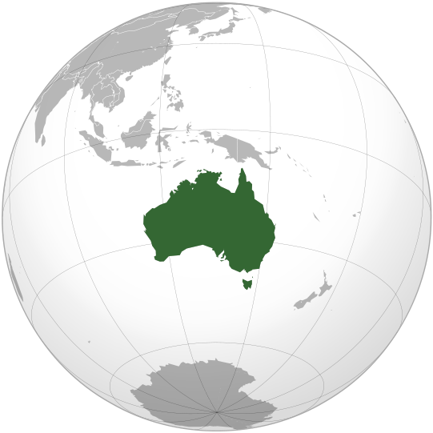
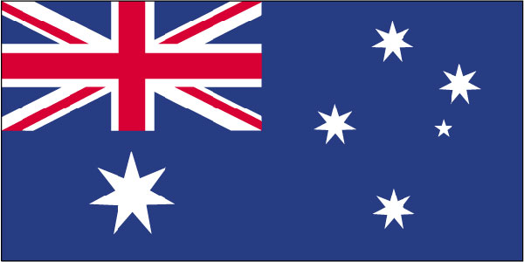
Australia is the smallest continent in the world.
It’s full name is COMMONWEALTH OF AUSTRALIA.
It is situated between the Pacific ocean and the Indian ocean.
Many people call it the Land Down Under because it is below the Equator

Slide 3
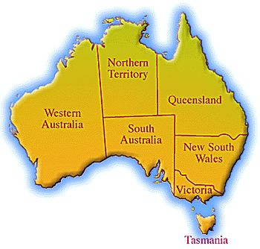
There are 6 countries on the continent
New South Wales
Northern territory
Queensland
South Australia
Tasmania
Victoria
Western Australia

Slide 4
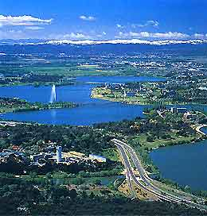
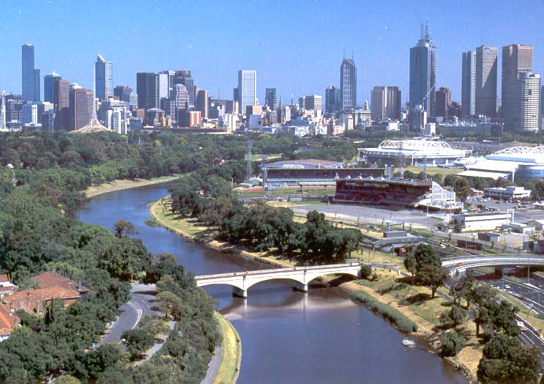
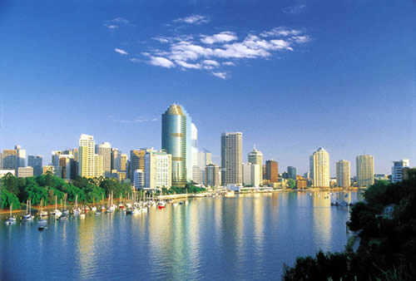
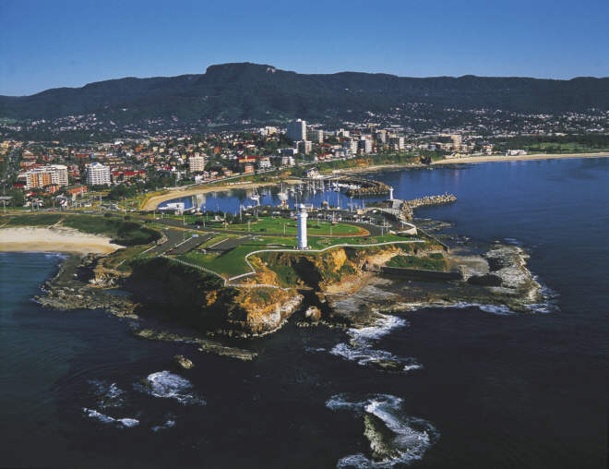
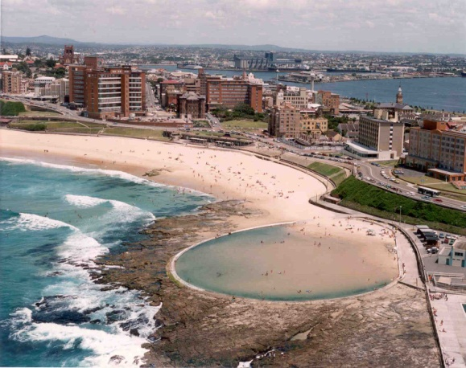
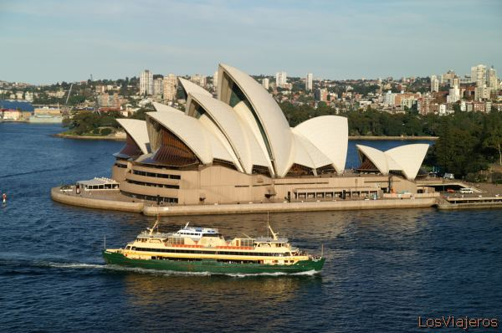
It has a population of about 18.000.000 people
Men are expected to live 70 years and women 80 years
The capital of Australia is Canberra, but the biggest city is Sidney. Other largest citys in Australia are: Brisbane, Melbourne, Wollongong and Newcastle

Slide 5
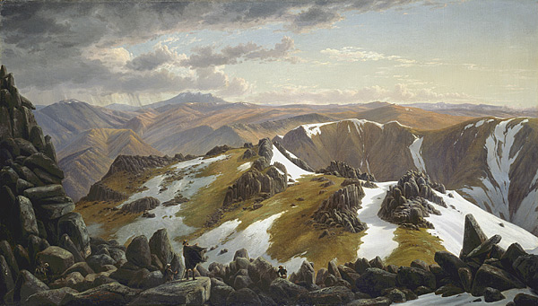
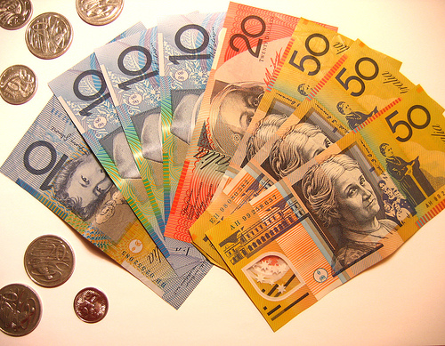
The highest mountain is MOUNT KOSCIUSKO (2228 m high)
Their currency is an Australian dollar

Slide 6
It is the MONARCHY – ruled by queen of England. This is why it’s flag has got an english flag in the top left hand corner and 6 stars respresenting one country each.
The government is ruled by the Prime Minister Kevin Rudd
People in Australia are mostly Catholics 26%, Anglican 20%, Christian 20%,…
They speak English

Slide 7
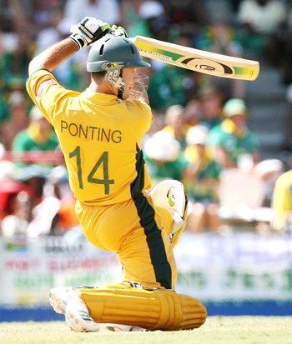
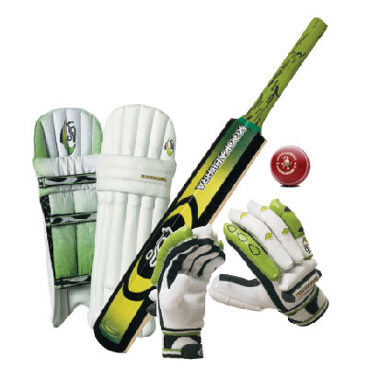
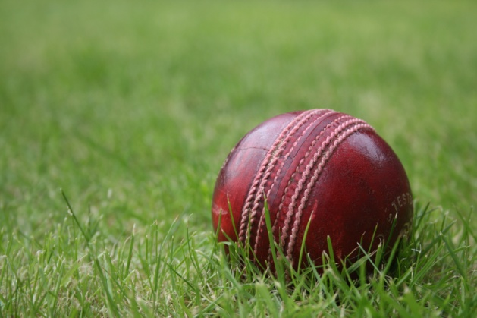
Australian ecoonomy farming (they breed sheep for wool)
Agriculture ( corn, wheat)
Mining (coal, boxit, gold, diamonds)
Australian’s national sport is cricket which is similar to baseball

Slide 8
January and February are the warmest months, and June and July are the coldest. They celebrate New Year in summer
The middle part of the country is called outback. There isn’t enought rain, so many people live there. But there are some sheep and cattle ranches. Children who live on stations can noool so they use a two-way radio to hear their teacher’s lesson

Slide 9
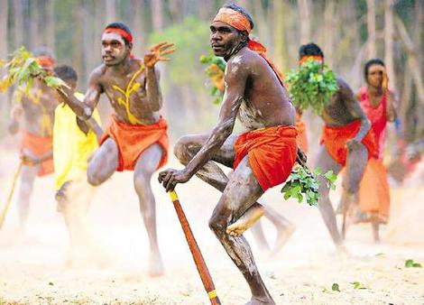
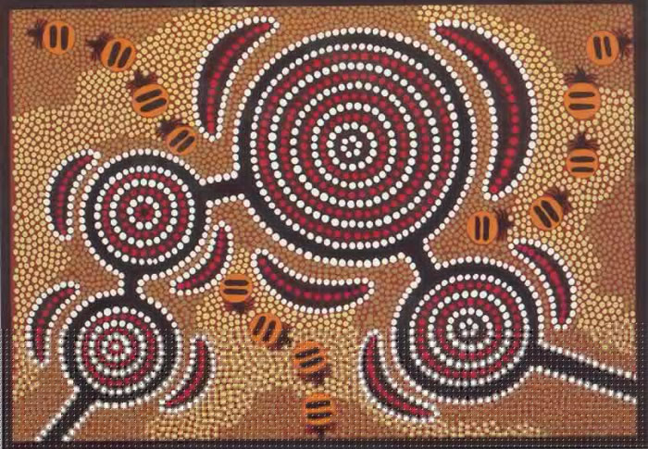
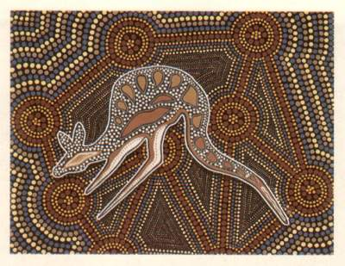
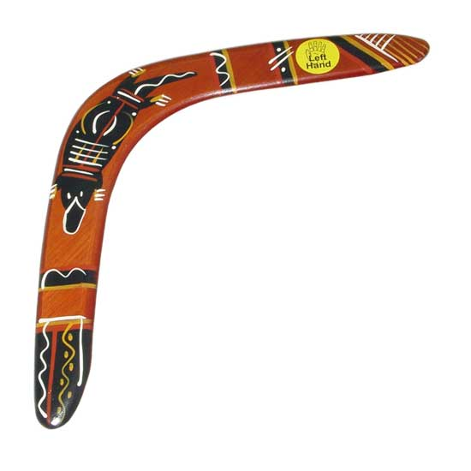
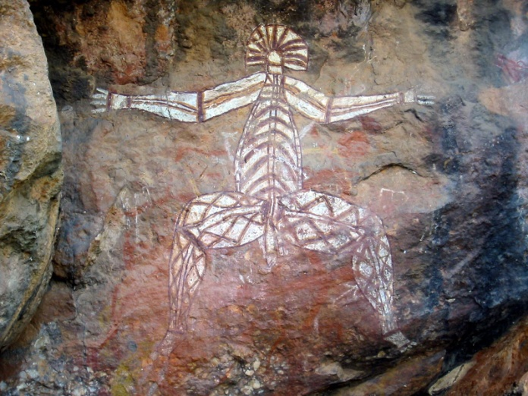
The first people in Australia were the
Aborigines. Aboriginal means the first.
When the other nations came they had
to go live in reservations, some live on
ranches. They also invite boomerang
and there are some examples of their
beautiful art all over the place

Slide 10
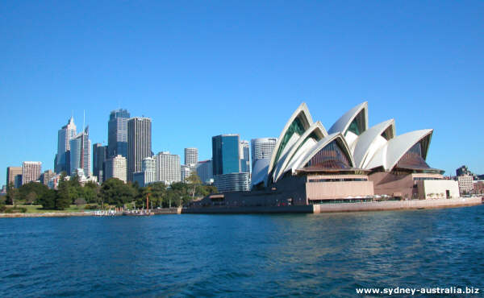
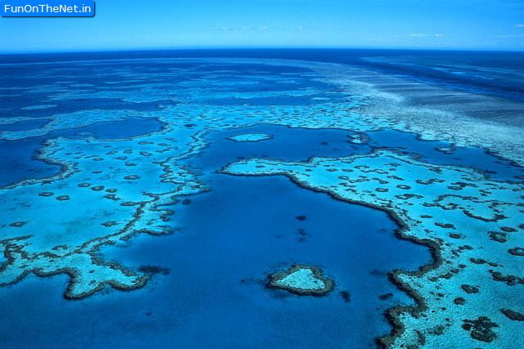
Australia is a wonderful country. Many people go there to see the sights and natural beauties of Australia. They usually visit The Opera House, The Great Barrier Reef which is made up of coral. It is world’s largest living structure.
There are also some unusual like duck – billed Playpus and kookaburra.

Slide 11
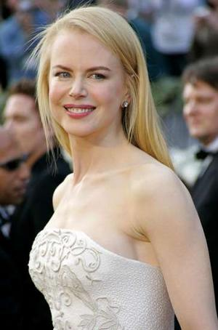
There is also a famous person
coming from Australia, an actress
and singer Nicole Kidman, and
some swimmers who are very
successful in competitions all
over the world.

