Slide 1
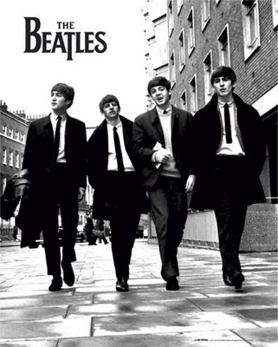
THE BEATLES

Slide 2
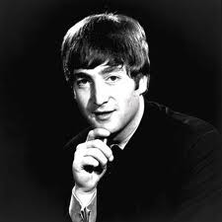
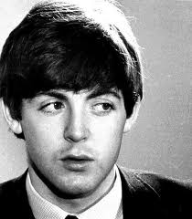
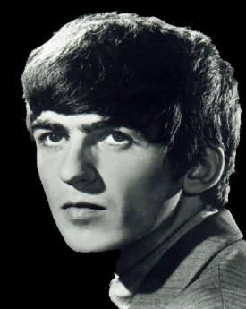
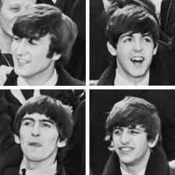
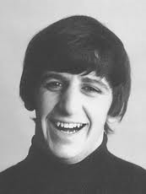
GROUP MEMBERS:
-John Lennon,
-Paul McCartney,
-George Harrison,
-Ringo Starr.

Slide 3
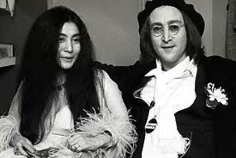
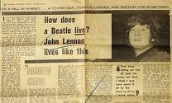
The reasons for the collapse of the group:
- Lennon's wife Yoko Ono, who wished to be present at the filming, but the other Beatles did not agree, - John Lennon, who said that the Beatles more popular than Jesus Christ, and hit a lot of people are losing popularity.

Slide 4
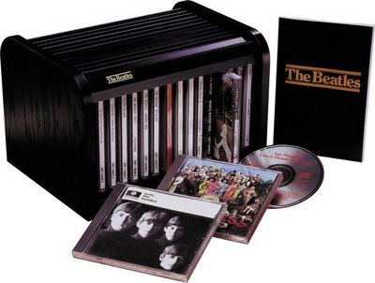
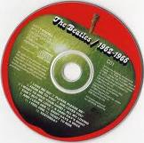
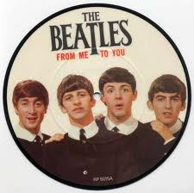
Songs:
* Please Please Me, * With The Beatles * A Hard Day's Night * Beatles for Sale, * Help! , * Rubber Soul, * Revolver,…

Slide 5
END

