Slide 1
BLACK RHINOS

Slide 2
LIFE
Mammals
South and central Africa
Savanna
Live alone
Territory

Slide 3
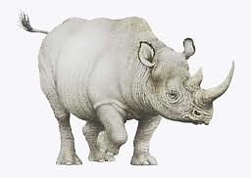
BODY DESCRIBE
Weight: more then 1 ton
They`re long from 2 to 5 meters
2 nasal horns
2cm fat skin
Grey color
Short legs
3 fingers on each leg
Small brains
Growl

Slide 4
OFFSPRINGS
Gestation:17-18 months
1 year suckle milk
Mum

Slide 5
FOOD
Vegetarian
Grass
Bushes

Slide 6
CAN
Eat
Drink
Sleep
Attack
Run
Walk
Growl

Slide 7
CAN`T
Fly
Read
Dance
Write
Clean the car
Play computer games

Slide 8
NATURALLY SETTING
In naturally setting black rhinos live above 50 years
In the WORLD is just 4000 black rhinos more
They`re endangered animals because of their horns

Slide 9
There are albino rhino and the zoo keeper .The zoo keeper feeding it.
The zoo keeper is wearing a green dress, black hat and brown shoes. In his hand is food for the rhino.
Rhino is probably starving

