Slide 1
Bluetooth

Slide 2
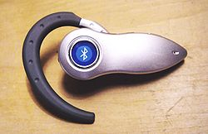
What is Bluetooth ?
Wireless protocol
Exchanging datas
Creating personal networks
Connecting tehnological devices
Freehand phoning

Slide 3
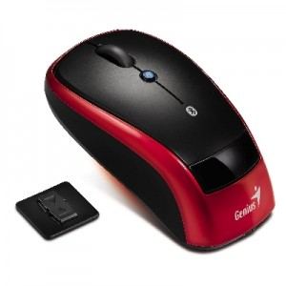
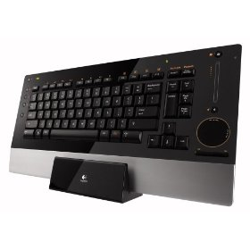
Options for using Bluetooth
Freehand phoning
Exchanging data with other devices (ohther phones, computers,…)
Bluetooth mouses and keyboards
Bluetooth printers, scanners,…..

Slide 4
Short history
1994
1998
2002
2005

Slide 5
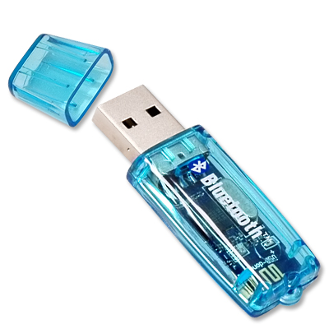
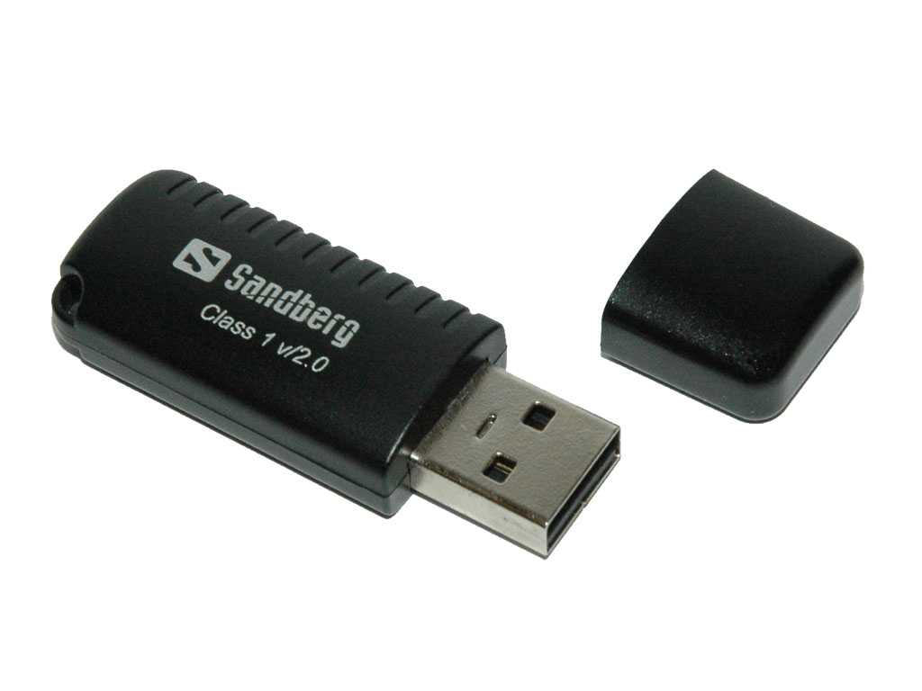
Versions
First versions :
Bluetooth 1.0
Bluetooth 1.0B
Later Versions :
Bluetooth 1.1
Bluetooth 1.2
Bluetooth 2.0 + EDR
Bluetooth 2.1
Bluetooth 3.0

Slide 6
Bluetooth classes:
Class 1 = 100mW (20 dBm), range about 100 m
Class 2 = 2,5 mW (4 dBm), range about 25 m
Class 3 = 1mW (0 dBm), range about 10 m

Slide 7
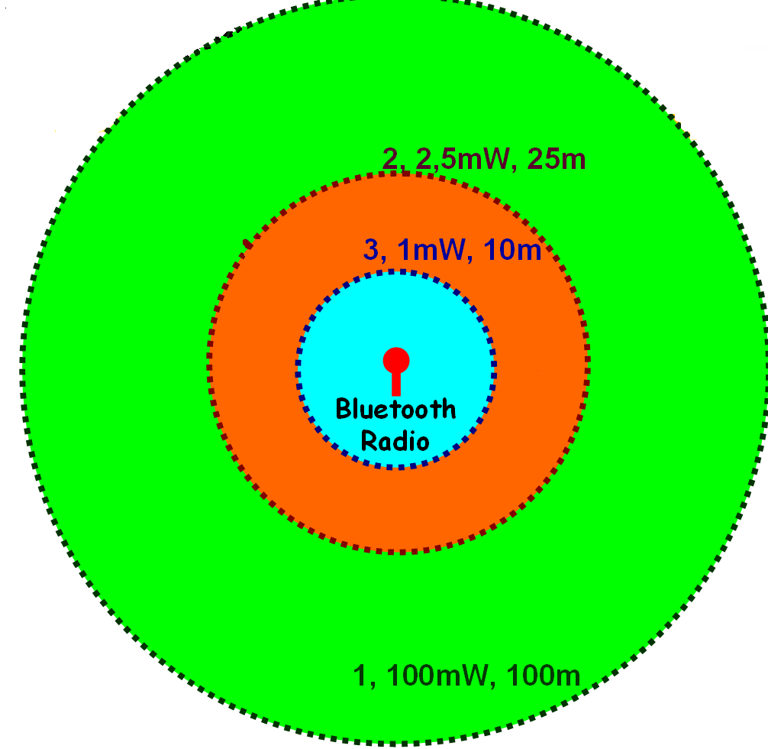

Slide 8
References:
www.bluetooth.com
www.bluetooth.org
www.ieee.org
www.itpapers.com
www.ericsson.com/bluetooth.htm

Slide 9
Thanks for your attention ☺

