Slide 1
BRIDE WARS
MY FAVOURITE FILM

Slide 2
TRAILER

Slide 3
ABOUT MOVIE
American romantic comedy film
Director: Gary Wincik
Writers: Greg DePaul, Casey Wilson
Premiere: (USA) 9th January 2009 (SLO) 5th February 2009
Boston, New York City
89min

Slide 4
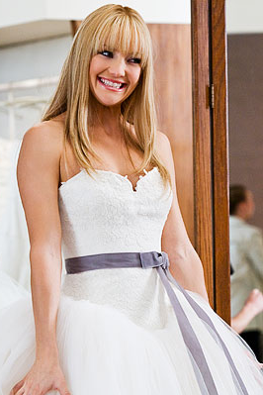
ACTORS and ACTRESSES
Kate Hudons as Liv Lerner
Successful woman who attemps to be perfect.
Anne Hathaway as Emma Allen
Middle school teacher who takes care of everyone.

Slide 5
ACTORS and ACTRESSES
Candice Bergen as Marion St. Claire (very famous wedding planner)
Chris Pratt as Fletcher Flemson (Emma's fiance)
Bryan Greenberg as Nathan (Liv's younger brother who is in love with Emma)
Steve Howey as Daniel Williams (Liv's fiance)
Fletcher
Daniel
Marion
Nathan

Slide 6
Some words which you possible won‘t understand?
Childhood – otroštvo
Fiance – zaročenec
Sun tanning – porjavitvena krema, solarij
Alternative dance instructor – nadomesten učitelj plesa
To torture – mučiti
Highlights – prameni

Slide 7
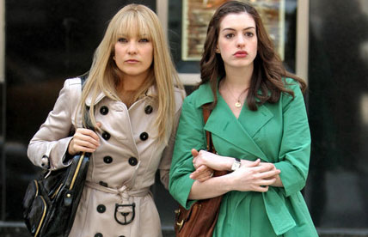
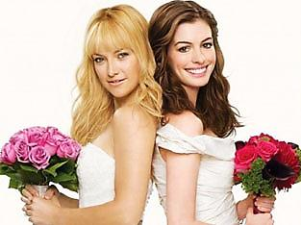
STORY
Story is about two best friends.
Dreaming about the perfect wedding.
Felling in love with the idea.
So when they grew up, became engaged to their boyfriends.
Starting planning the wedding. First step: reservation.
They picked the date.
Few days later, they found out..
None of them didn‘t want changed her plans.
Their fiances suggested a double wedding

Slide 8
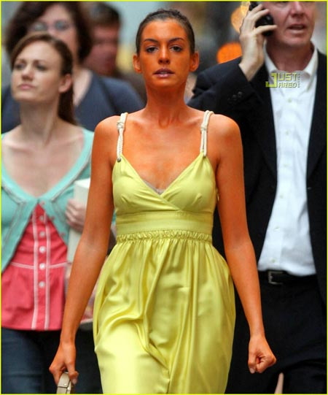
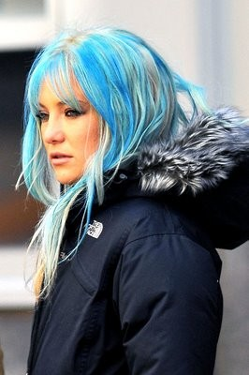
STORY
So war between brides began.
Each wanted to destroy the wedding of another one.
Liv stole Emma's dream DJ.
With help of spray tanning she changed Emma's skin to orange.
Emma sent Liv cookies and chocolate so she will gain weight and not fit her dress.
She also changed Liv's hair highlights to blue.
Uncover end!

Slide 9
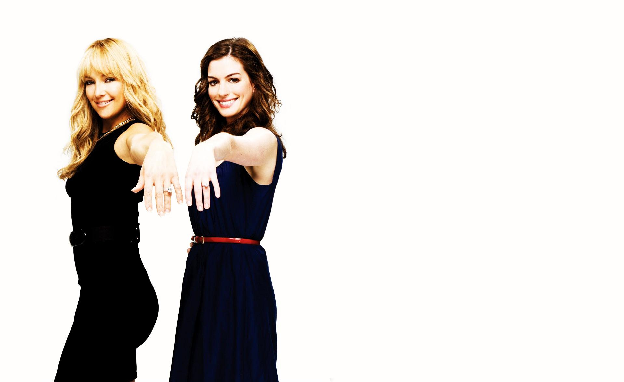
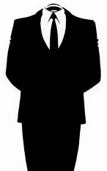
»They haven't spoken in a week. That's like a century in girl years.«

