Slide 1
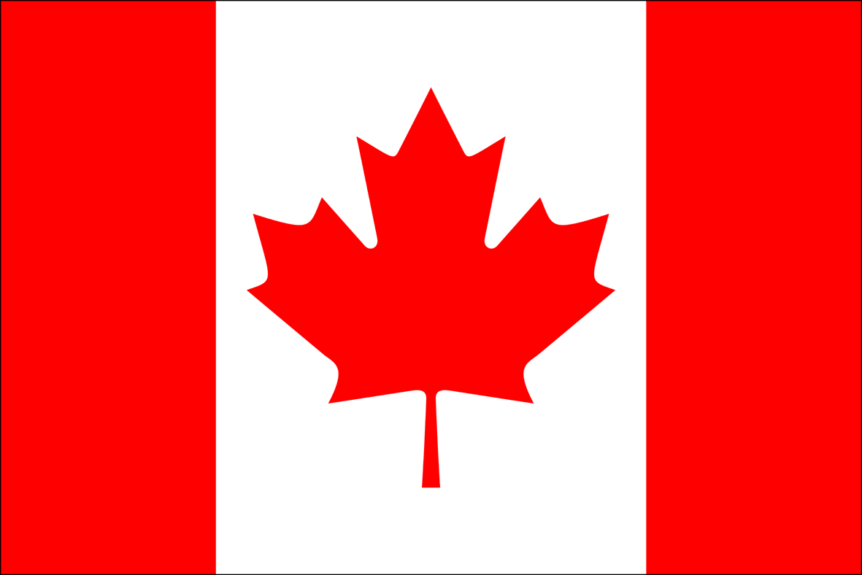
CANADA

Slide 2
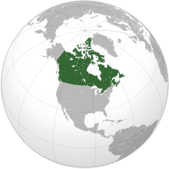
Canada is a country in north of USA. It is located in the most northen part of the continent. It has more than 27 milion inhabitenst. It's the world's second – largest country, after Rusia.
Canada is a country in north of USA. It is located in the most northen part of the continent. It has more than 27 milion inhabitenst. It's the world's second – largest country, after Rusia.

Slide 3
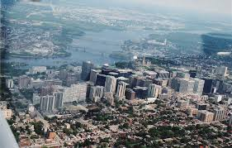
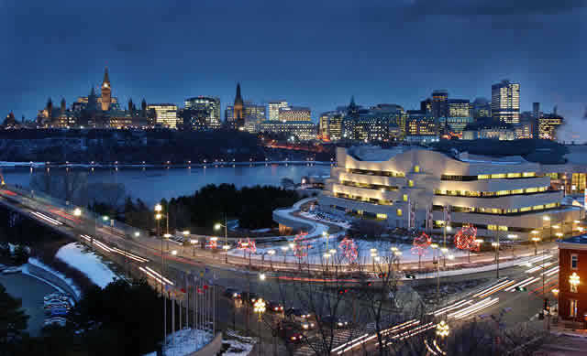
OTTAWA
The capital city of Canada is Ottawa and it has more than 300 000 inhabitens

Slide 4
CANADIAN FLAG
Like every country Canada has a flag. It's red and white in the midlle is a maple leaf.

Slide 5
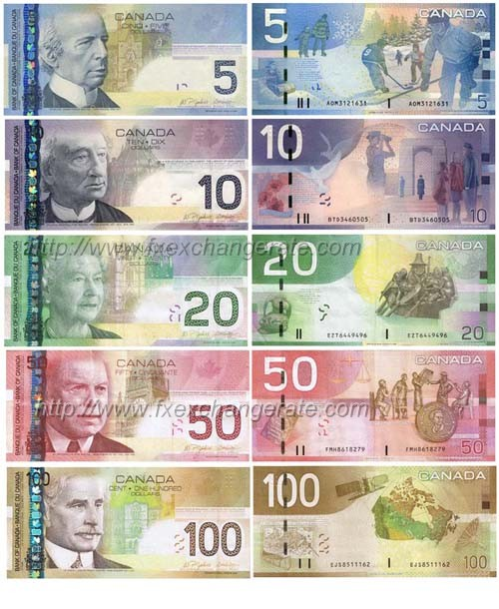
LANGUAGES IN CANADA AND CURRENCY
In Canada a lot of people speak Franch but 60% of people speak English. The currency of Canada is Canadian dolar.

Slide 6
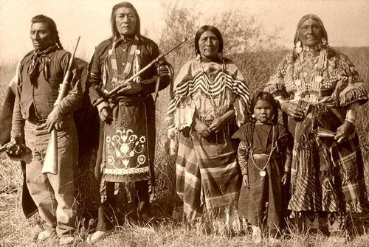
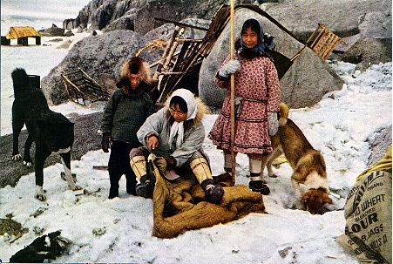
HISTORY
the first people that came in to Canada are Indians and Eskimos, Indians came from Asia, but Eskimos came from North. And Canada became government at 1st of July 1867.

Slide 7
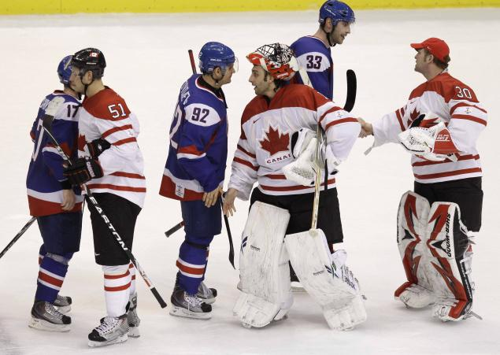
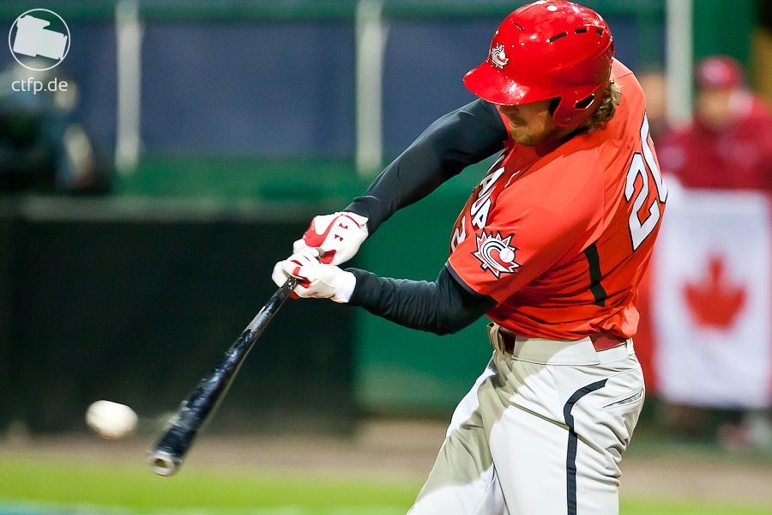
SPORTS
they have a lot of interesting activities like : skiing, baseball, tennis, a lot of people fish and hike. But the most inportant sport in Canada is a hokey

Slide 8
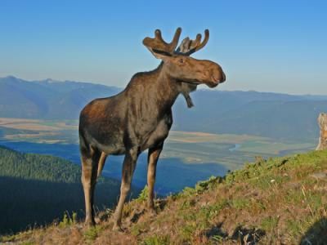
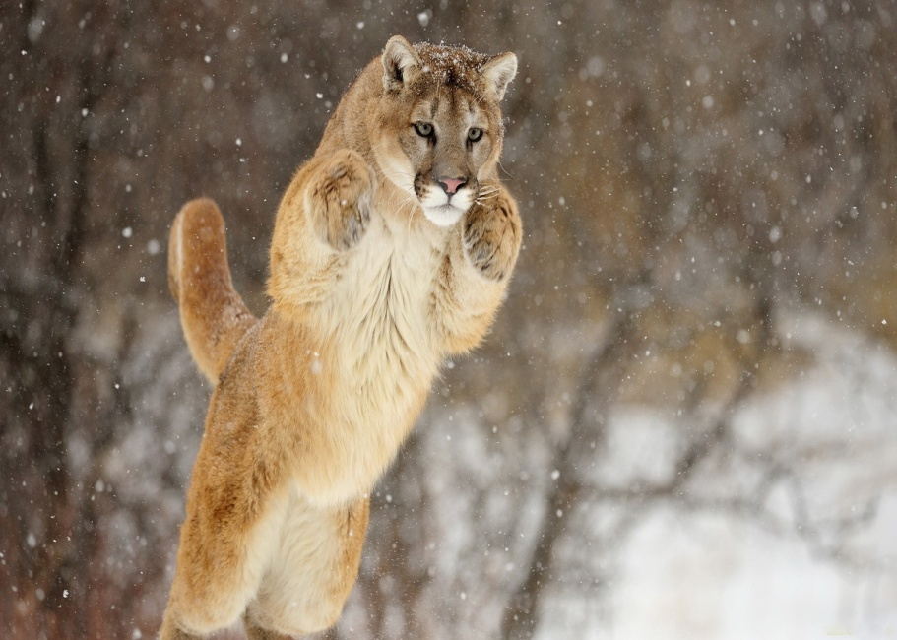
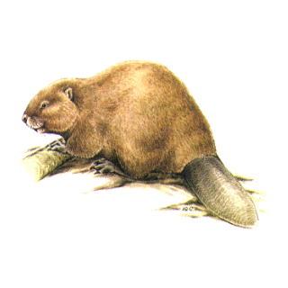
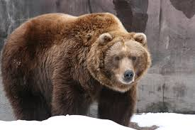
ANIMALS
in Canada animals aren't that diffirent then in Evrope. The most known are Grizli bears, deers, pumas and the most inportant for the intire country are beavers.

Slide 9
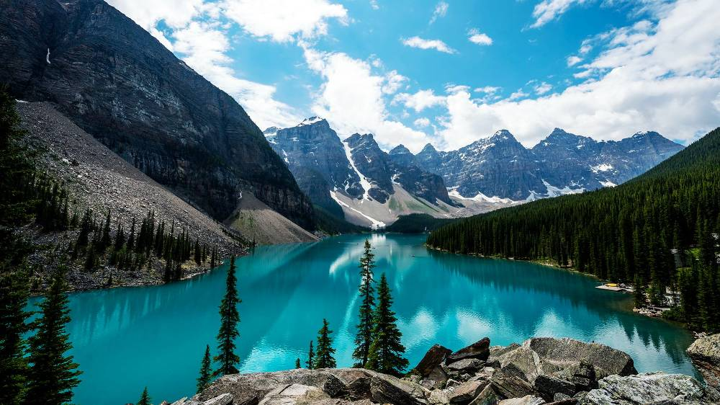
INTERESTING FACTS
- Canada has more than 38 national parks. The oldest is called Banff.

Slide 10
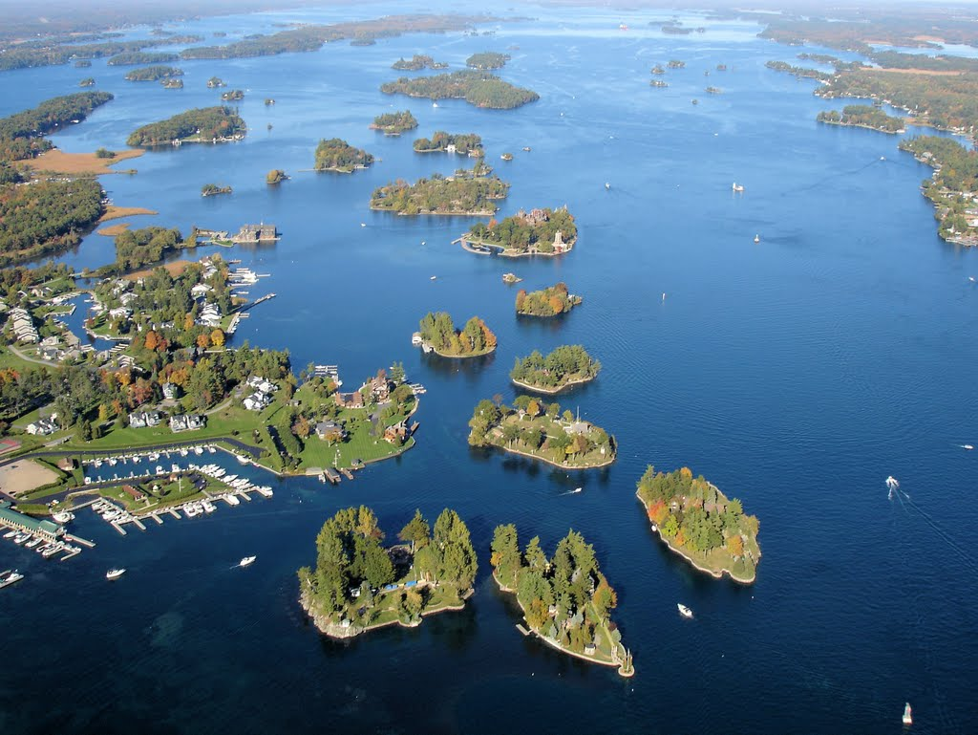
- it has more 1000 islands

Slide 11
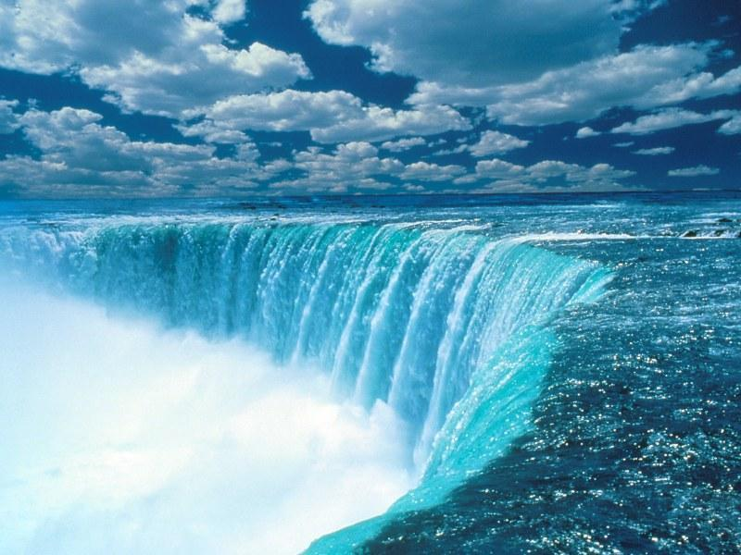
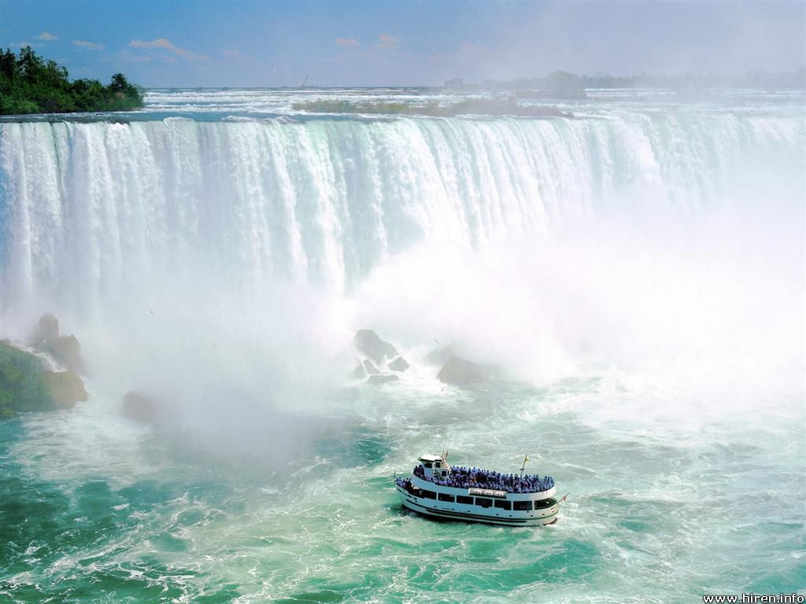
NIAGRA FALLS
Niagra Falls are the most beautiful and most visit falls in Canada. There located beetwen Canada and America. There falling almost 55m deep. And there more than 12 tousand years old. And every year 15 milion people visit Niagra Falls

Slide 13
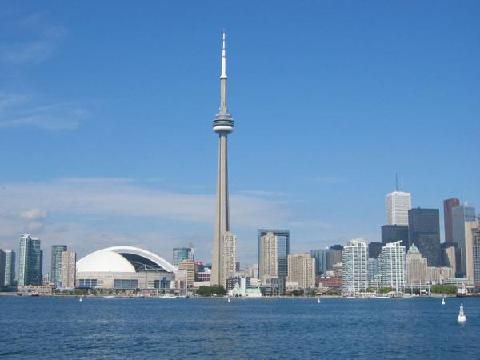
TELEVISION TOWER
Television Tower it’s 554m high, it was built 1976. Every year almost 2 milion people visit it. It's located in Toronto.

Slide 14
INPORTANT PEOPLE
A lot of famous people were born in Canada. But i chose JUSTIN BEIBER and CELINE DION. And now im going to tell you something about them.

Slide 15
JUSTIN DREW BIEBER
Justin Drew Bieber was born in Canada 1994. His kariere started when he was 14 year old. He is a singer, songwriter and actor. He also plays a lot of instruments. Some of them are qitar, piano and drumbs. And he has a lot of fans there called BELIBERS.

Slide 16
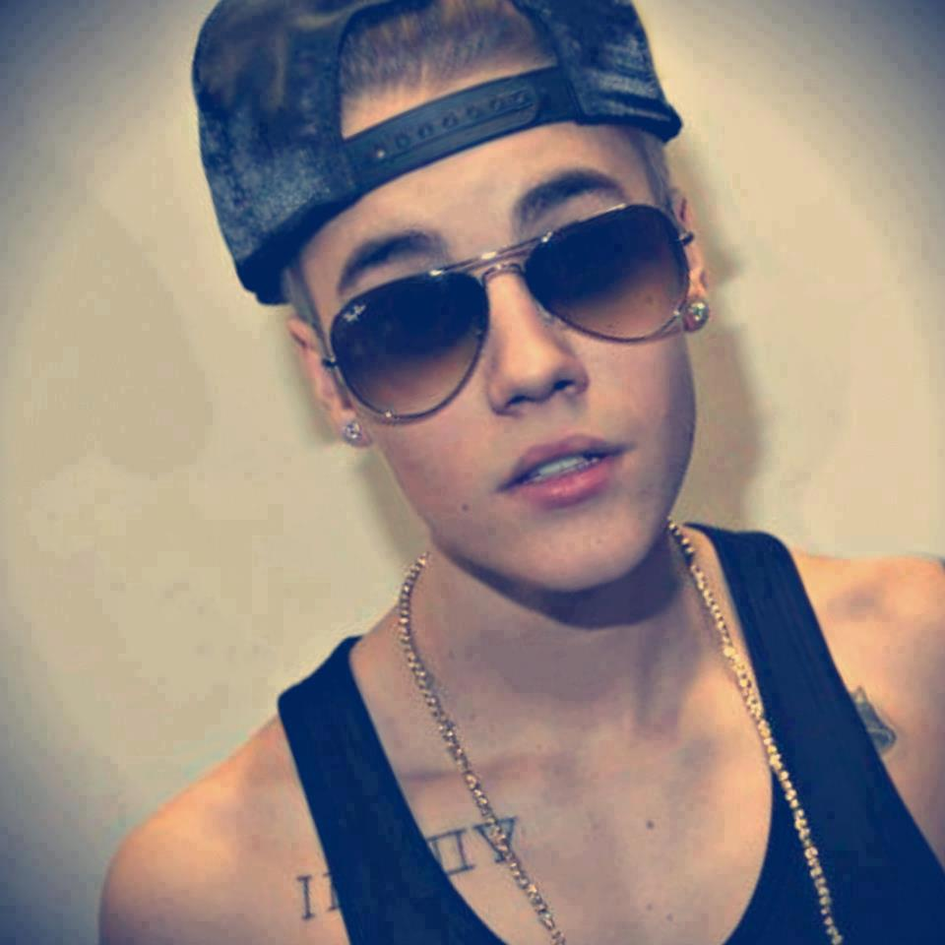
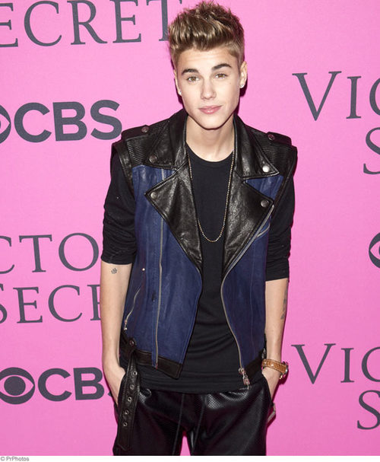
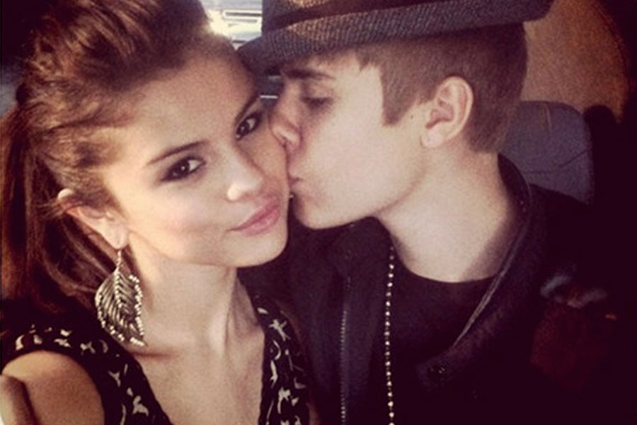
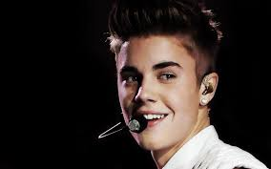

Slide 17
CELINE DION
Celine Dion was born in Canada 1968. She is singer and songwriter. She is most known from Titanic, when she did soundtrack.

Slide 18
THE END
And this was something about Canada and interesting things about her. I really hope that you enjoyed my prazintacion.
And thanks for listening :D

