Slide 1
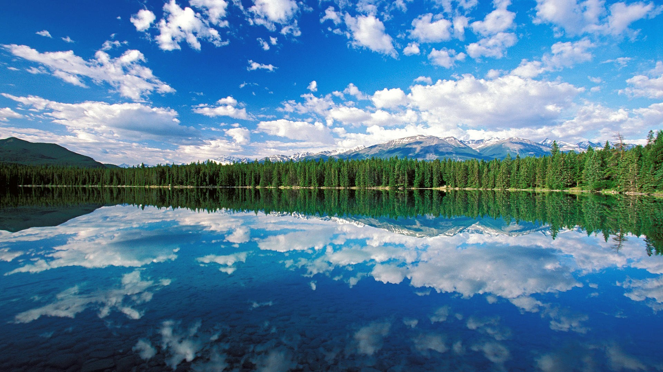
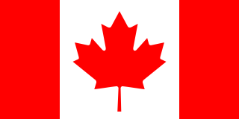
CANADA

Slide 2
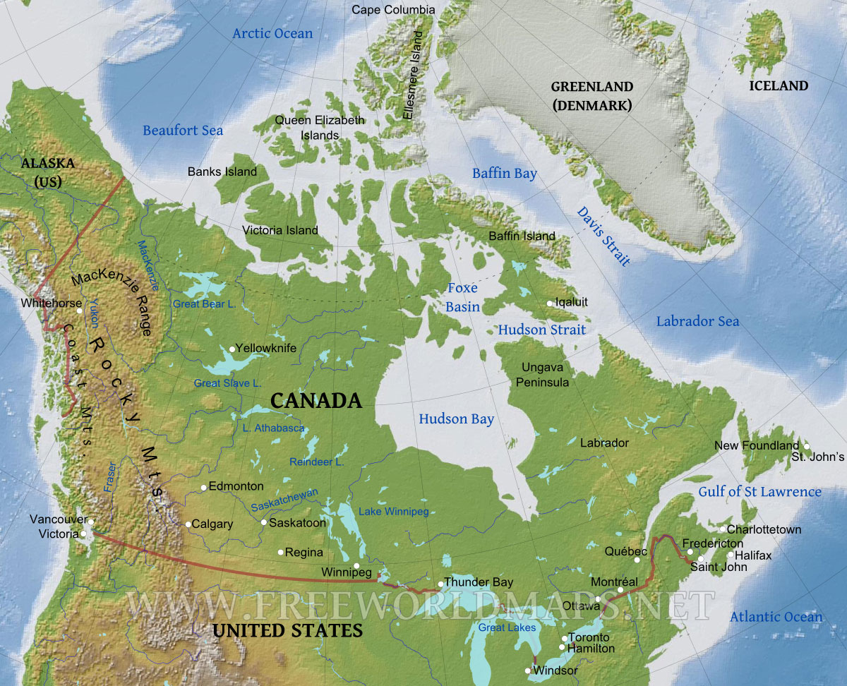
BASICS ABOUT CANADA
10 provinces and 3 territories
World’s second-largest country
Country with the longest land border (with USA)
Capital: Ottawa in Ontario
Offical language: English and French
Currency: Canadian Dollar (CAD) $
Motto: From sea to sea (A Mare usque ad Mare)

Slide 3
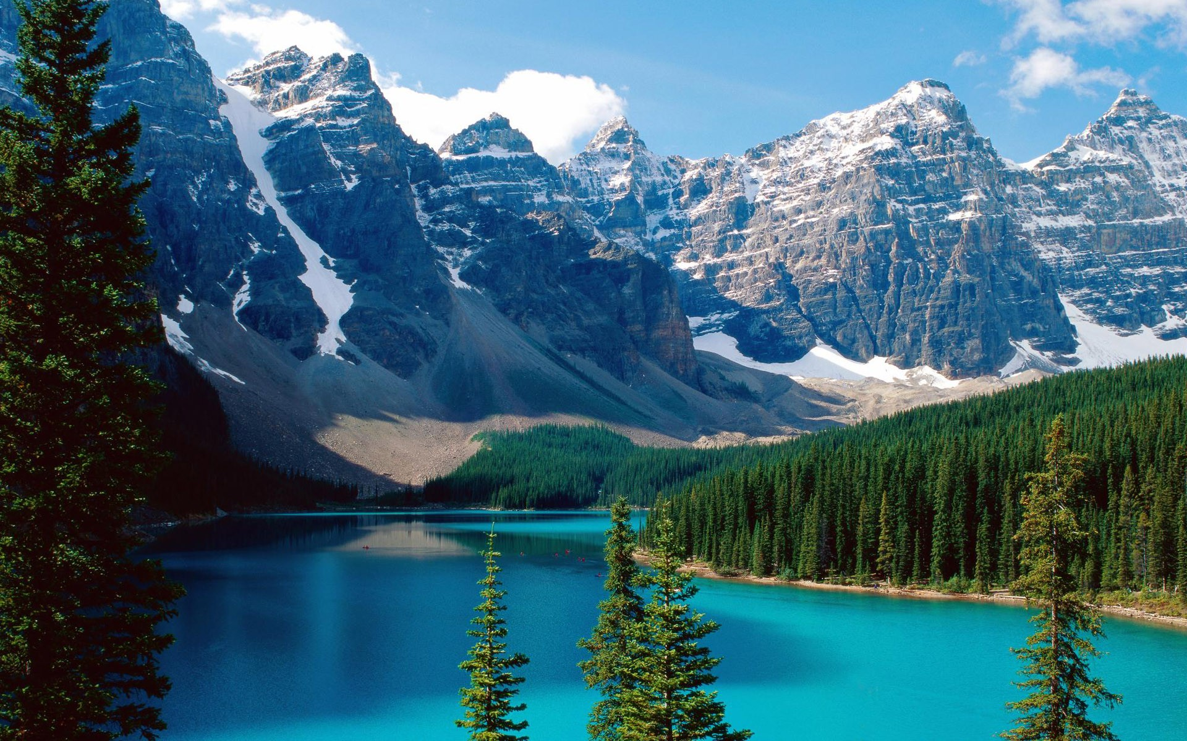
GEOGRAPHY
From Atlantic to Pacific ocean; Arctic ocean on the north
Canadian shield, Hudson bay, river St. Lawrence, Great Lakes and Great Plains/Prairie, Rocky Mountains,...
Highest peak of Canada is Mount Logan/Pierre Elliott (5959m)

Slide 4
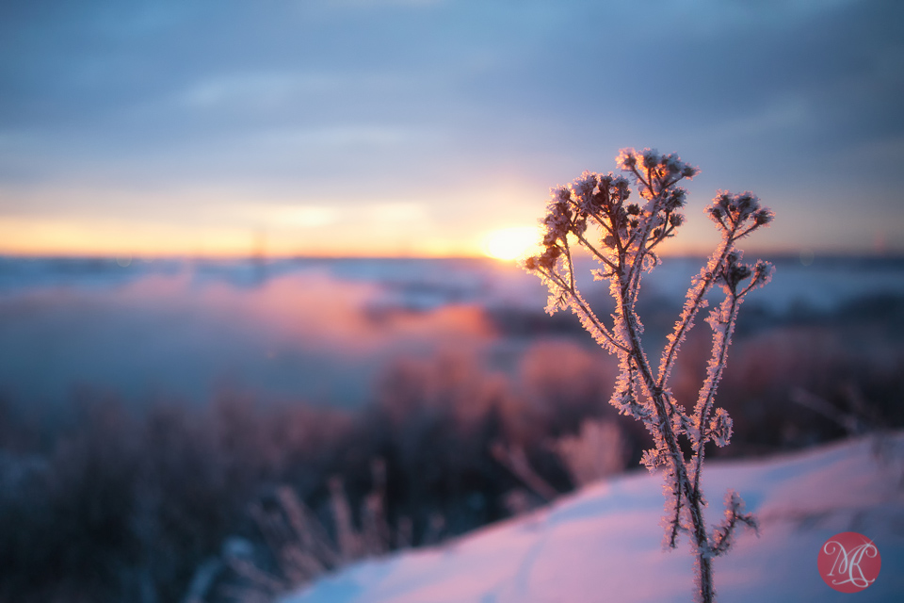
NATURE
A lot of national parks (Banff, Jasper,...)
Waterfalls (Niagara Falls), rivers, lakes, forests and islands (Prince Edward Island)
Mammals: grizzly bear, stags, mountain lions, moose, beaver,...
National Dinosaur Park

Slide 5
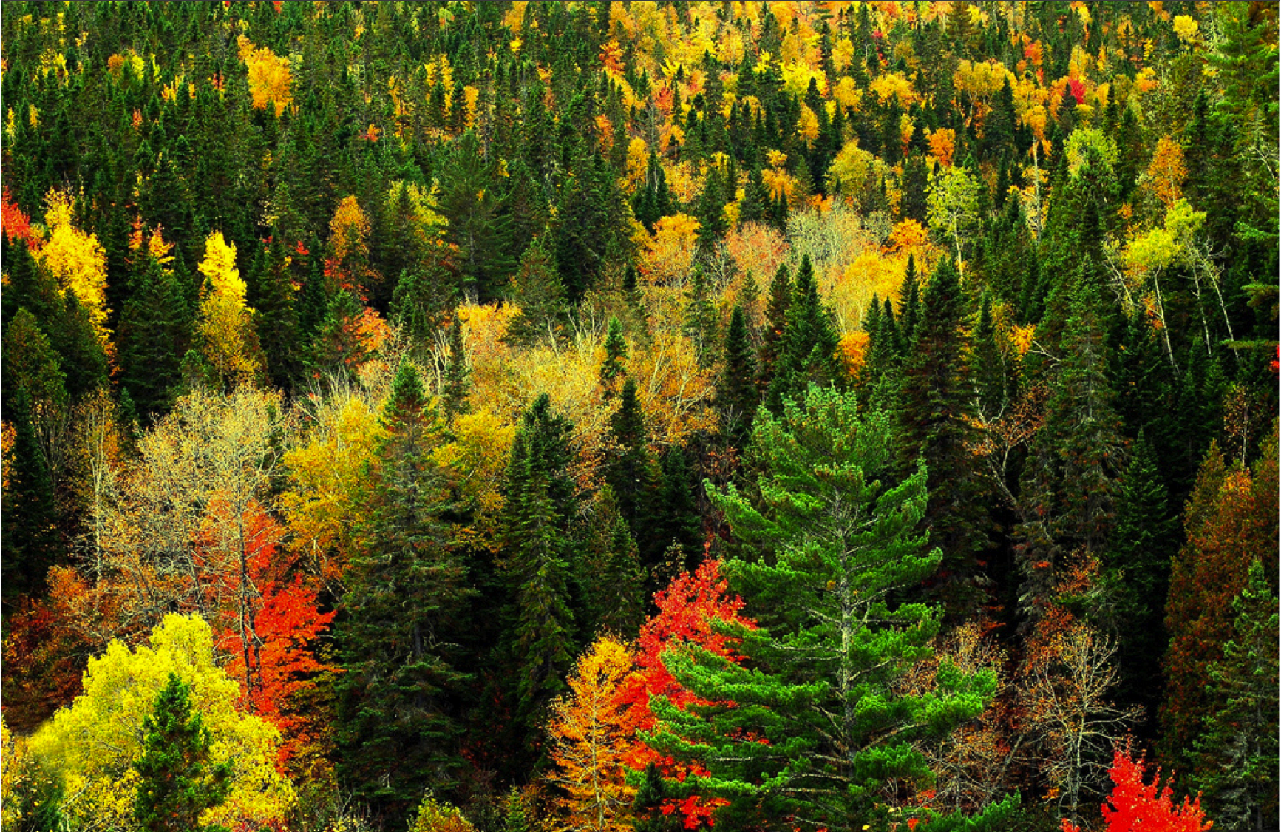
INDUSTRY
Deposits of oil and iron ore
Alberta-center of the oil industry
Forests, wood

Slide 6
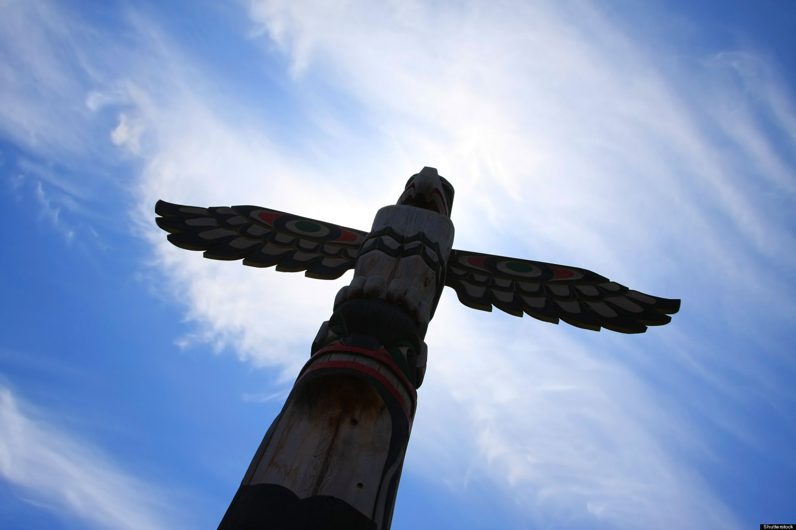
SIGHTS
The Canadian Rockies
Old Quebec City
Bay of Fundy
CN Tower
Northen lights, Niagara Falls, lakes,...

Slide 7
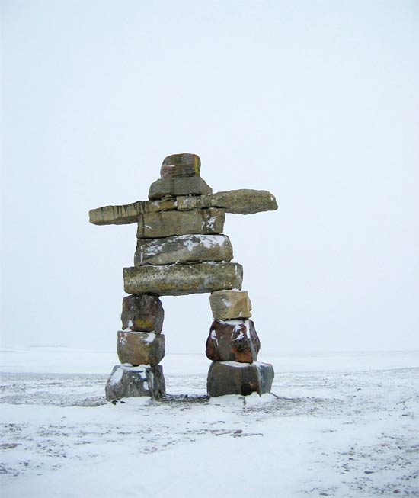
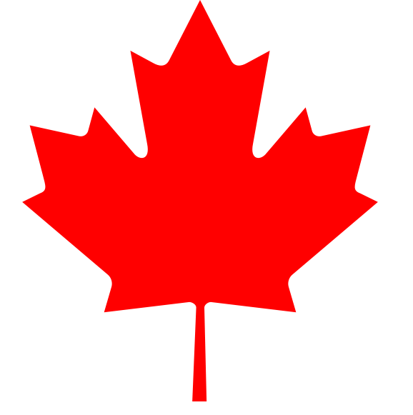
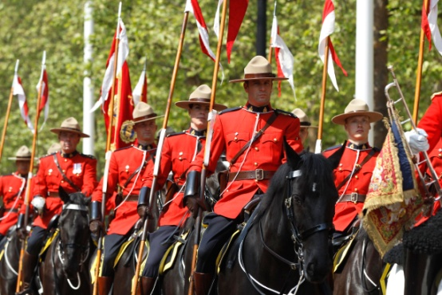
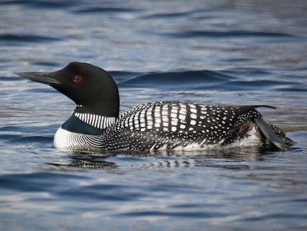
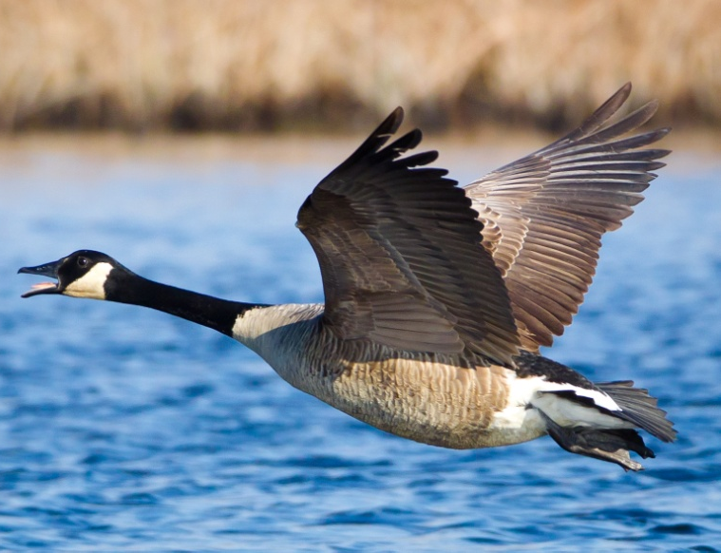
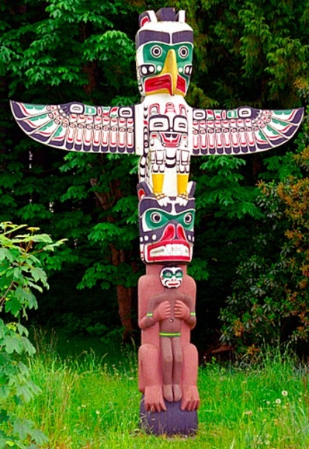
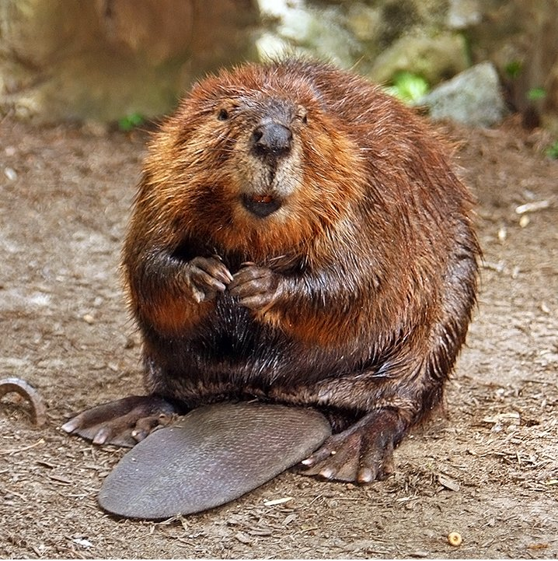
NATIONAL SYMBOLS
Maple leaf, totem pole, beaver, Canadian goose, The Royal Canadian Mounted Police, Common Loon and Inuksuk.

Slide 8
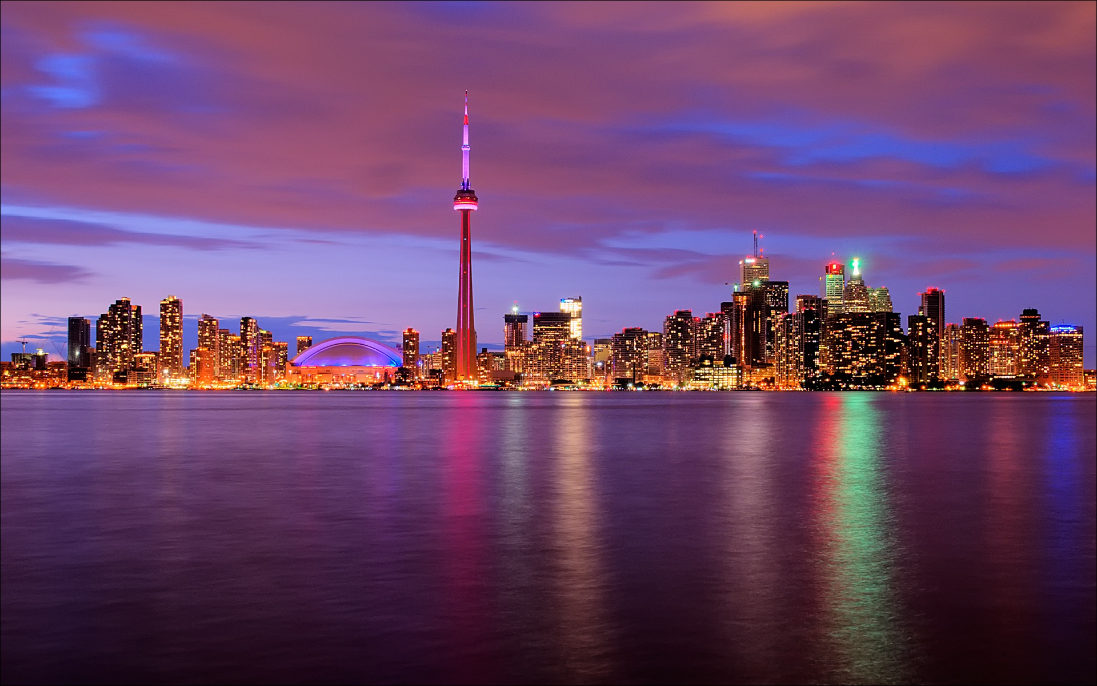
INFORMATION
Wikipedia
My knowledge

