Slide 1
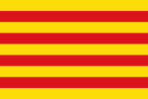
Catalunya

Slide 2
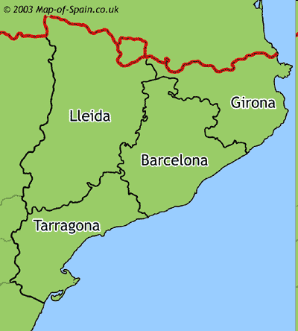
What is Catalunya?
is an autonomous community in northeastern Spain. Catalonia comprises four provinces: Barcelona, Girona, Lleida, and Tarragona. Barcelona is the capital and the largest city in Catalonia.
Catalunya provinces

Slide 3
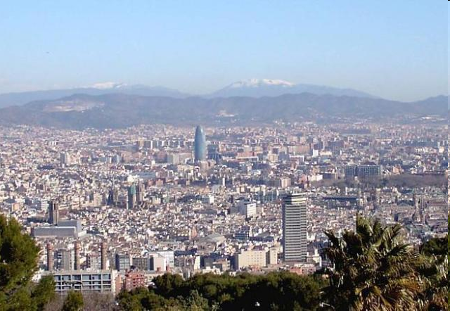
Barcelona
Barcelona is the capital of Catalonia and the second largest city in Spain, after Madrid. It is also Europe's largest metropolis on the Mediterranean Sea. Barcelona is today one of the world's leading tourist, economic and cultural-sports centres. Barcelona is the 16th-most-visited city in the world and the fourth most visited in Europe after Paris, London, and Rome, with several million tourists every year Barcelona is the 14th most "livable city" in the world. Also, the city is Europe's fourth best business city and fastest improving European city.
Barcelona

Slide 4
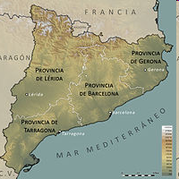
Location
It borders France and Andorra to the north, Aragon to the west, the Valencian Community to the south, and the Mediterranean Sea to the east. Catalonia covers an area of 32,114 km² and has an official population of 7,535,251 .

Slide 5
History
The name Catalunya began to be used in the late 11th century . Catalonia was colonised by Greeks. Both Greeks and Carthaginians, briefly ruled the territory. After the Carthaginian defeat by Rome, it became, along with the rest of Hispania, part of the Roman Empire, Tarraco being one of the main Roman posts in the Iberian Peninsula.

Slide 6
Languages
The official languages are Catalan, Spanish, Castilian and Aranese (Occitan).
Catalan | 54.8 %
Castilian | 40.9 %
Aranese | 1.1 %
Other language | 3.2 %

Slide 7
Climate
The climate of Catalonia is diverse. The populated areas lying by the coast in Tarragona, Barcelona and Girona provinces feature a Mediterranean climate.The inland part show a mostly continental Mediterranean. The Pyrenean peaks have a mountain or even Alpine climate. In the Mediterranean area, summers are dry and hot. Winter is cool. The inland part of Catalonia is hotter and drier in summer. Nights are cooler there than at the coast.

Slide 8
Economy
Catalonia has a long industrial tradition. At the end of 2010, Catalonia had 10.1% unemployment. The main economic sectors in Catalonia are :industry, construction, tourism and other services. The main tourist destinations in Catalonia are the city of Barcelona, the beaches of the Costa Brava and Girona, the beaches of Costa Bercelona. In the Pyrenees there are several ski resorts, near Lleida.

Slide 9
Science
Scientific and technological research are pillars of development in Catalonia. Nowadays authorities and private Company invest heavily in scientific and technological research. The Tarras can be viewed Catalan museum of science and technology, in Barcelona you can viewed Scientific Museum.

Slide 10
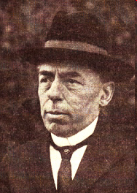
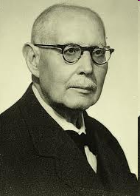
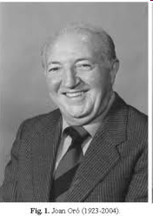
famous Catalan scientists
Narcís Monturiol
José Comas y Solá
Eduard Fontserè
Joan Oró

Slide 11
Painting
Catalan painters are:
Salvador Dalí,
Joan Miró and
Antoni Tàpies
They are created in the 20th century.
Catalan picturesque landscape has attracted a Pablo Picasso, who lived in Barcelona at a young age

Slide 12
Music
Music is one of the most vibrant areas of cultural industries in Catalonia. The most famous catalan composers are:
Pau Casals,
Isaac Albéniz,
Enrique Granados and
Pascal Comelade.
The most important musical events are in Barcelona.

Slide 13
Literature
Literature in the Catalan language has a long tradition. Dating back to the 13th century. Catalan literature was revived in the 19th century. In the 20th century were the most prominent representatives of Catalan literature are poets, writers and essayists. In Catalonia, lives and works lots authors who write in Spanish.

Slide 14
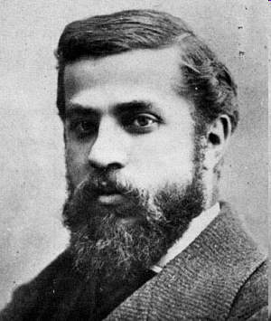
Architecture
Among the most famous Catalan architect is Antoni Gaudí , which, with its modernist works left a special mark in Barcelona.
Antoni Gaudí

Slide 15
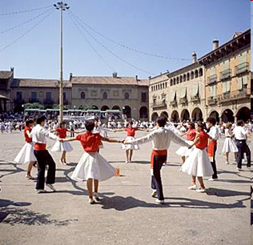
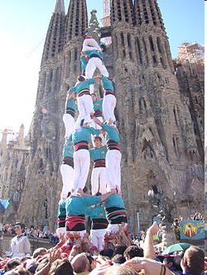
Folk tradition
The sardana is the Catalan national folk dance and music, though originally only from the north of the region. It is a circle dance, popular since at least the 16th century.
Castles, spectacular human towers. Six tiers is considered child's play, nine is not uncommon. Competitions are held, and the real fun comes when they have to get down.
sardana
Castells

Slide 16
Cuisine
Catalan cuisine is a Mediterranean cuisine from Catalonia. It relies heavily on ingredients found along the Mediterranean coast, including fresh vegetables (especially tomato and garlic,), wheat products (bread), legumes (beans), mushrooms, all sorts of pork preparations (sausages , ham), all sorts of cheese, lamb, and many types of fish like sardine, tuna. the desserts is very famous Catalan cream.Catalunya have got very old viticultural tradition.

Slide 17
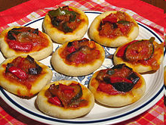
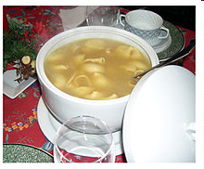
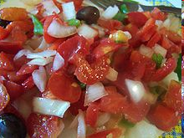
Typical dishes
suquets
Coques, a kind of pizza.
escudella
Esqueixada

Slide 18
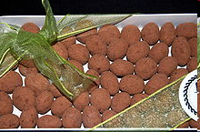
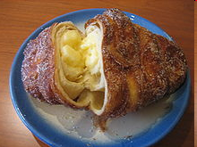
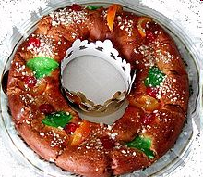
Typical Catalan desserts
Catalan cream
Some catànies
Xuixo
Tortell

Slide 19
Sport
Sport has an important incidence in Catalan life since the beginning of the 20th Century. The main sports in Catalonia are football, basketball, handball, tennis and motorsport.
One of the main sport events held ever in Catalonia were the 1992 Summer Olympics in Barcelona.

Slide 20
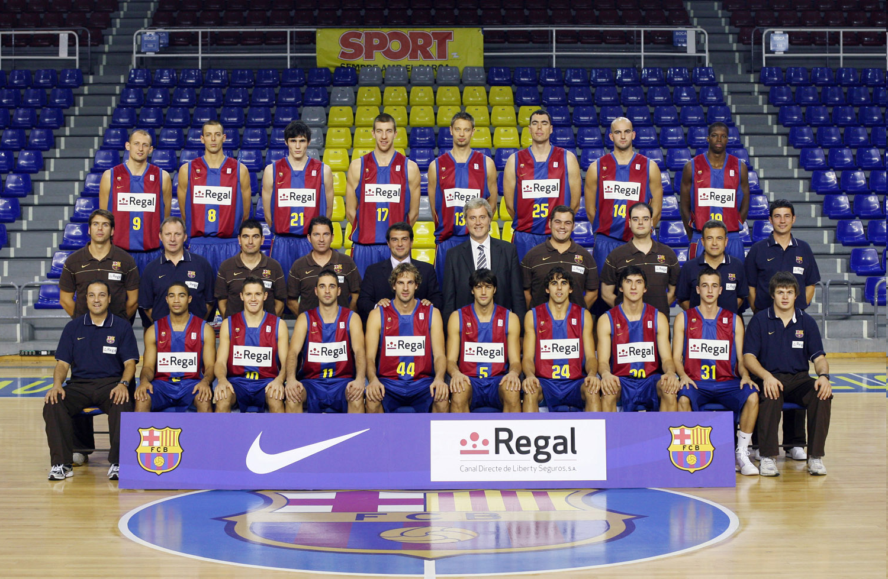
Basketball
Basketball was played for the first time in Catalonia in 1913. In 1922 was born the first club in Catalonia. Some Catalan players are or have been playing in the NBA, as Juan Carlos Navarro.

Slide 21
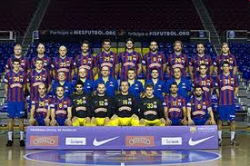
Handball
In 1941 were played the first handball matches in Catalonia and one year later was founded a Handball Federation in Catalonia. Then handball was developed over Catalonia. FC Barcelona is one of the best clubs of Europe.

Slide 22
Football
Football is considered the most important sport in Catalonia. Today, Catalan teams compete in La Liga, the Copa del Rey, and several European competitions as the UEFA Champions League and the UEFA Europa League. The biggest clubs is FC Barcelona, which has won 4 European Champions leagues, 4 UEFA Cup Winners' Cups. The Catalonia national team's first match was in 1912 in Paris, against France.

Slide 23
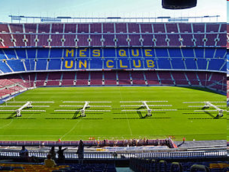
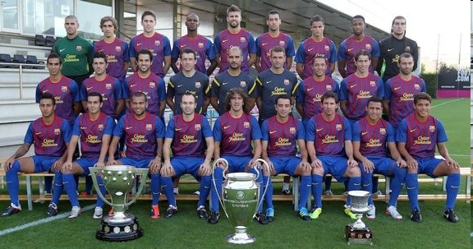
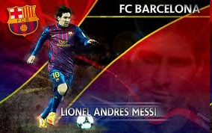
FC Barcelona stadium (Nou Camp)
Fc Barcelona football team
Lionel Andres Messi

Slide 24
Holidays
Major holidays in Catalonia are:
23rd april: Sv. Jurij (Sant Jordi), patron of Catalonia. At the celebration, we gave the flowers to the loved. (like on Valentine's Day).
24th June: Feast of St. John (Sant Joan)
11th september: Catalan national day.

Slide 25
Public holidays
In Catalonia have 15 no working days:
First January: New Year
6th January: Arrive St. Epiphany.
First May: Labour Day.
Easter Week: Good Friday
Easter Week: Easter Monday
24th June: St. Janez
15th August: The Assumption
11th september: Catalan National Day
12th October: The Spanish day
First november: All Saints
6th december: Spanish Constitution Day
8th december: Immaculate Conception
25th december: Christmas
26th december: st. Stephen

Slide 26
cultural Heritage
As cultural heritage protected by UNESCO:

Slide 27
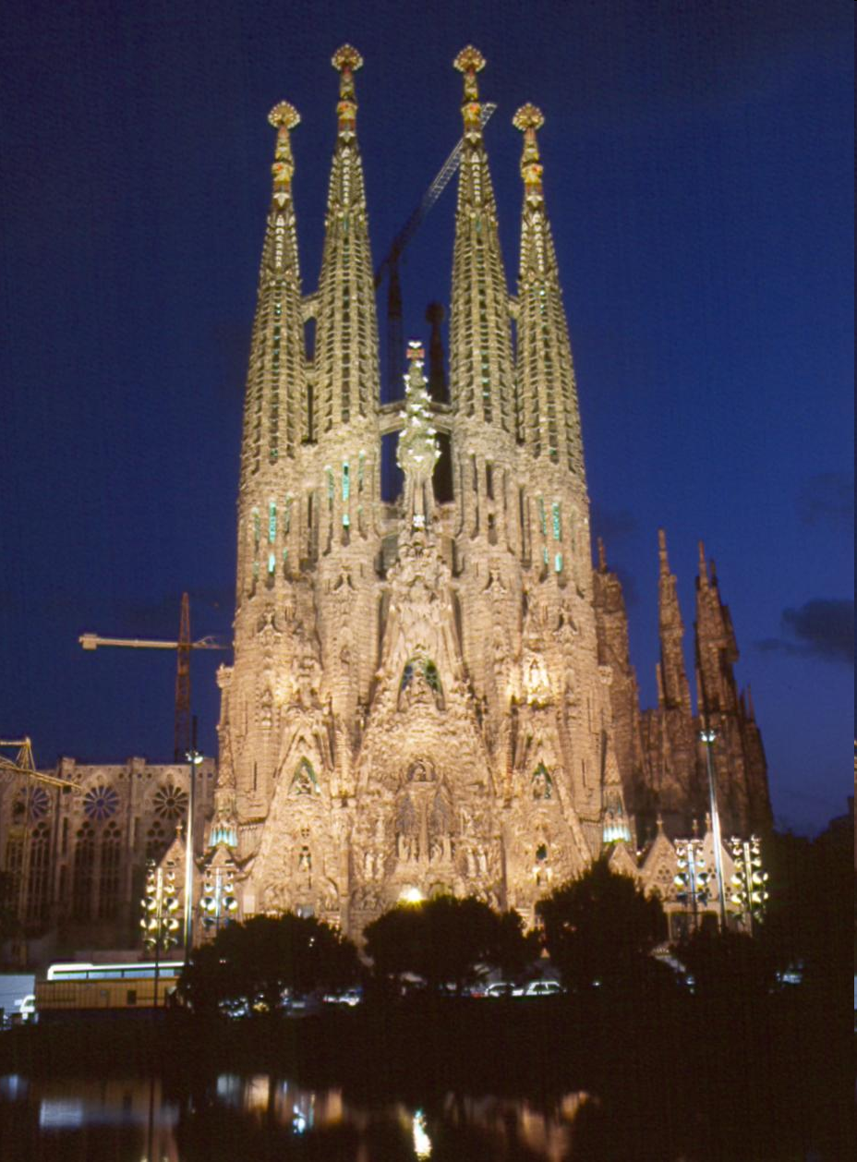
is a large Roman Catholic church in Barcelona designed by Catalan architect Antoni Gaudí .
Sagrada Família

Slide 28
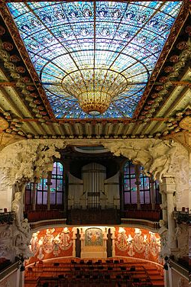
The Palau de la Música Catalana is a concert hall in Barcelona. Designed in the Catalan modernista style by the famous architect Lluís Domènech i Montaner, it was built 1908 for the Orfeó Català.
Palau de la Música Catalana

Slide 29
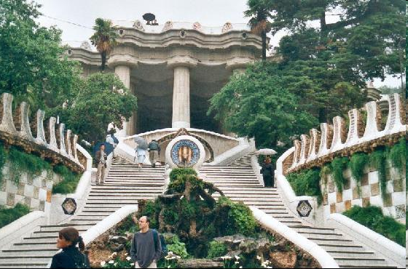
Park Güell is a garden complex with architectural elements. It was designed by the Catalan architect Antoni Gaudí and built in 1914. It is part of the UNESCO World Heritage Site.
The entrance to the park

Slide 30
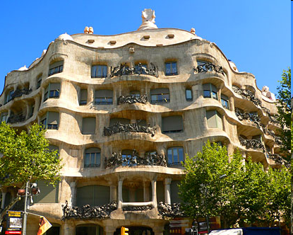
Casa Milà better known as La Pedrera is a building designed by the Catalan architect Antoni Gaudí and built in 1912. It is located in the Barcelona.
La Pedrera (Casa Mila)

Slide 31
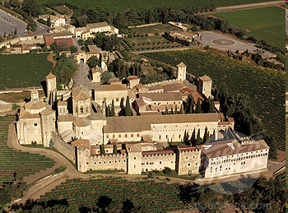
The Poblet Monastery is a Cistercian monastery, founded in 1151, located in Catalonia. The main architect was Arnau Bargués.
This monastery was the first of three sister monasteries, known as the Cistercian triangle, that helped consolidate power in Catalonia in the 12th century.
Poblet Monastery

Slide 32
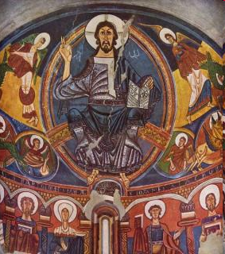
The Churches of the Vall de Boí are a set of nine Early Romanesque churches declared World Heritage Site by UNESCO and located in the Vall de Boí, in the Catalan (Province of Lleida).
Catalan Romanesque Churches of the Vall de Boí

Slide 33
Resources
http://en.wikipedia.org/wiki/Catalonia
http://www.red2000.com/spain/region/r-catal.html
Books:
Hopkins ,G. Macphedran,Svetovni popotnik Španija,Založba Mladinska knjiga,Ljubljana 1999
D. Simonis, J. Noble, T. Nollen, Spain , Založba Mladinska knjiga, Ljubljana 2002,2008
A.Sorensen , R. Chander, Naj 10 Barcelona, Založba Mladinska knjiga, Ljubljana 2009
M. Ivory, Mesto na dlani Barcelona, Založba Mladinska knijga, Ljubljana 1998
M. Krušič, Jugazahodna in južna Evropa, Založba Mladinska knjiga, Ljubljana 1997

