Slide 1




CATSHOW

Slide 2

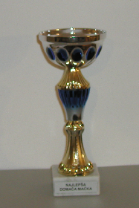
the purpose of the show:
to sell cats
to win the trophy
entrance fee
fun !!!

Slide 3
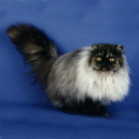


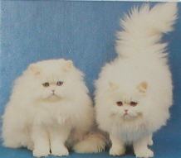
Persian cat:

Slide 4

show is divided in to 2 parts:
in the morning cats are judged and nominated
in the afternoon there is BEST IN SHOW

Slide 5
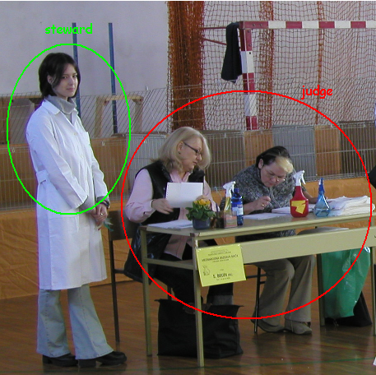

Slide 6

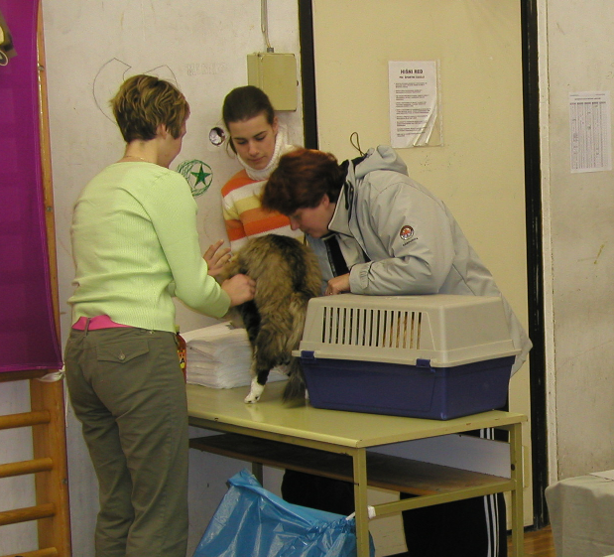
VETS ☹
before the show all cats are examined by vets

Slide 7
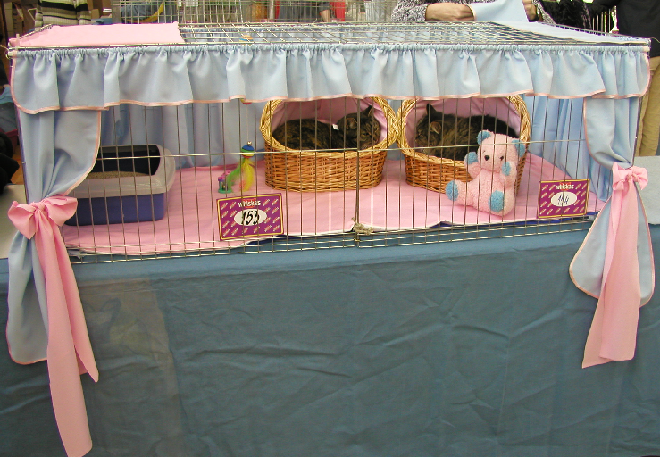
Cages:
best looking cage!!!

Slide 8



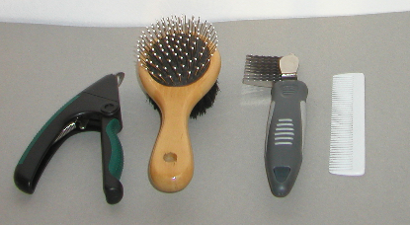
Combing cats

Slide 9
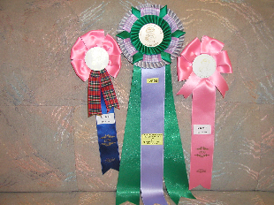
!! rosette !!

Slide 10

CAT BREEDS

Slide 11
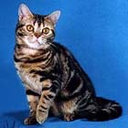
American Shorthair
Characteristics | American Shorthair
Coat type: | Shorthair
Country of origin: | USA
Size: | Large
Care: | Not very demanding, brush and comb several times a week
Nature: | Very independant, average temperament

Slide 12
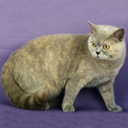
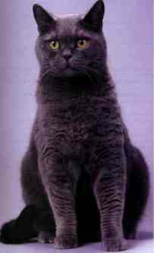
British Shorthair
Characteristics | British Shorthair
Coat type: | Shorthair
Country of origin: | Great Britain
Size: | Large
Care: | Not very demanding, brush and comb once a week
Nature: | Uncomplicated, patient and quiet

Slide 13
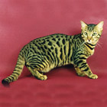
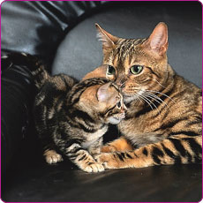
Bengal
Characteristics | Bengal Cat
Coat type: | Shorthair
Country of origin: | USA
Size: | Large
Care: | Not very demanding, brush and comb once a week
Nature: | Still sometimes very unsettled, not a cat for beginners, but the majority are very affectionate

Slide 14
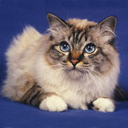
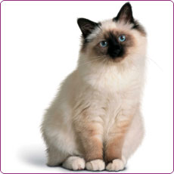
Birman
Characteristics | Birman (Sacred cat of Birma)
Coat type: | Semi-Longhair
Country of origin: | France
Size: | Medium/large
Care: | Really demanding, brush and comb several times every week
Nature: | Quiet, become attached to owner,

Slide 15
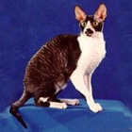
Cornish Rex
Characteristics | Cornish Rex
Coat type: | Shorthair
Country of origin: | Great Britain
Size: | Medium
Care: | Not very demanding, brush and comb several times a week
Nature: | Very quiet, affectionate and fond of human company

Slide 16
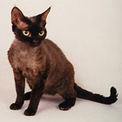
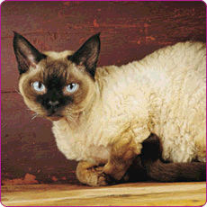
Devon Rex
Characteristics | Devon Rex
Coat type: | Shorthair
Country of origin: | Great Britain
Size: | Medium
Care: | Not very demanding, brush and comb several times a week
Nature: | Very quiet, calm and fond of human company

Slide 17
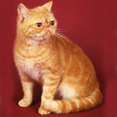
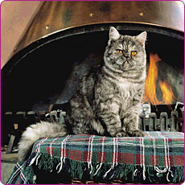
Exotic Shorthair
Characteristics | Exotic Shorthair
Coat type: | Shorthair
Country of origin: | USA
Size: | Medium/large
Care: | Easy to care for, brush and comb once a week
Nature: | Calm, affectionate, moderate temperament, enjoys being petted, and very good-natured

Slide 18
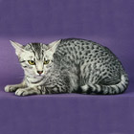
Egyptian Mau
Characteristics | Egyptian Mau
Coat type: | Shorthair
Country of origin: | USA
Size: | Medium
Care: | Easy to care for, brush and comb once a week
Nature: | Needs a lot of care and attention

Slide 19
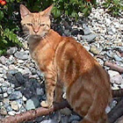
European Shorthair
Characteristics | European Shorthair
Coat type: | Shorthair
Country of origin: | Central Europe/Scandinavia
Size: | Medium/Large
Care: | Easy to care for, brush and comb once a week
Nature: | Feels at home in any situation, very independent

Slide 20
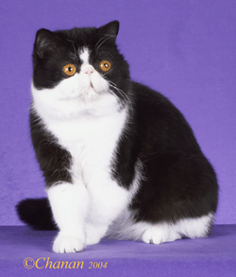
Exotic
Characteristics | Exotic Shorthair
Coat type: | Shorthair
Country of origin: | USA
Size: | Medium/large
Care: | Easy to care for, brush and comb once a week
Nature: | Calm, affectionate, moderate temperament, enjoys being petted, and very good-natured

Slide 21
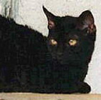
German Rex
Characteristics | German Rex
Coat type: | Shorthair
Country of origin: | Germany
Size: | Medium
Care: | Not very demanding, brush and comb several times a week
Nature: | Very quiet, affectionate and fond of human company

Slide 22
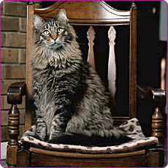
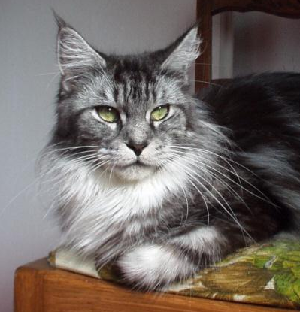
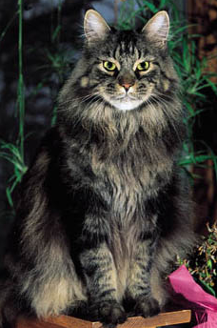
Maine Coon
Characteristics | Maine Coon
Coat type: | Semi-Longhair
Country of origin: | USA
Size: | Very large
Care: | Very demanding, brush and comb several times every week
Nature: | Very attached to people, quiet, reserved, independant

Slide 23
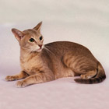
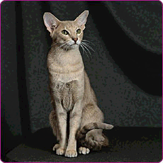
Oriental Shorthair
Characteristics | Oriental Shorthair
Coat type: | Shorthair
Country of origin: | Great Britain/USA
Size: | Medium
Care: | Easy to care for, brush and comb once a week
Nature: | Intelligent. They love to roam and are very sociable.

Slide 24
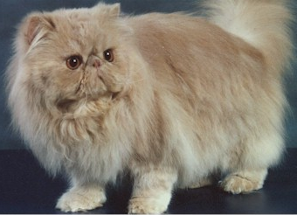
Persian
Characteristics | Persian
Coat type: | Longhair
Country of origin: | Persia/Turkey
Size: | Medium/Large
Care: | Very demanding, should be brushed and combed every day
Nature: | Enjoys being petted

Slide 25
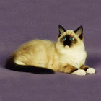
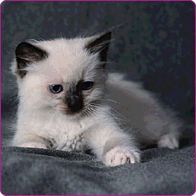
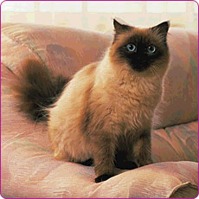
Ragdoll
Characteristics | Ragdoll
Coat type: | Semi-longhair
Country of origin: | USA
Size: | Large
Care: | Not very demanding, brush and comb several times a week
Nature: | Very quiet, balanced and drawn to people

Slide 26
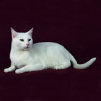
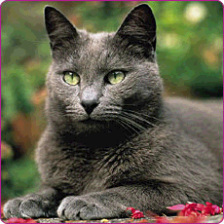
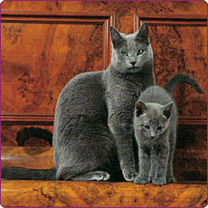
Russian Blue
Characteristics | Russian Blue
Coat type: | Shorthair
Country of origin: | Russia/Great Britain
Size: | Medium
Care: | Brush, comb several times a week
Nature: | Very lively, affectionate and fond of human company

Slide 27
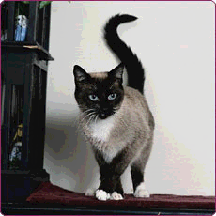
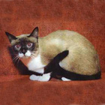
Snowshoe
Characteristics | Snowshoe
Coat type: | Shorthair
Country of origin: | USA
Size: | Medium
Care: | Not very demanding, brush and comb several times a week
Nature: | Temperamental, vivacious, very fond of human company

Slide 28
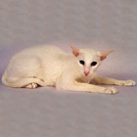
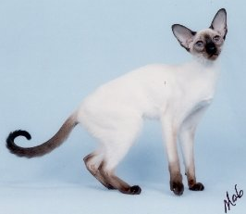
Siamese
Characteristics | Siamese
Coat type: | Shorthair
Country of origin: | Thailand/Great Britain
Size: | Medium
Care: | Brush and comb several times a week
Nature: | Intelligent, very sensitive

Slide 29
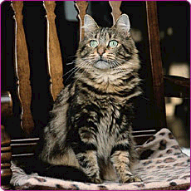
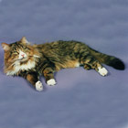
Siberian Cat
Characteristics | Siberian Cat
Coat type: | Semi-longhair
Country of origin: | Russia
Size: | Medium
Care: | Relatively demanding, must be combed and brushed regularly.
Nature: | Balanced and quiet, courageous

Slide 30
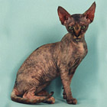
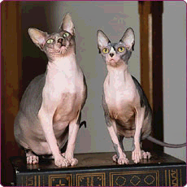
Sphynx
Characteristics | Sphynx
Coat type: | Shorthair, almost bald
Country of origin: | USA/Holland
Size: | Medium
Care: | Not very demanding, folds in skin must be cleaned regularly
Nature: | Very fond of human company and playful

Slide 31
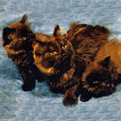
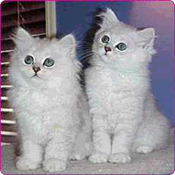
Tiffany
Characteristics | Tiffany
Coat type: | Semi-Longhair
Country of origin: | USA
Size: | Medium
Care: | Relatively demanding, must be combed and brushed often
Nature: | Very curious, gentle and friendly

Slide 32
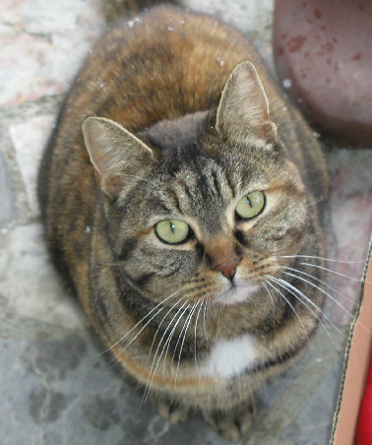
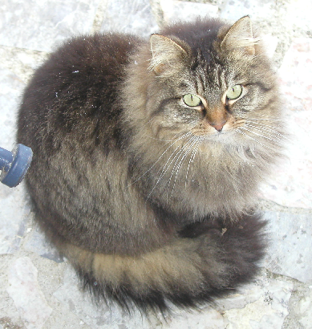
NON PEDIGREE CATS

Slide 33
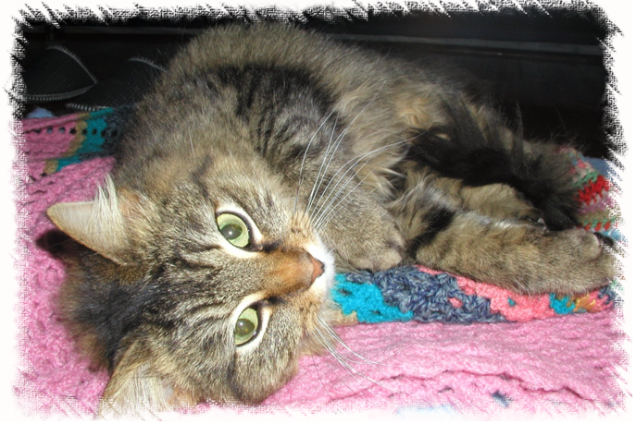
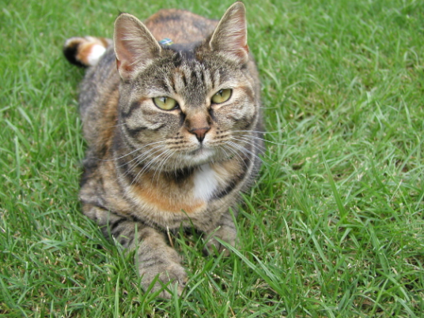
Pika & Čopa
Characteristics | Pika & Čopa
Coat type: | Longhair and Shorthair
Country of origin: | SLO-Radovljica
Size: | Medium
Care: | Brushed often
Nature: | Very curious!!!

Slide 34
☺ !!! NEW WORDS !!! ☺
catshow: a show where cats compete
trophy: an object such as a silver cup that is given as a prize for winning a competition
entrance fee: money that you pay for seeing something
breed: a particular type of animal that has been developed by people in a controlled way, especially a type of dog, cat
estimate: judgement or opinion about the value or quality of sb/sth
muzzle: nose and mouth of an animal, especially a dog, cat
to judge (V): to form an opinion about sb/sth, based on the information you have
judge (N): a person who has the necessary knowledge or skills to give their opinion about the value or quality of sb/sth
steward: a person who helps to organize a large public event
to nominate: to formally suggest that sb should be chosen for an important role, prize, position, etc.
vet/veterinarian: person who has been trained in the science of animal medicine, whose job is to treat animals who are ill or injured
to comb: to pull a comb through your hair in order to make it neat
sterilize: to make an animal unable to have babies
rosette: it is worn by supporters of a political party or sports team, or to show that sb has won a prize
enthusiastic: feeling or showing a lot of excitement and interest about sb/sth
claw: one of the sharp curved nails on the end of an animal's paw

