Slide 1
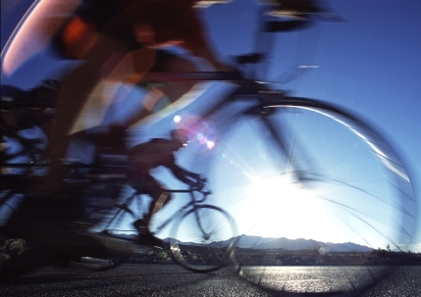
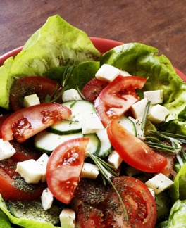
Are we aware of the importance of food?

Slide 2
What‘s happening with our eating habits
Modern food
Modern lifestyle
Facts about children
Facts about Slovenes
World facts
Balanced diet

Slide 3
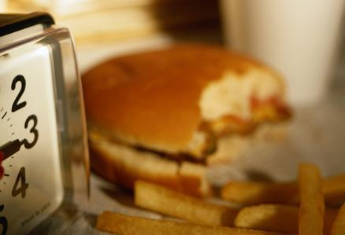
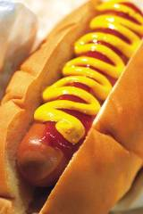
What’s happening with our eating habits?
Ready-to-eat, microwavable, drive through, take-out meals, backseat breakfasts, eating out;
Modern food
attractive appearance and taste
unbalanced
rich in calories
high in fat & sugar
Larger portion sizes
one of the reasons for the emergence of modern diseases: cardiovascular disease, obesity, diabetes, fatigue, mood swings, headaches, digestive problems, restless sleeping

Slide 4
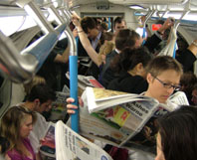
Modern lifestyle
Two-parent working families =the norm
Kids are overscheduled
cooking and eating at home =less of a priority
Sedentary lifestyle

Slide 5
A half century ago…
women took charge of the cooking responsibilities
did not work outside the home, spend time for planning, shopping, and feeding families
Preparing meals three to five hours each day
gathered at regular dinner hours, ate together, shared stories about their days
no microwave ovens, toaster ovens or pre-packaged one-dish dinners

Slide 6
reality
women have entered the workplace
children spend their days in day care or engaged in extracurricular activities
Working hours have changed→ skipping lunch and eat late in the afternoon/evening
we transformed lunch into a snack and dinner has become lunch

Slide 7
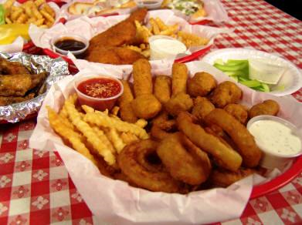
lack of time to engage in exercise
Children prefer to eat more, consume sugar-sweetened drinks
→ increase the risk for obesity
fewer meals at home
more fried food
more saturated fat

Slide 8
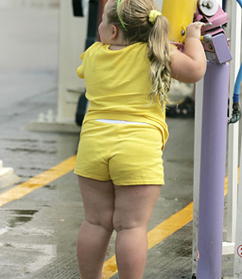
Facts about children
Body mass index is increasing
The predominance of obesity has increased: pupils aged 8 years- from 0.0% in 1983 to 9.6% in 2003
the proportion of overweight and obesity has increased 3 times: boys from 6.21% to 17.78% girls from 6.37% to 18.48%

Slide 9
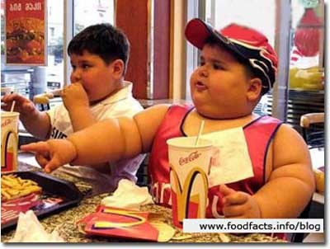
Facts about slovenes
A million Slovenians have high blood pressure
1.4 million have high cholesterol
a million have high blood sugar
1.2 million have excessive or increased body weight
a million Slovenians eat unhealthy
Only 600,000 people are enough physically active

Slide 10
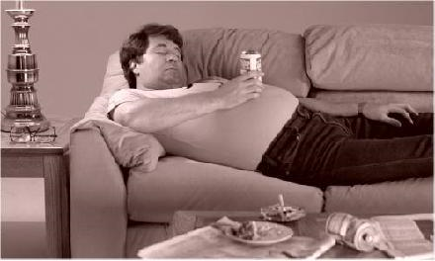
World facts
A research by WHO
more than 1,6 billion adults are overweight, and 400 million obese
by 2015 approximately 2,3 billion adults will be overweight and 700 million obese
more than a third of Americans are obese

Slide 11
Balanced nutrition
what , how much, how and when do we eat?
4 to 6 meals per day
Excellent regeneration
energy throughout the whole day
no accumulation of fat
carbohydrates, proteins and fats

Slide 12
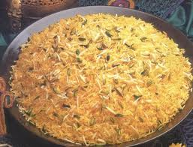
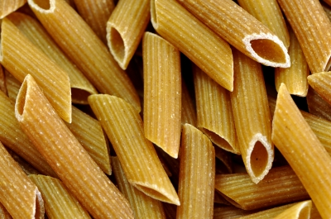
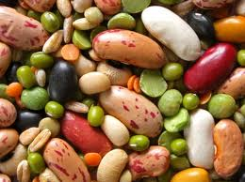
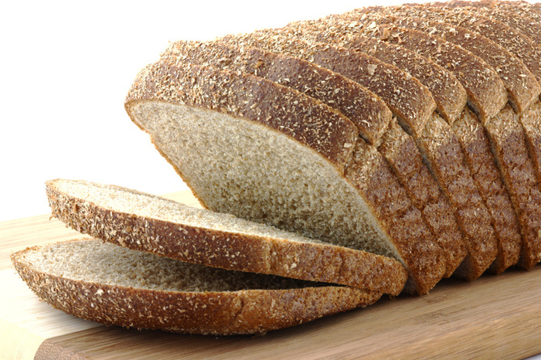
carbohydrates
source of energy
fuel
complex carbohydrates
wholemeal pasta, whole grain bread, legumes, brown and black rice, oatmeal

Slide 13
proteins
9 proteins
milk, yogurt, cottage cheese, eggs, meat, fish

Slide 14
fats
15 to 30 % of all kilocalories
unsaturated fats
olive oil, olives, peanut butter, avocados, nuts.
avoid animal fats, whole milk, whole milk yogurt, dishes roasted in oil

Slide 15
fibres
Normal intestinal function
lowering the blood cholesterol
smaller rise in blood sugar after feeding
legumes, cereals, vegetables, fruits and nuts

Slide 16
In general
avoid larger amounts of fat and sugar
foods that have a high glycemic index- raise level of blood sugar + quickly reduce it → cause=fatigue
Drink water!
no energy value
occupies the largest part of the body
regulates body temperature
1 liter /25 kilos of weight

