Slide 2
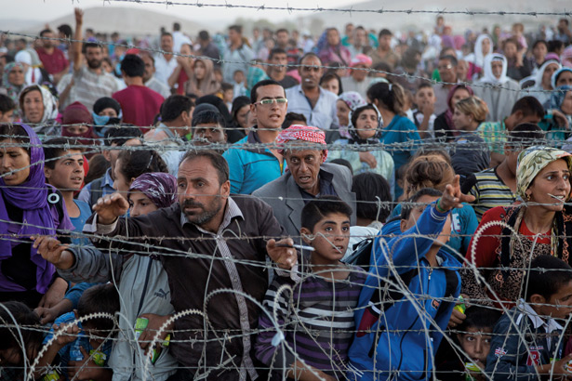
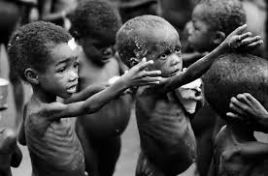
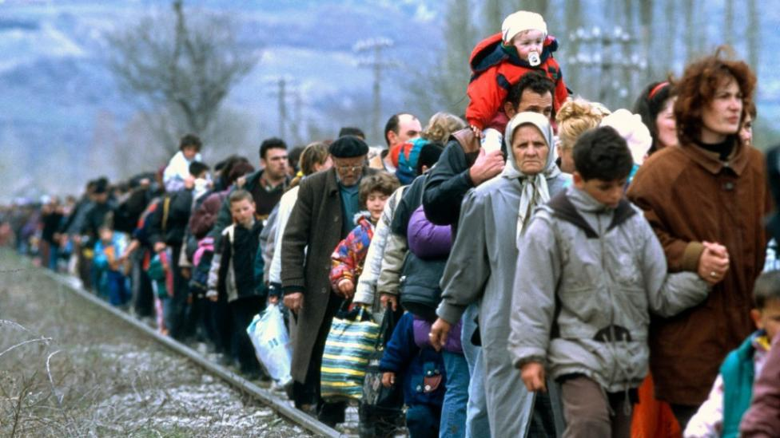
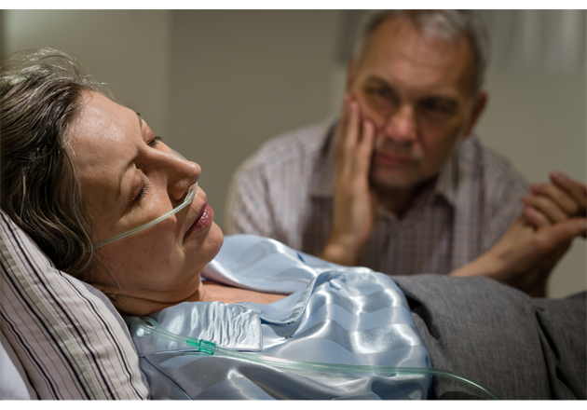
Human charities

Slide 3
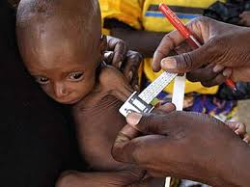
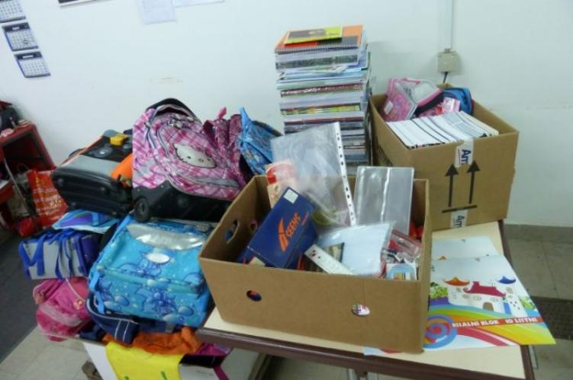
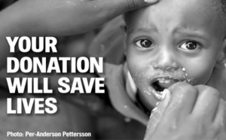
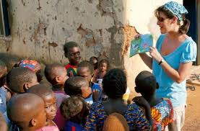

Slide 4
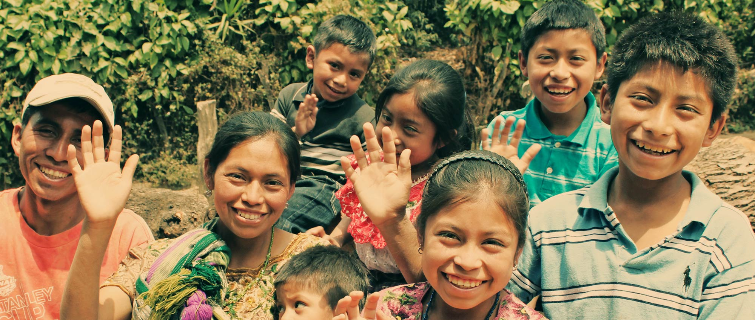
unbound
Financial support
Encouragement to become self-sufficient
300 000 people in 21 countries

Slide 5
Breast cancer research foundation
To prevent and cure breast cancer
Raised almost 570 million $
Over 200 researchers in 13 countries

Slide 6
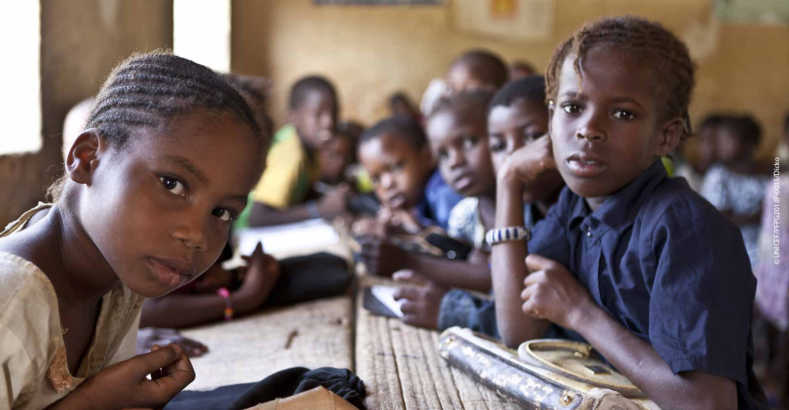
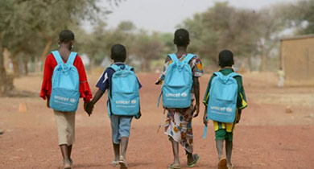
UNICEF
United nations international children’s emergency fund
Humanitarian and developmental assistance
Contributions from governments and private donors

Slide 7
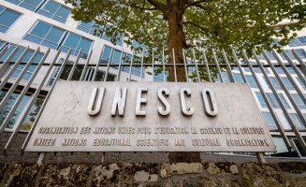
unesco
The united nations educational, scientific and cultural organization
Peace and security
Justice, human rights

Slide 8
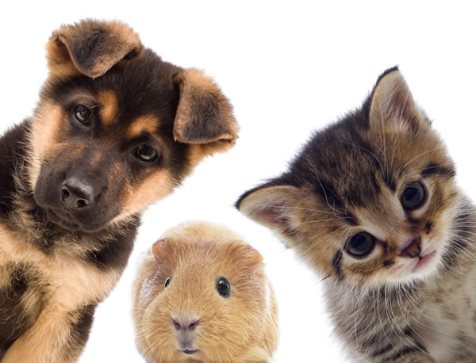
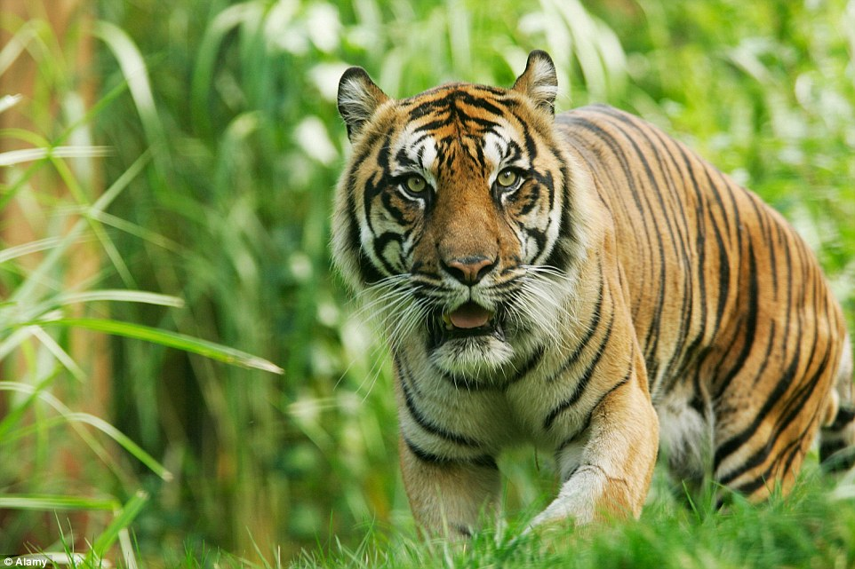
Animal charities
- wildlife conservation organizations - pet and animal welfare organizations - hunting and fishing conservation groups - zoos and aquariums

Slide 9
Animal charity organisations
Mercy For Animals
The Good Food Institute
The Humane League
Animal Equality
Animal Ethics
IN SLOVENIA: Glas živali

Slide 10
Charity in slovenia
Fund-raising concerts
Rdeči križ/ Red cross
Anina zvezdica/ Ana’s star
Majhni koraki za velik cilj/ Little steps for a greater cause Society for cystic fibrosis in Slovenia

Slide 11
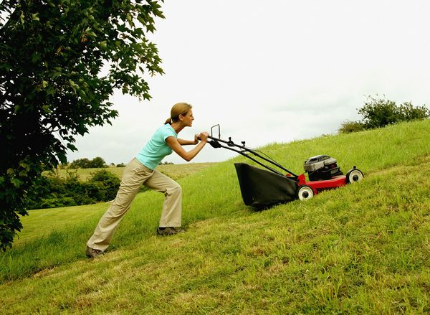
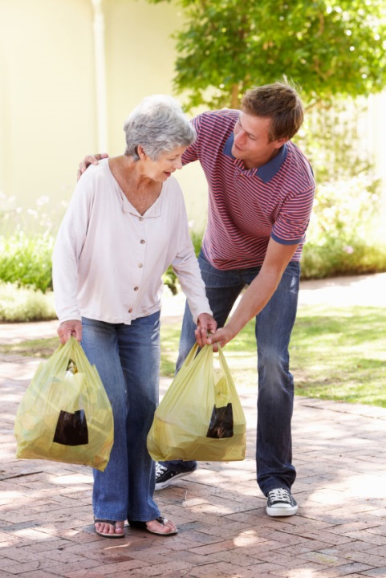

Slide 12
