Slide 1
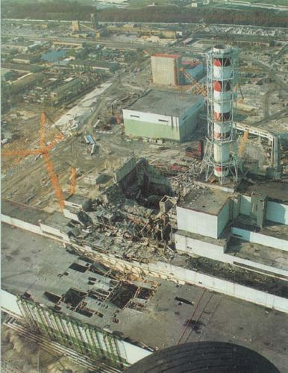
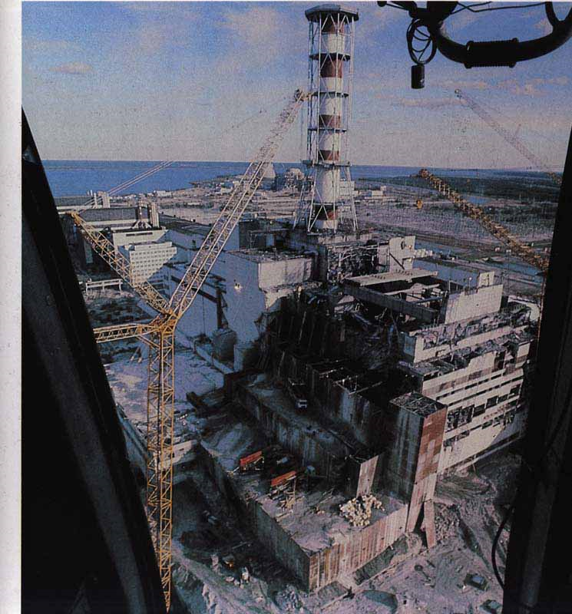

Slide 2
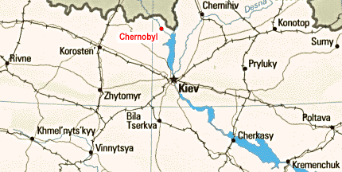
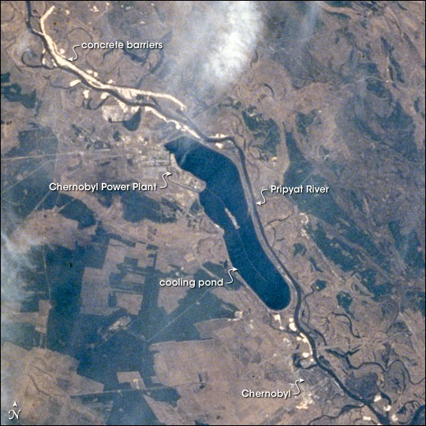
LOCATION
ukraine
Nuclear power station
in the Ukraine
near the Belorus border
110km north of Kiev
nuclear power station lies 15km from the town of Chernobyl

Slide 3
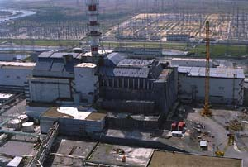
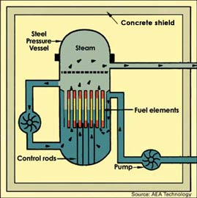
THE NUCLEAR POWER STATION
In one nuclear station is one or more reactors.
If they work, they are very hot¸and need to be cooled.
reactor

Slide 4
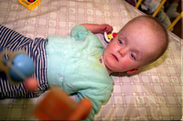
THE RADIOACTIVE RADIATION
Is harmful in two ways:
immediately after radiation:
- radiation sickness - death
many years after radiation: - cancer (leukemia)
- genetic mutations
- disfigured newborns
- cardiac abnormalities
invisible
nothing is felt
it is very dangerous for humans, specially for children, animas and plants.

Slide 5
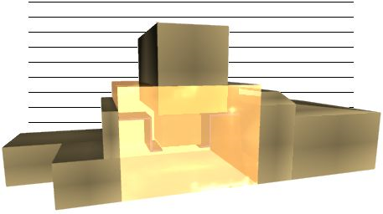
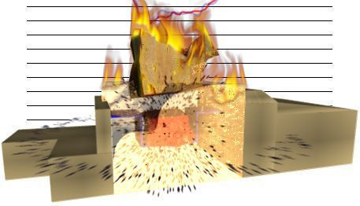
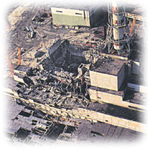
THE DISASTER
at night 25th April 1986 scientists made a dangerous experiment
they changed the pressure in one reactor and temperature of it started to rise
in some seconds the reactor blew up
pieces of burning material were flying
into the air
50 ton of nuclear fuel was released to the atmosphere
reactor before accident

Slide 6
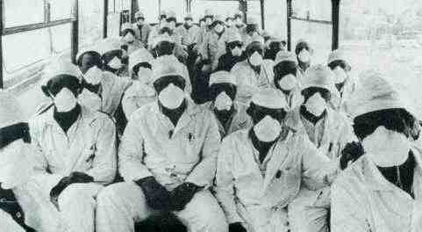
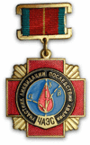
THE ACCIDENT
the explosion of the reactor released huge radiation
7 million people lived in contaminated zone (3 million children) and they were not aware of the danger
1 person was immediately killed
35 fire-fighters helped to put out the fire and were also killed
fortunately the fire was put out and didn`t reach other reactors
25 000 soldiers, who cleaned up the place of accident died in 3 monthc
a special medal for help

Slide 7
THE SPREAD OF RADIOACTIVITY
1.
2.
Radioactivity moved north and west (Sweden, Poland)
to westeren Europe (Germany, France)
4.
3.
to Great Britan, Spain, Italy, Slovenia

Slide 8
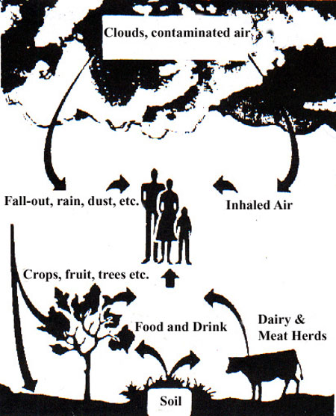
RADIOACTIVE ENVIRONMENT
Air, soil, food (vegetable, fruit, milk, meat) became radioactive
the ground was covered with radioactive dust
radioactive fallout- radioactive material which drop from atmosphere, was formed
135 000 people moved from the Chernobyl

Slide 9
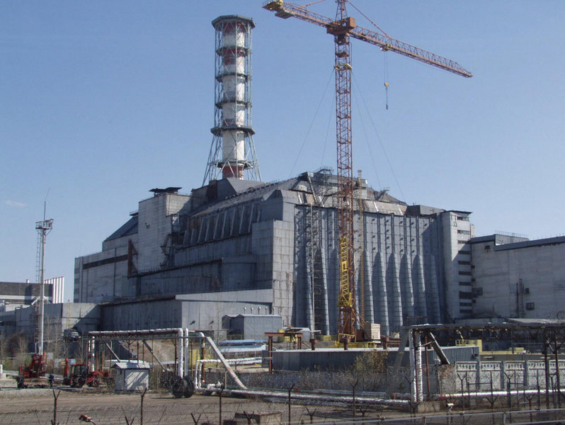
AFTER THE ACCIDENT
1 800 helicopters deposited around 5 000 tons of sand onto the damage reactor
most radioactivity was released in the first 10 days
a massive sarcophagus was constructed around the reactor to prevent further radioactivity
the 30km zone around Chernobyl became a desert

Slide 10
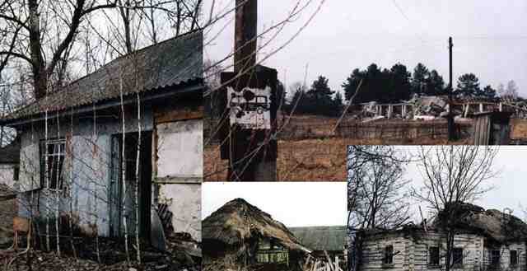
Some children say:
“We didn’t just lose a village, we lost a life. Chernobyl is like a big stone in my heart, always heavy, always present.”

Slide 11
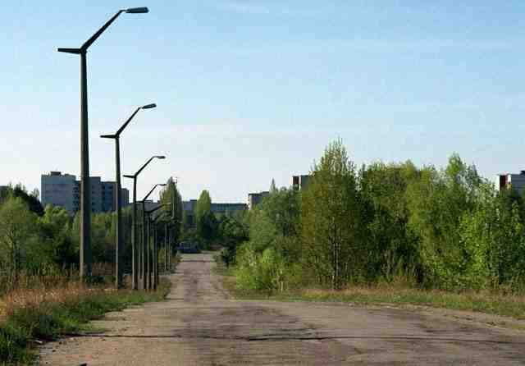
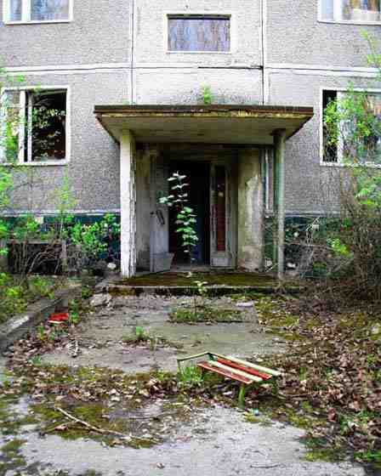
CONCLUSION
Chernobyl disaster is the greatest environmental catastrophe of human history
20 years after the accident the 30km zone around Chernobyl is still uninhabited
Chernobyl disaster was caused by human mistake
nuclear power stations are very unpopular and we have to look for other ways of making electricity
Chernobyl Children`s Project International was founded to provide medical help and hope to the children of Chernobyl

Slide 12
THE END

