Slide 1
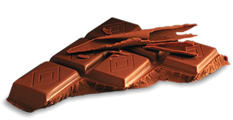
The truth about
Chocolate

Slide 2
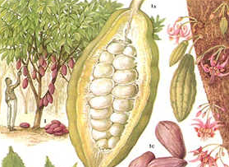
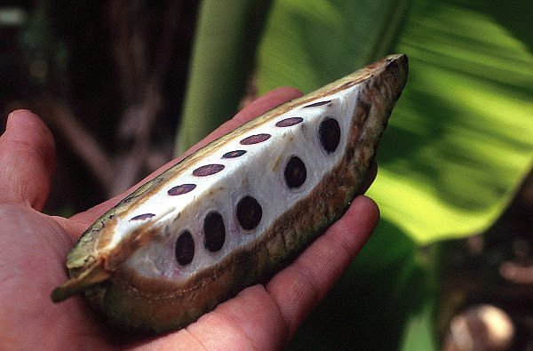
Chocolate is extracted from the beans of the cocoa plant
Beans are a vegetable

Slide 3
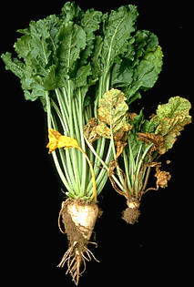
Sugar is extracted from sugar beat
The Sugar beat is a vegetable

Slide 4
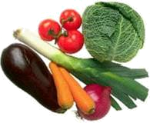
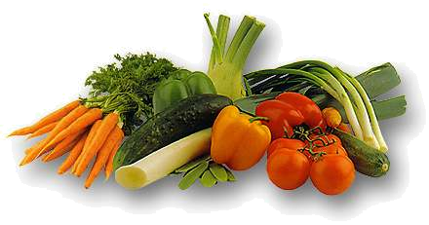
Therefore chocolate is a vegetable

Slide 5
Let´s spin the theory further:

Slide 6
Chocolate bars contain milk
Therefore chocolate bars
are healthy!!!

Slide 7
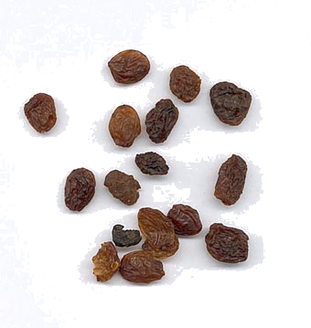
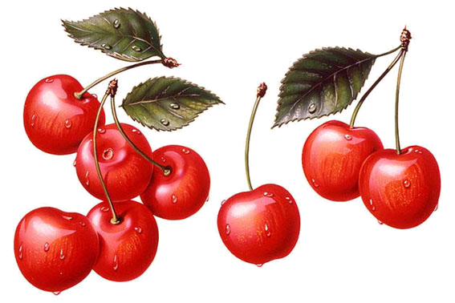
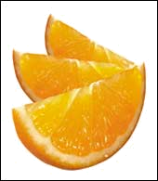
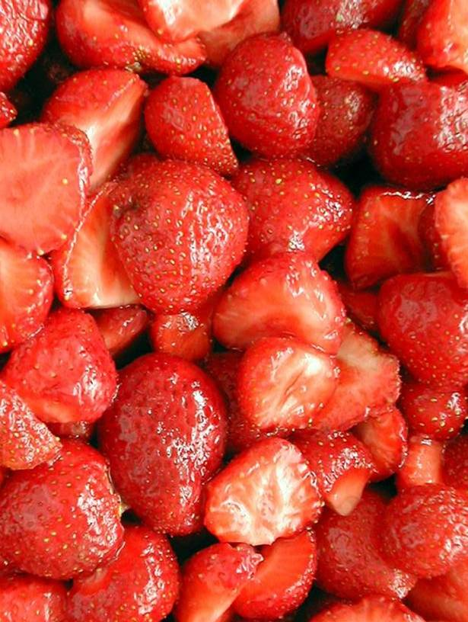
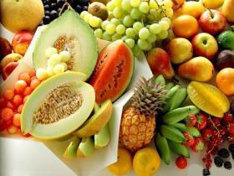
Raisins, cherries, orange peels and strawberries are in chocolate
They belong to the fruit family, so eat as much as you like

Slide 8
Chocolate is good for stress
Just think :

Slide 9
"STRESSED“ read backwards means:
"DESSERTS"

Slide 10
But don’t risk,
acept if jou vanet to be …

Slide 11
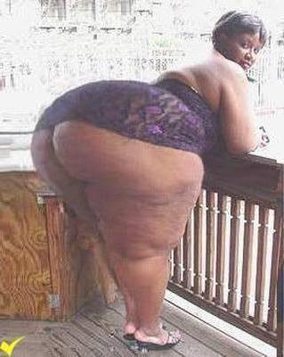
… fat
“and end up like this”

