Slide 1
COMMUNICATION AMONG YOUNG PEOPLE

Slide 2
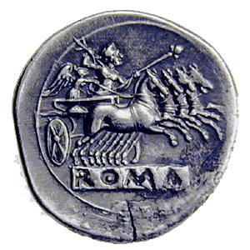
History
Word communication originally come Latin word "communicare" .
Romans invent first real postal system in order to centralize control of the empire from Rome.

Slide 3
Introduction
Communication plays important part in our life
Through the process of communication we develop our personality

Slide 4
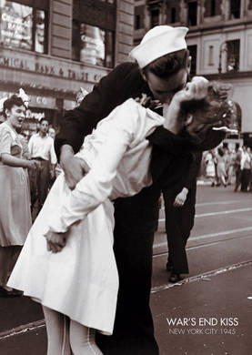
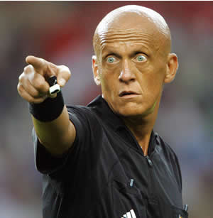
Type of communications
Communication it’s not just talking and listening.

Slide 5
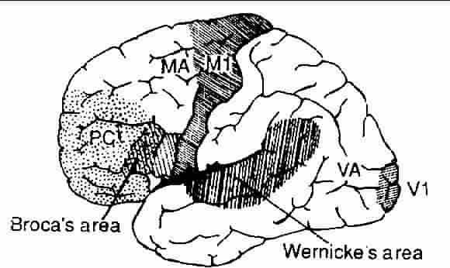
Verbal communication
Verbal communication requires the use of words, vocabulary, numbers and symbols and is organized in sentences using language.

Slide 6
Body language
Such messages can be communicated through gesture, body language or posture, facial expression and eye contact, object communication such as clothing, hairstyles or even architecture.
The body language component can be divided roughly into three parts: One The stuff you can do nothing about - your gender, race, age, height, etc Two The stuff you can change with effort - your dress, hair, weight, etc Three The stuff you already have that you can chose to use - gesture, eye contact, voice, etc.

Slide 7
An Internet forum
Is a facility on the World Wide Web for holding discussions and posting user generated content. A sense of virtual community often develops around forums that have regular users. Technology, computer games, and politics are popular areas for forum themes, but there are forums for a huge number of different topics
Internet forums are also commonly referred to as web forums, message boards, discussion boards, (electronic) discussion groups, discussion forums, bulletin boards.

Slide 8
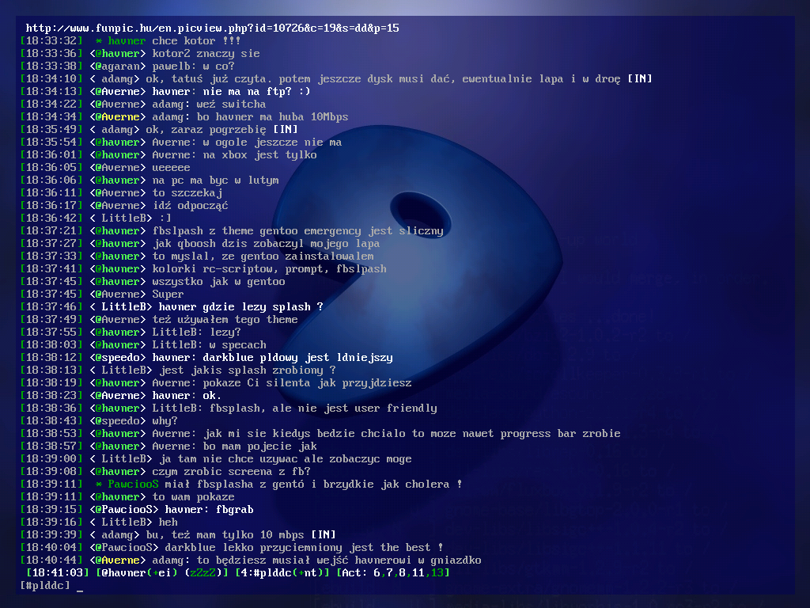
Internet Relay Chat (IRC)
is a form of real-time Internet chat or synchronous conferencing. It is mainly designed for group (many-to-many)‏
communication in discussion forums called channels, but also allows one-to-one communication and data transfers via private message.

Slide 9
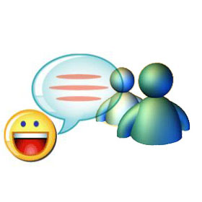
Instant messaging
is a form of real-time communication between two or more people based on typed text. The text is conveyed via computers connected over a network such as the Internet.
The most popular instant messaging program is MSN Messenger.

Slide 10
Short Message Service (SMS)
is a service available on most digital mobile phones, other mobile devices (Pocket PC, or occasionally even desktop computers) and some fixed phones, that permits the sending of short messages between mobile phones, other handheld devices and even landline telephones.

Slide 11
Electronic mail
is a store and forward method of composing, sending, storing, and receiving messages over electronic communication systems.

Slide 12
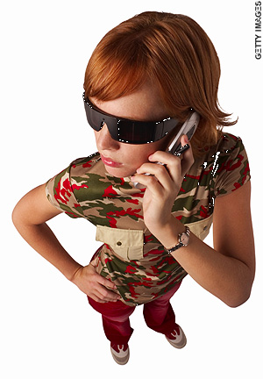
Telephone
is a telecommunications device which is used to transmit and receive sound (most commonly voice and speech) across distance.
They allows almost any phone user to communicate with almost any other.

Slide 13
Smart mobbing
It is effective many-to-many communication and social networking

