Slide 1
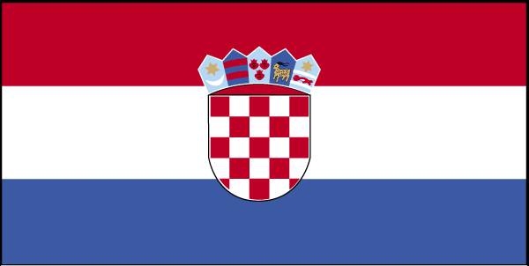
CROATIA

Slide 2
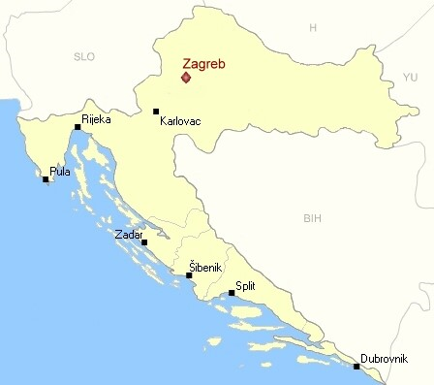
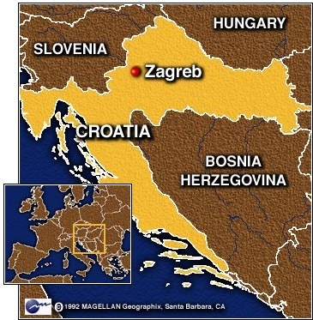
This country lies in central and southeastern Europe. It’s capital city is Zagreb. It is large as two Slovenia and a half. Sea side has many islands.

Slide 3
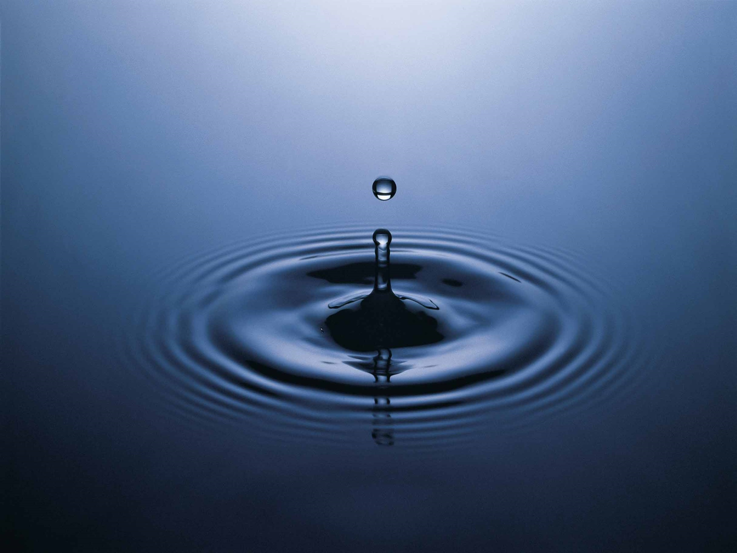
There are wonderful mountains like Velebit, Papuk, Učka and the highest Dinara. The longest river is Vrana Lake. There are also other Rivers like Krka and Plitviška River.

Slide 4
The flag is red, white and blue. In the middle of the flag is crest. Crest is red and white like chessboard. On crest are five little pictures. Croatian money is kuna and lipa. Croatians speak Croatian.

Slide 6
This anthem wrote Antun Mihanovića.
LIJEPA NAŠA
Lijepa naša domo
Oj junačka zemljo mila,
Stare slave djedovino,
da bi vazda sretna bila!
Mila, kano si nam slavna,
Mila si nam ti jedina.
Mila, kuda si nam ravna,
Mila, kuda si planina!
Teci Dravo, Savo teci,
Nit' ti Dunav silu gubi,
Sinje more svijetu reci,
Da svoj narod Hrvat ljubi.
Dok mu njive sunce grije,
Dok mu hrašće bura vije,
Dok mu mrtve grobak krije,
Dok mu živo srce bije!

Slide 7
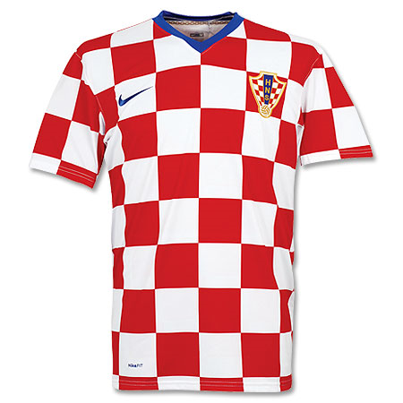
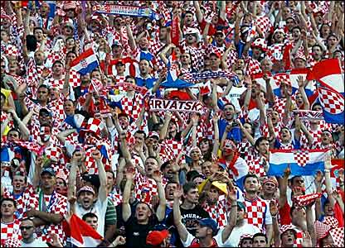
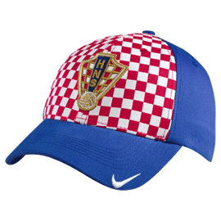

Slide 8
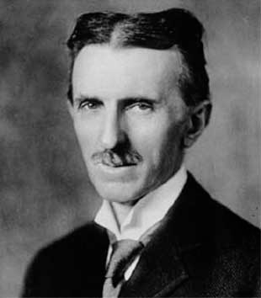
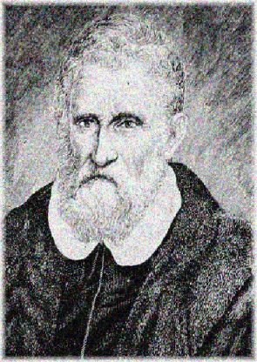
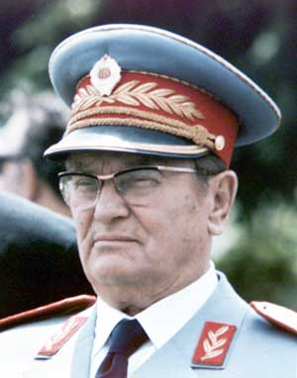
Around the sea there are many of same and well buildings. Famous people are Josip Broz Tito, Marco Polo and Nikola Tesla. Croatians sport is hiking and water sports. They have fun in casino and night club.
NIKOLA TESLA MARCO POLO JOSIP BROZ TITO

Slide 9
THANK YOU FOR LISTENING

