Slide 1
CUBA

Slide 2
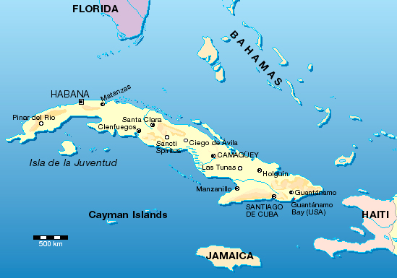
This is the map of Cuba!

Slide 3

This is the flag of Cuba.

Slide 4
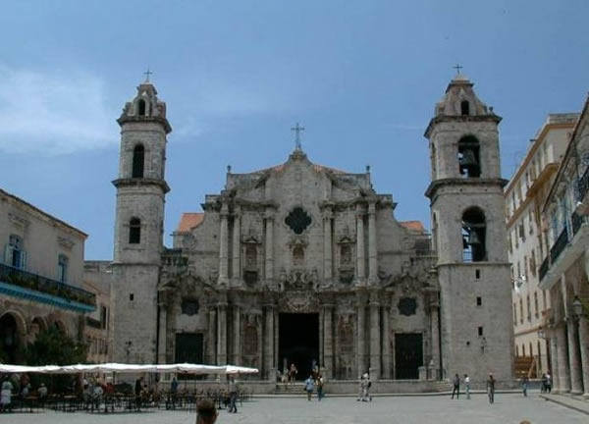
Cuba is a country in the Caribbean see.
Capitl an the largest city is
Havana .

Slide 5
Country is made of one big island and many smoller island.
It is near the Unite States, Mexico,Haiti, Jamaica and the Bahamas.
People from Cuba are colled Cubans, and they speak spanish.

Slide 6
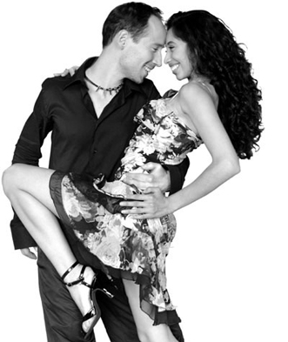
Cuba is famous for its many types of music. Special is the dance music lake salsa and mamba.

Slide 7
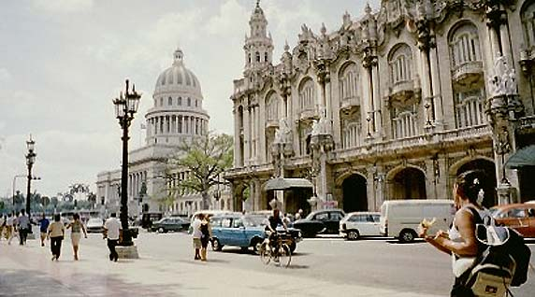
Because Cubans come from Spain, Afica, South America and North America, is Cubans music special and different.

Slide 8
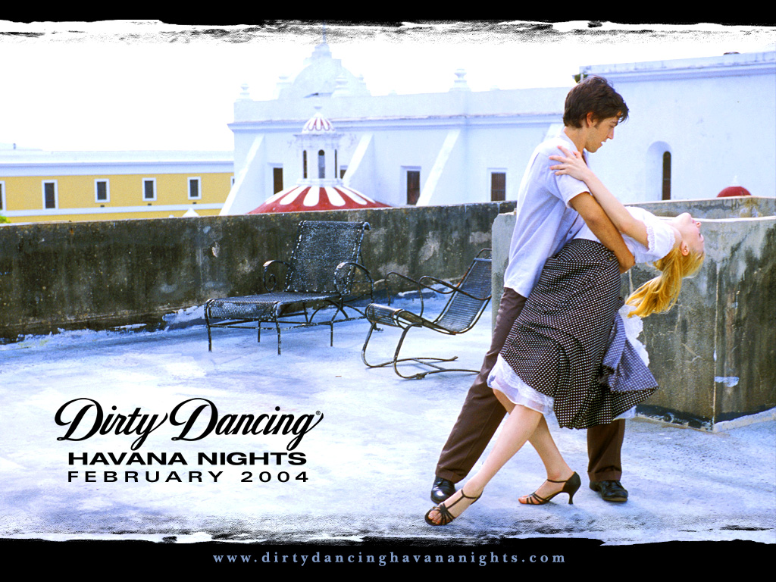
Havana night

Slide 9
This film was filmed on Cuba in 2004.
Player Diego Luna was born in Cuba.
Film speaks about true life on Cuba.
Kuba is known as very poor contry, this is showed on film.

Slide 10
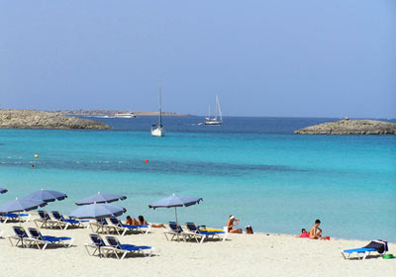
Kuba has very beautiful beaches.

Slide 11
I hope that I will visit Kuba someday.
The end!! ☺

