Slide 1
D-day 6. 6. 1944 ¸

Slide 2
Operaton OVERLORD
General Eisenhower as Supreme Allied Commander
Enter the Continent of Europe and the destruction of her armed
forces undertake
operations aimed at
the heart of Germany
Original codename:
"Operation Roundup"

Slide 3
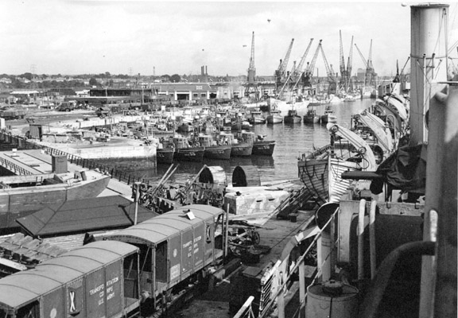
Britain as an army camp
3.5 million soldiers, sailors and airmen
Airforce: 13,000 aircraft, 3,500 gliders
Navy: 1,200 fighting ships,1,600 merchant
ships and 4,000
assault craft

Slide 4
Normandy
Five landing beaches, covering a distance of 40 miles
The Americans: Omaha (Pointe de Hoc), Utah,
The British: Gold, Sword
The Canadians: Juno

Slide 5
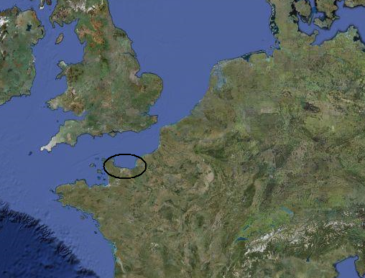

Slide 6
Erwin Rommel
Given command of Army Group B
Opinion that the invasion site would be at the Pas de Calais → Atlantic Wall
Obstacles constructed on the beaches the full length of the Normandy coast
"IT WILL BE THE LONGEST DAY"

Slide 7
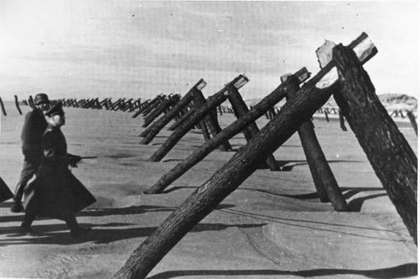
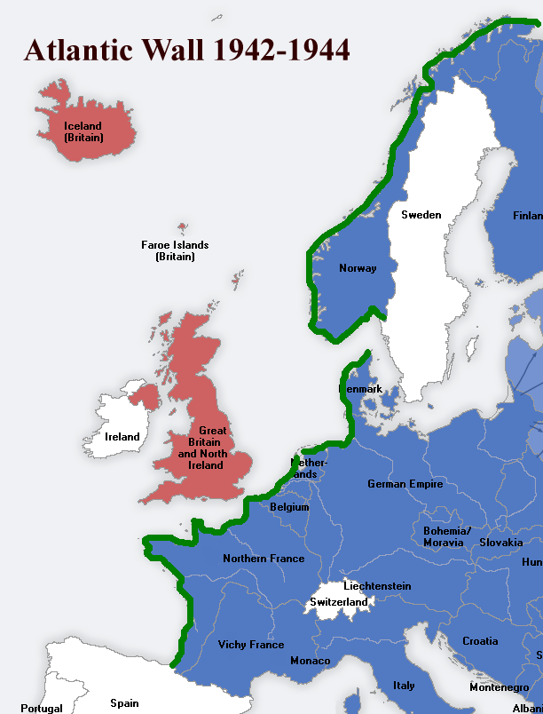
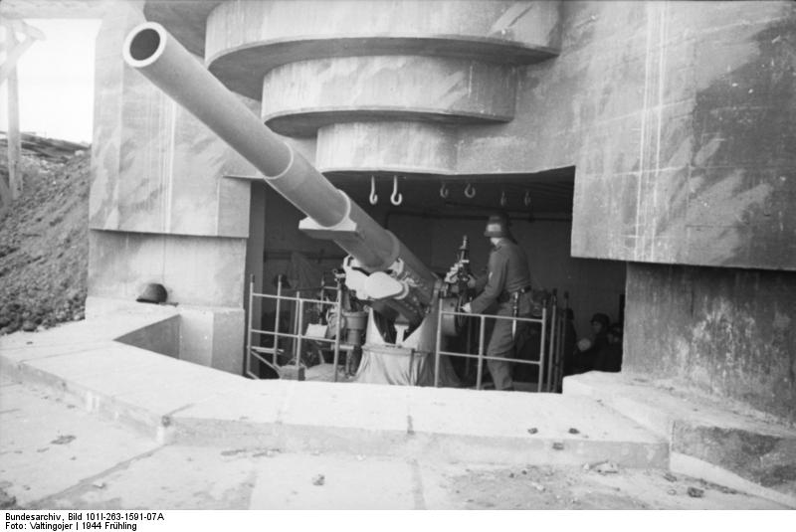
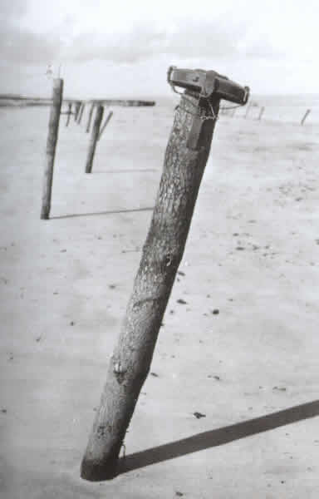

Slide 8
British Airborne
Objective of securing the eastern flank of the British, French and Canadian landing beaches
The Pathfinders first drop on the landing zones to guide other to the correct locations
Only 50% were landed on the correct landing zones

Slide 9
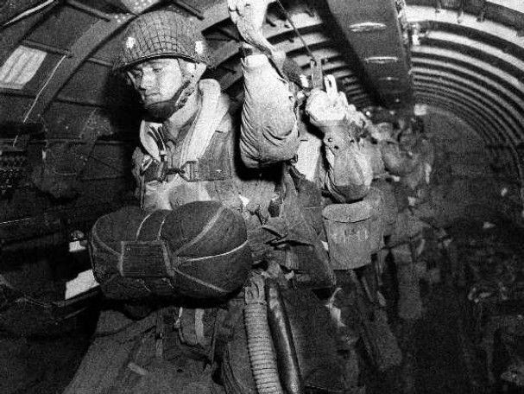
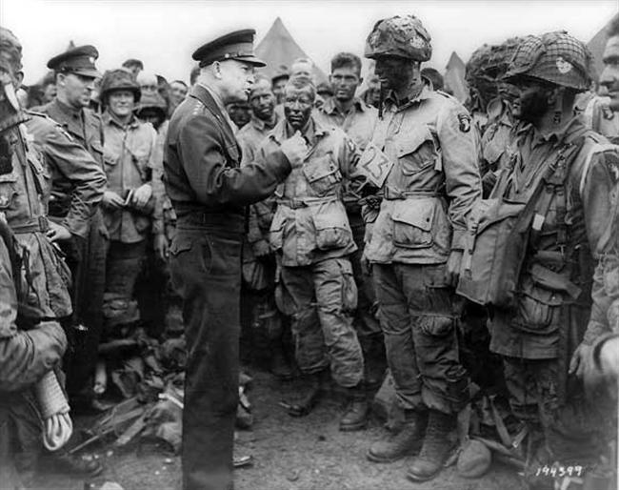
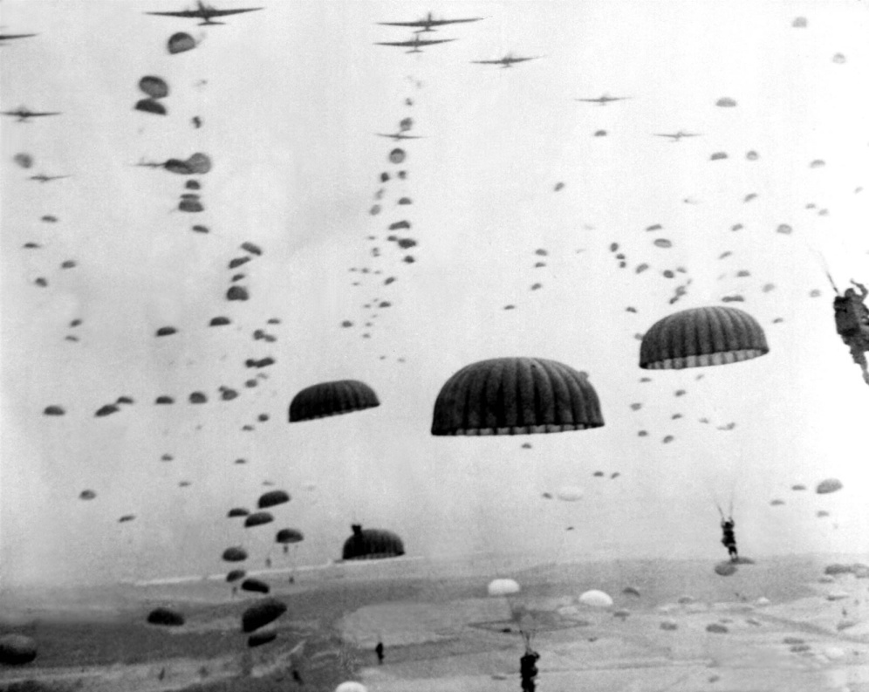

Slide 10
Omaha beach (Bloody Omaha)
German defenders at full strength
The American troops expected only minimal opposition
First wave was completely overhelmed
Rangers helped to relieve the situation
Casualties between 2,000 – 3,000 men

Slide 12
Utah beach
The losses were the smallest
The first wave: 20 landing crafts of the type's LCVP (Landing Craft Vehicle Personnel)
The second wave: 32 LCVP's, including engineers
The third wave: 8 LCT's with armored vehicles
The fourth wave: mainly detachments

Slide 13
The Pointe de Hoc
U.S. Ranger battalion
30 meter high cliffs
The target: concrete cliff battery
At the end of the 2-day action there were 90 men who could still fight (initial force had 225)

Slide 15
Casualties and losses
Allies: about 120,000
Germany: about 115,000

Slide 16
