Slide 1
DANISH CUISINE
OŠ Mirna Peč
Trg 8
8216 Mirna Peč

Slide 2
In past
Danish was known as station of farmers and fishermans
food is still reflecting culture of hardworking people
was containing lots of energy, wich they neded

Slide 3
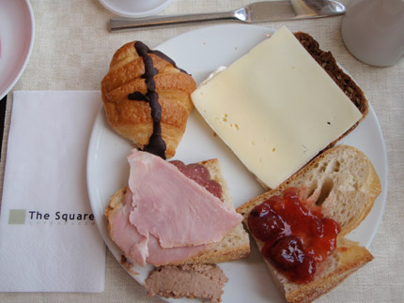
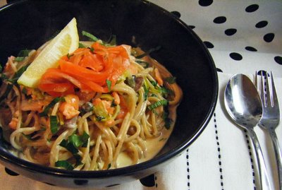
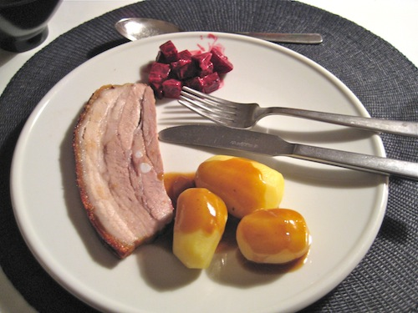
Three main meals of the day:
breakfast
lunch
dinner

Slide 4
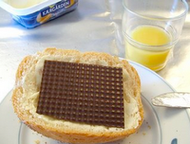
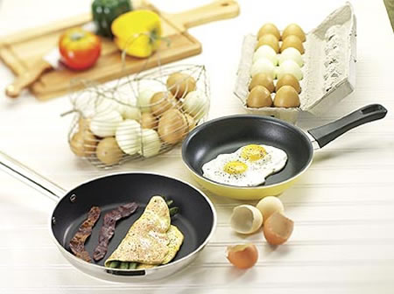
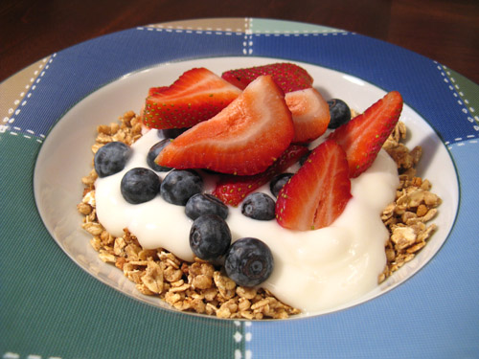
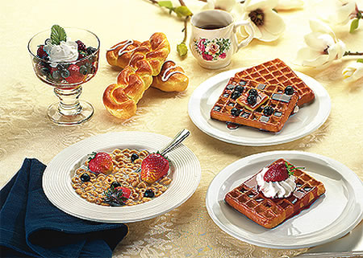
Typical breakfast
Adults: coffe or tea and bread with jam or cheese
Children: milk products with cereals; corn flakes, muesli...
Sunday breakfast: fresh bread, boiled eggs and juice, tea or coffee

Slide 5
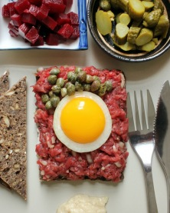
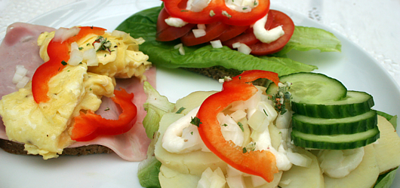
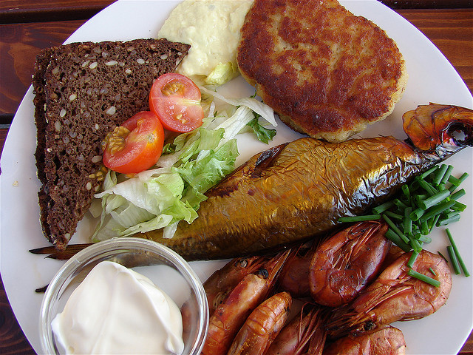
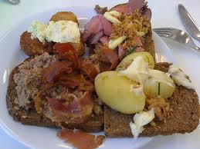
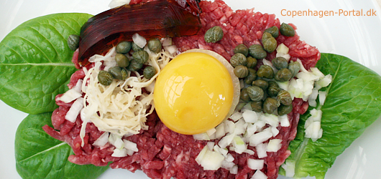
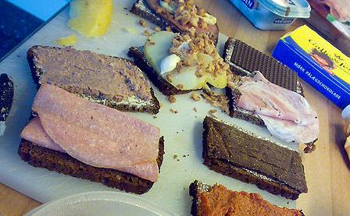
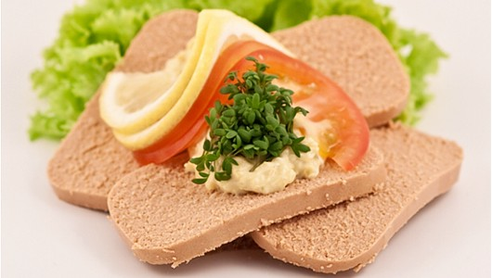
Typical lunch
Ordinary eaten elswhere
It can be bringed from home, from school kitchen or canteens
offering hot meals or open sendwiches

Slide 6
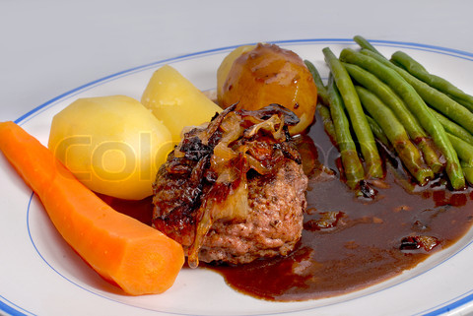
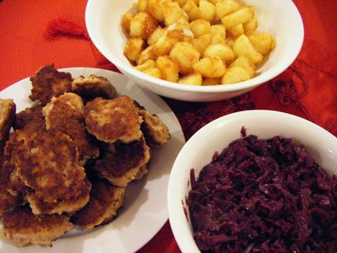
Typical dinner
Only meal when family can be together
Meat; fish or chicken with potatoes, rice or pasta in all kinds of preparing

Slide 7
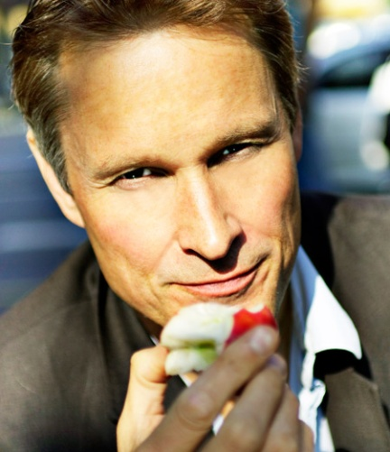
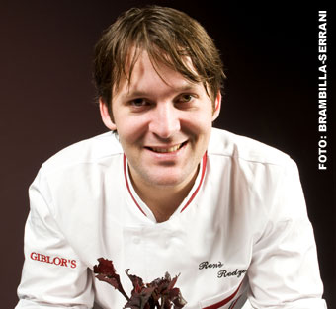
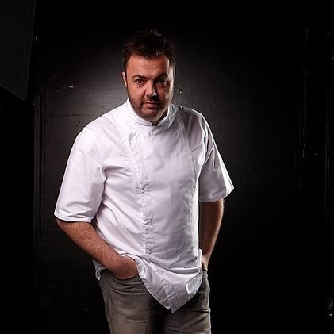
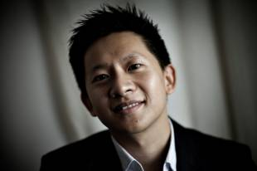
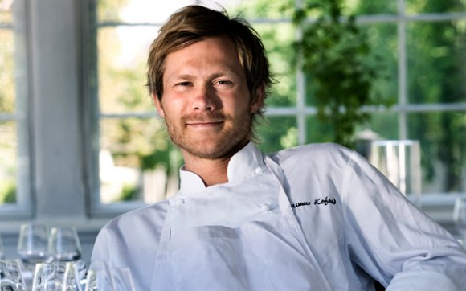
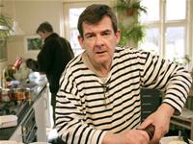
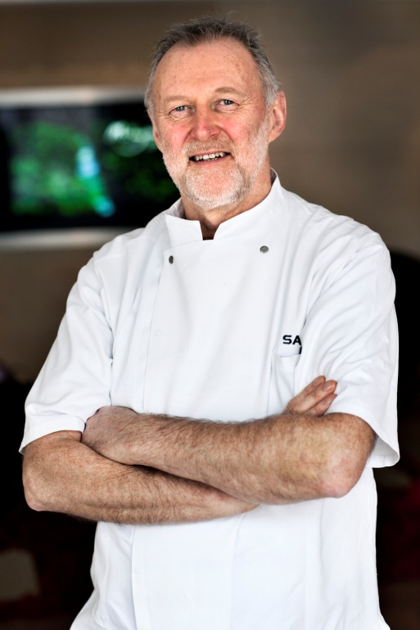
Chefs form Denmark
Claus Meyer,
Rene Redzepi,
Lertchai Treetawatchaiwong,
Søren Gericke,
Bo Bech,
Rasmus Kofoed,
Erwin Lauterbach

Slide 8
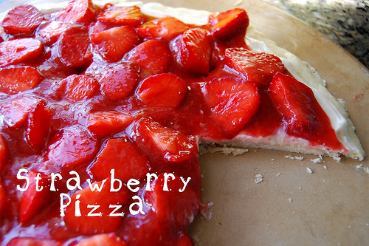
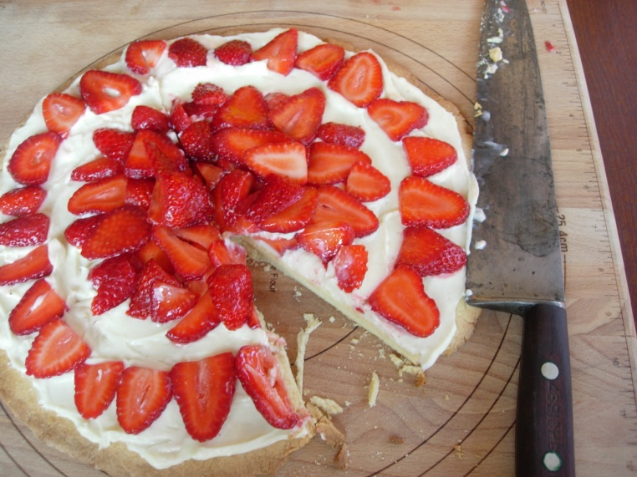
Strawberry pizza
Ingrediens:
1 cup flour
1/2 cup sugar
1/2 cup butter
1 package cream cheese, softened
1/2 cup white sugar
2 1/2 cups strawberries
1/2 package strawberry Danish dessert mix
1 cup water

Slide 9
Sources
http://allrecipes.com/recipe/strawberry-pizza/detail.aspx
http://www.denmark.dk/en/menu/Lifestyle/Food+and+Drink/Danish-Food-Culture/
http://en.wikipedia.org/wiki/Danish_cuisine
http://www.copenhagenet.dk/cph-eating.htm
http://www.denmark-getaway.com/danish-food.html

