Slide 1
DEFORESTATION

Slide 2
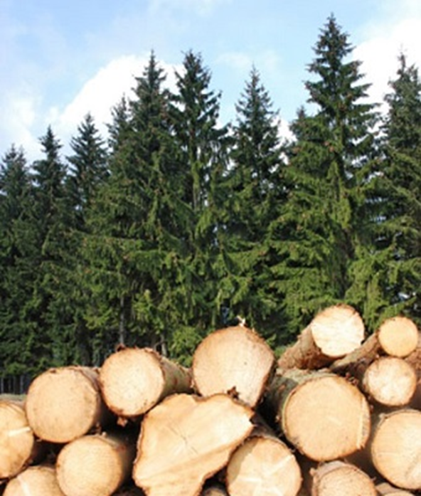
What is deforestation?
Process where by natural burning, either to use the growing woods or to replace for alternative uses.
Either- bodisi

Slide 3
What is the extent of deforestation?
12-15 million hectares of forest are lost each year.
36 football fields per minute.
2,000 trees per minute are cut down in the rainforests.
This is worrying and very serious.

Slide 4
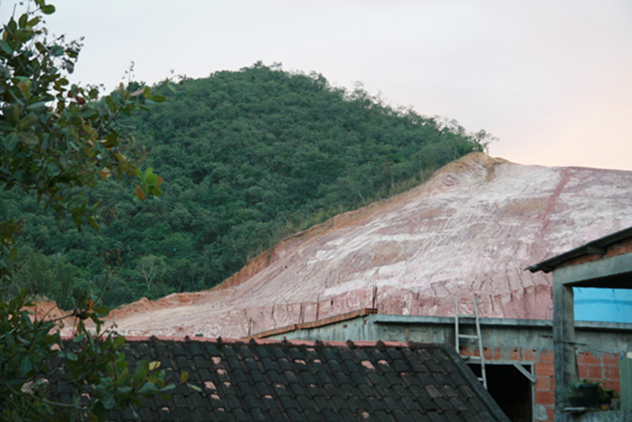
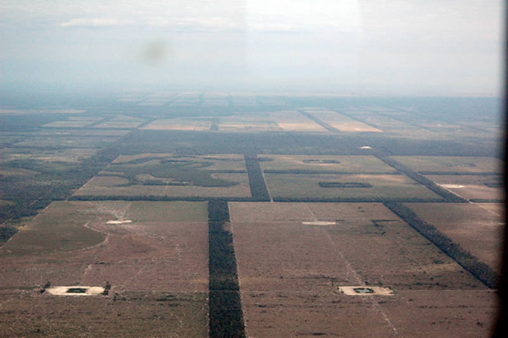
How to stop deforestation?
? recycle a ton of paper can help save 17 trees .
buy products that are made from recycled materials like:
-paper, tissues, cups
-reuse paper bags
-think before printing
-plant trees

Slide 5
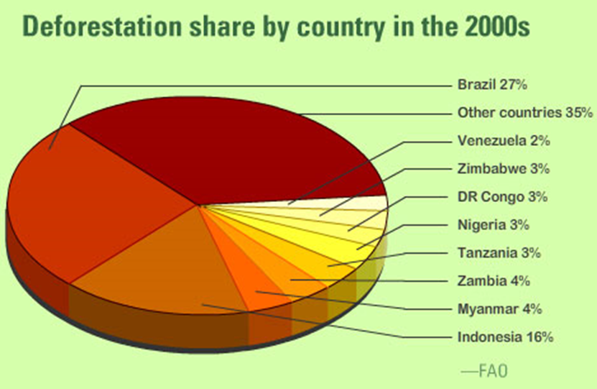

Slide 6
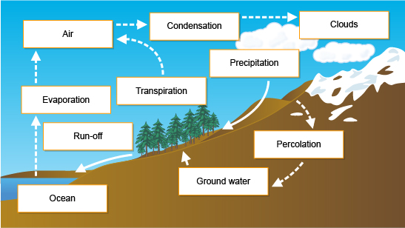
What are the effects of deforestation?
Soil erosion destruction
Water Cycle
Loss of Biodiversity
Climate Changes

Slide 7
Why do humans clear forest lands?
Trees are cut down (deforestation) for many reasons including:
-to be used, sold or exported
-to be used for farming purposes (farming activities)
-urbanization (these include making space for shelter, industries and roads)
Shelter-zavetišče
Purposes-namene

Slide 8
Thank‘s for your attention!

