Slide 1
DIABETES
Srednja zdravstvena šola Izola

Slide 2
What is Diabetes?
Diabetes mellitus is a group of metabolic diseases
•Diabetes is a chronic condition
associated with abnormally high levels of sugar (glucose) in the blood.

Slide 3
What is glucose?
Is a simple sugar found in food.
is an essential nutrient that provides energy for the proper functioning of the body cells

Slide 4
What is insulin?
-Insulin is a hormone that is produced by specialized cells (beta cells) of the pancreas.
Insulin helps glucose enter the cells, insulin is also important in tightly regulating the level of glucose in the blood

Slide 5
What causes diabetes?
inability of cells to use insulin properly and efficiently.
( This is the primary problem in type 2 )
Problem in type 1
Insufficient production of insulin (either absolutely or relative to the body's needs),

Slide 6
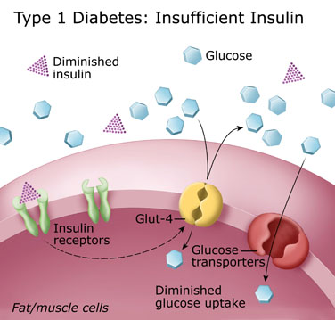
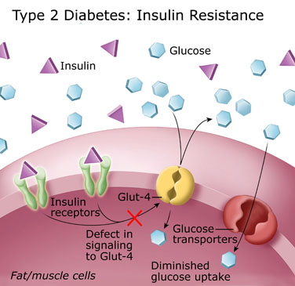
DIABETES TYPE 1
DIABETES TYPE 2

Slide 7
There are two types of diabetes:
DIABETES TYPE I
DIABETES TYPE 2

Slide 8
DIABETES TYPE 1
•Type 1 diabetes is usually recognized in childhood or early adolescence,
often in association with an illness (such as a virus or urinary tract infection) or injury.

Slide 9
Symptoms:
polyuria (frequent urination),
polydipsia (increased thirst) and
polyphagia (increased hunger).

Slide 10
DIABETES TYPE 2
Type 2 diabetes is the most common form of diabetes.Affects older
In type 2 diabetes, either the body does not produce enough insulin or the cells ignore the insulin

Slide 11
Symptoms:
•high amounts of glucose in the urine, which leads to dehydration and causes increased thirst and water consumption;
•weight loss despite an increase in appetite;
•fatigue;
•nausea;
•vomiting;
•bladder, skin, and vaginal infections;
•blurred vision; and

Slide 12
DIAGNOSIS:
•Diabetes is diagnosed by blood sugar (glucose) testing.
Normal values:
3,5 mmol/l – 5,6 mmol/l

Slide 13
Deviation from normal values:
Hypoglycemia:
Is the medical term for a state produced by a lower than normal level of blood glucose.
Hyperglycemia:
Hyperglycemia, or high blood sugar, is a condition in which an excessive amount of glucose circulates in the blood plasma.

Slide 14
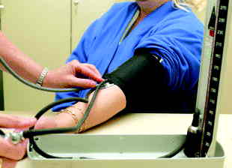
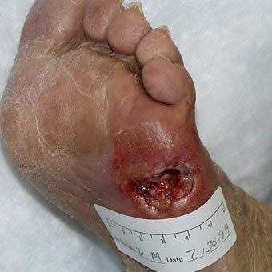
Complications of diabetes are acute and chronic:
ACUTE:
dangerously elevated blood sugar, abnormally low blood sugar due to diabetes medications may occur.
CHRONIC:
disease of the blood vessels (both small and large) which can damage the eye, kidneys, nerves, and heart may occur

