Slide 1
DISABLED PEOPLE AND SOCIETY Disabled people – treated as less human?

Slide 2
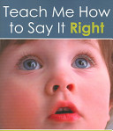
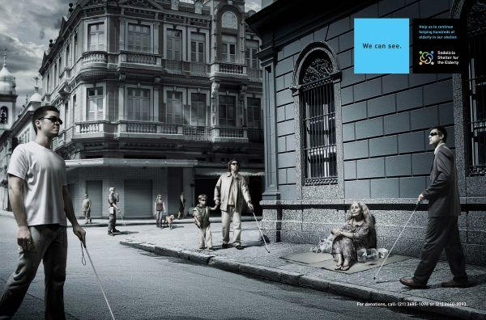
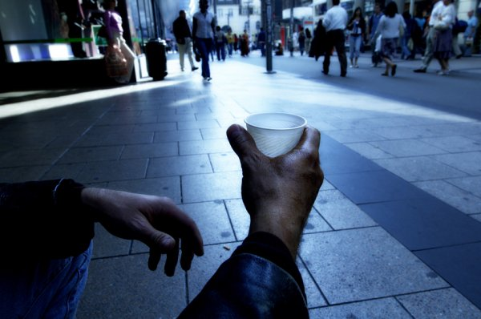
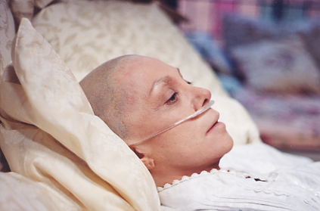
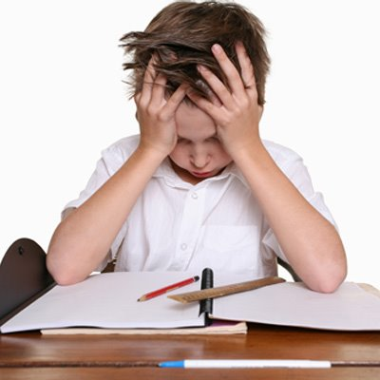
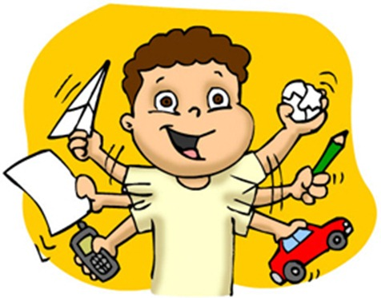
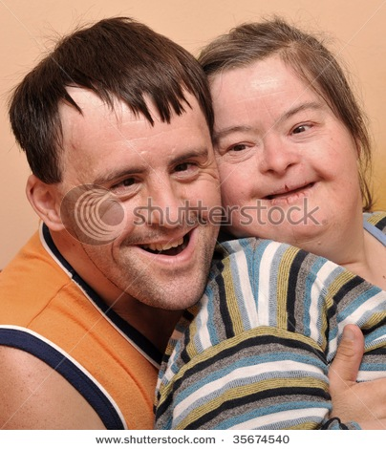
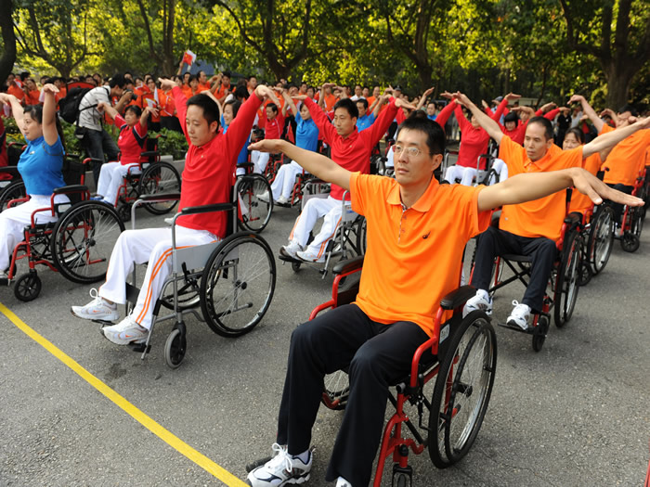
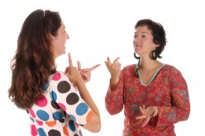
Disabled people
People with long-term physical, cognitive, mental, sensory, emotional or developmental impairments, which in interaction with various barriers may hinder their full and effective participation in society

Slide 3
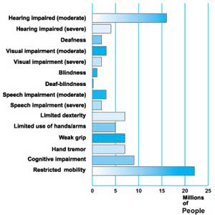
Disabled people in numbers
European Union:
More than 45 million citizens (16 - 64)
Every 6th person
World:
600 million people
10% of the world’s population
Slovenia:
About 8% of Slovenians

Slide 4
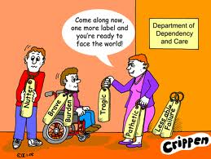
Prejudice
Stereotypes:
“ugly and mean”
“everlasting children, whose parents are extremely brave”
Discomfort, embarrassment, pity, compassion, guilt, a wish of running away
Delphine Siegrist: “Idiot and superwoman”

Slide 5
Prejudice
Denying that the disabled people are able to choose for themselves, are able to think for themselves
Inappropriate reactions
e.g. refusing to look at a disabled person’s face, staring at a disabled person’s face, running away, mocking, pitying ...
“The parents are guilty”

Slide 6
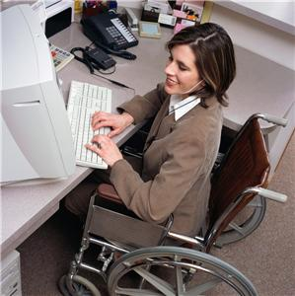
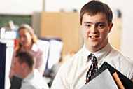
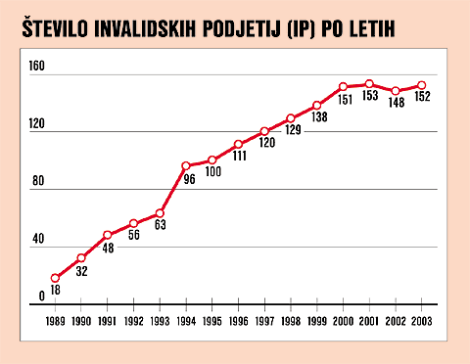
Employment of disabled people
Almost 80% of all disabled people are unemployed
Companies for the disabled people
In Slovenia: about 170 such companies

Slide 7
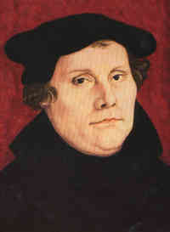
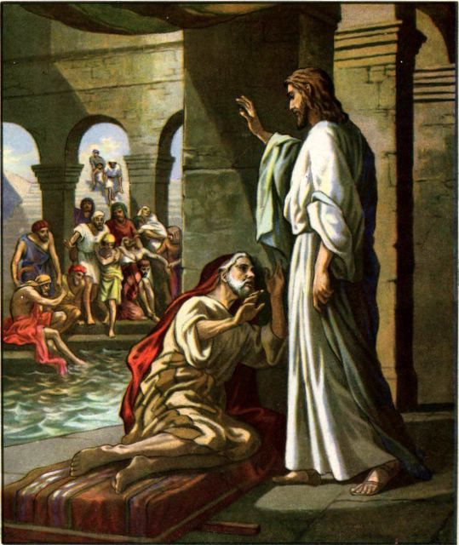
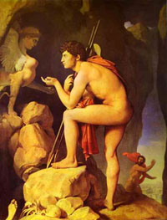
A brief history of our attitude towards disabled people
The Bible:
Cronic illnesses sin
A disability a test and God’s punishment
Jesus
Ancient Greece:
Disabilities expressions of gods’ anger
The Middle Ages:
Disabled people – guilty for the plague
Martin Luther

Slide 8
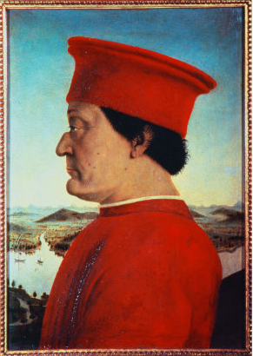
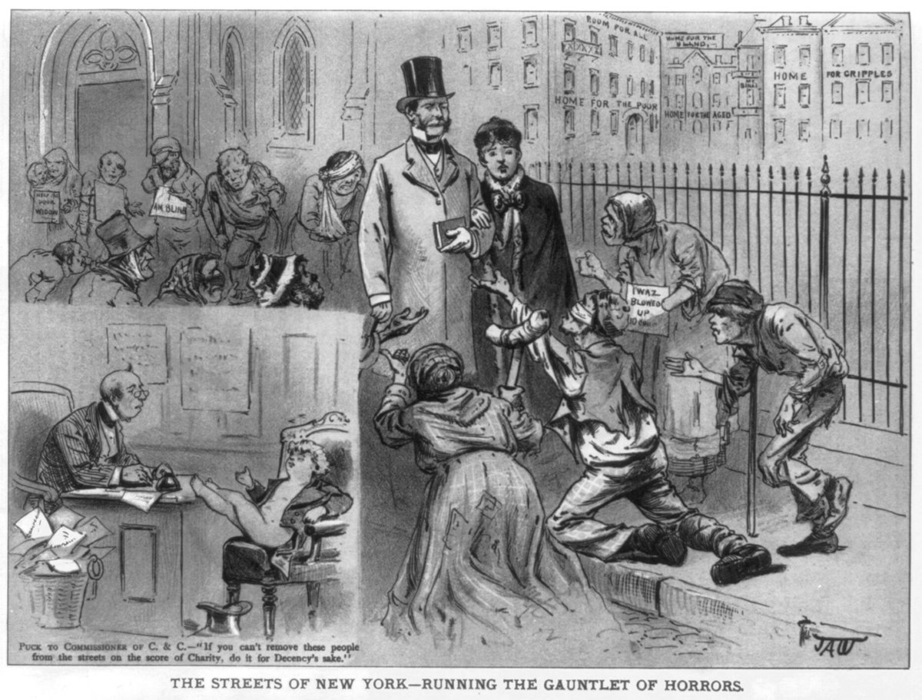
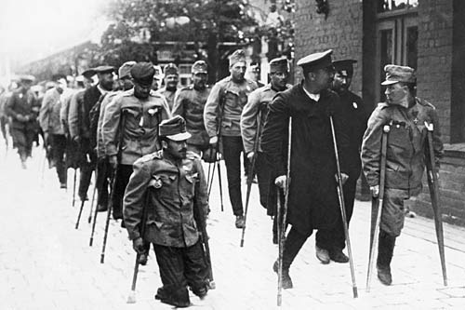
A brief history of our attitude towards disabled people
The Renaissance:
“Disabilities do not exist”
19th century:
The concepts of heredity and infectivity emerged
“Ugly law”
Institutions for disabled people
Mothers hid their disabled children
Disabled people - an attraction at fairs

Slide 9
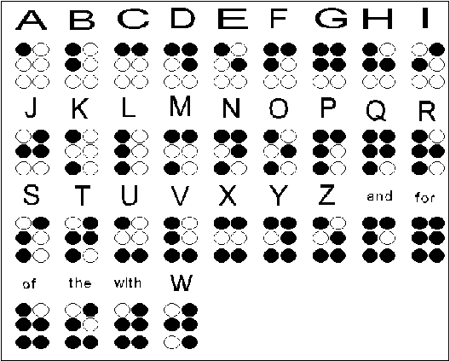
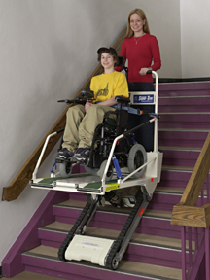
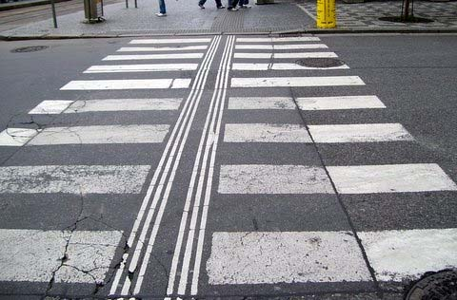
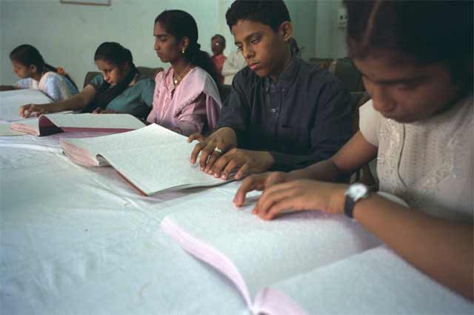
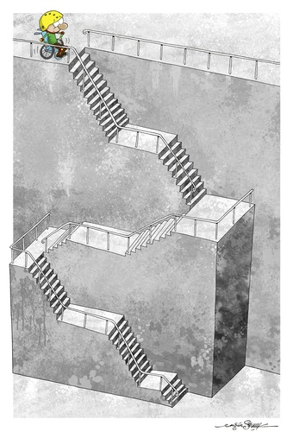
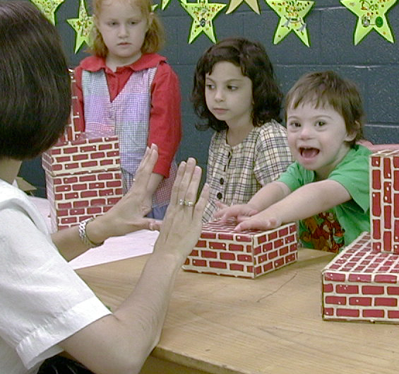
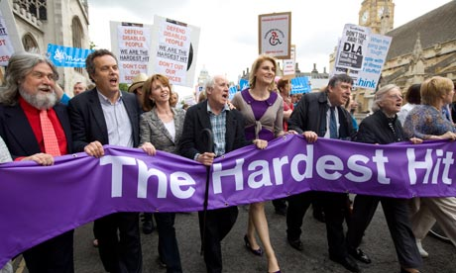
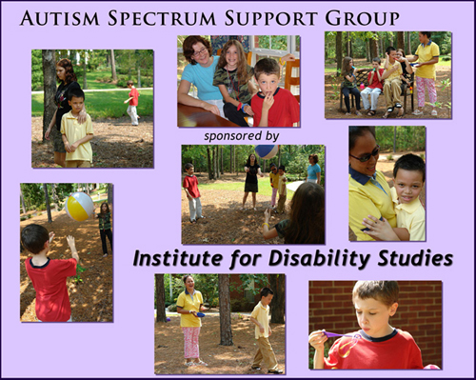
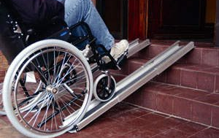
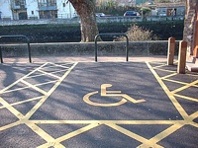
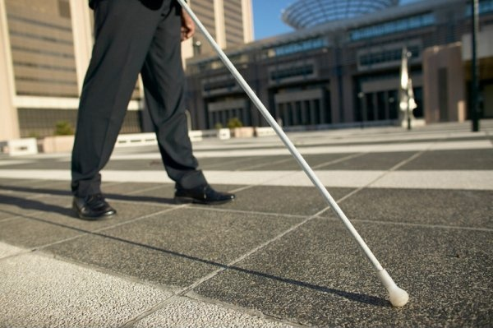
Nowadays
Incouraging against discrimination
Technological improvements
e.g. braille, canes and a special leading system for the blind, special parking spaces, ramps and special elevators for wheelchair users ...
Offering disabled children a special educational support

Slide 10
Sources
Statistični urad Republike Slovenije: Invalidi, starejše in druge osebe s posebnimi potrebami v Sloveniji
Pauline RESTOUX: Življenje z drugačnim otrokom
Andreja KRIVIC: Čutim, vidim, zmorem ...
http://en.wikipedia.org/wiki/Disability
http://www.bfi.org.uk/education/teaching/disability/thinking/

