Slide 1
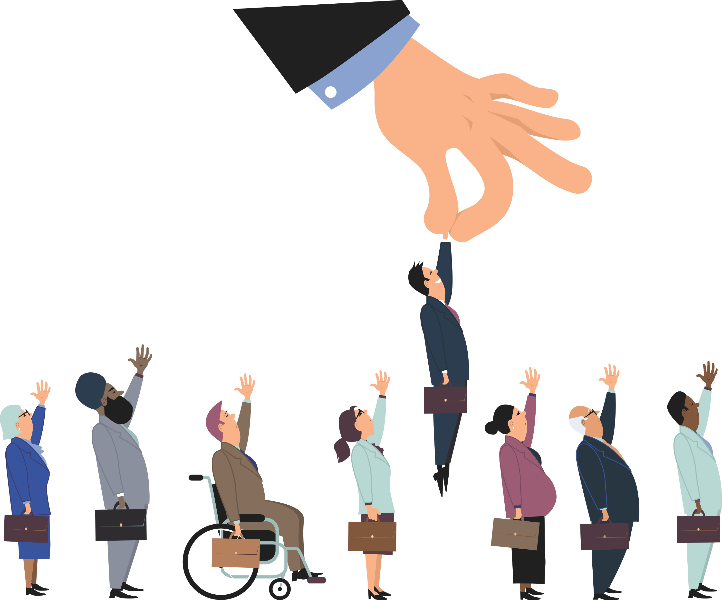
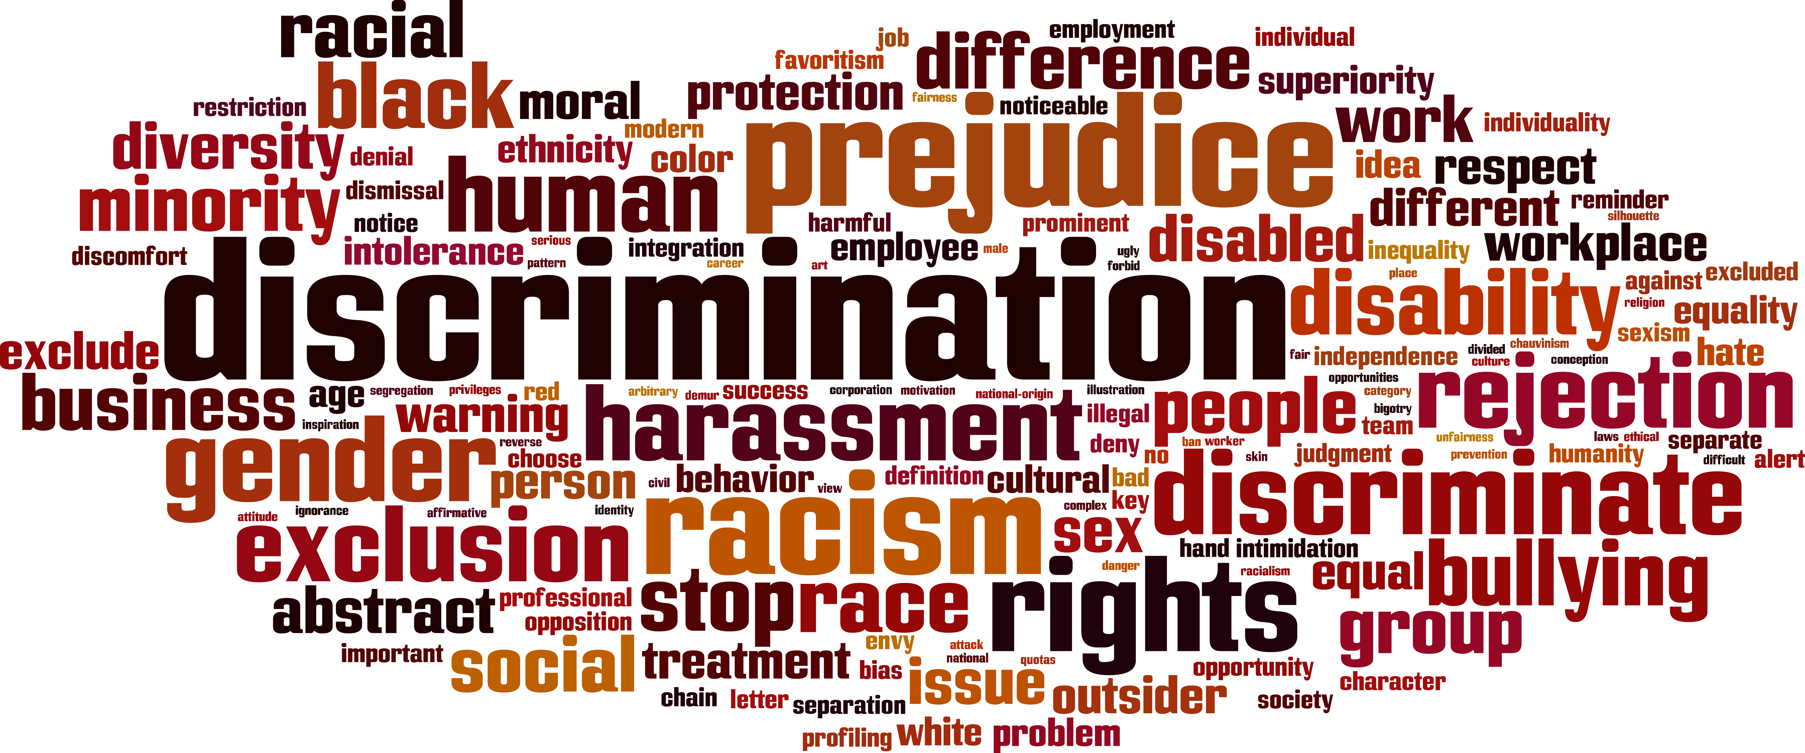
DISCRIMINATION
Slika 2
Slika 1

Slide 2
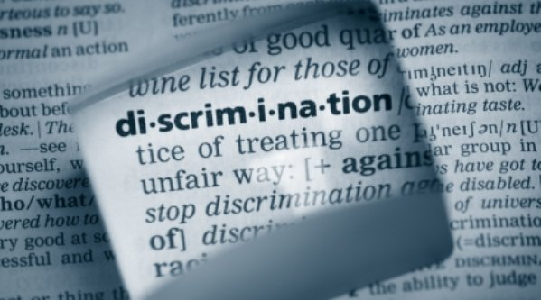
WHAT IS DISCRIMINATION?
Injustice
Favouring
Slika 3

Slide 3
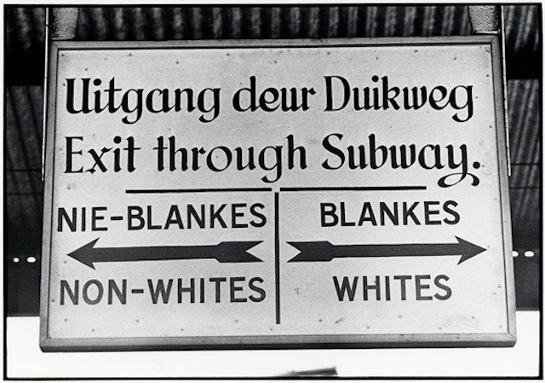
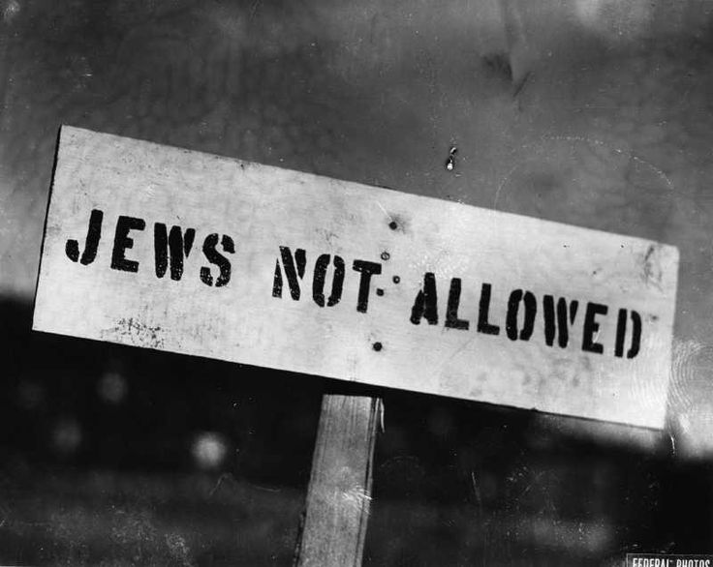
RACIAL AND ETHNIC DISCRIMINATION
Apartheid
Genocide
Slika 4
Slika 5

Slide 4
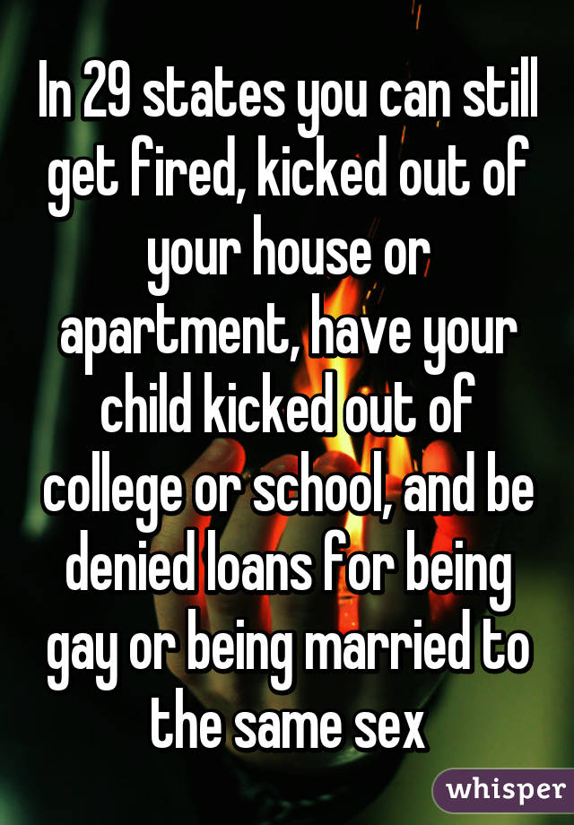
gENDER AND SEXUAL ORIENTATION
Direct, indirect
Glass celling, sticky floor
Slika 6
Slika 7

Slide 5
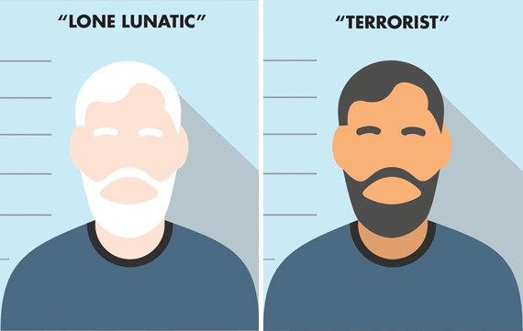
RELIGION
Muslim people
Illegal (religion + race)
Language, nationality, disability…
Slika 8

Slide 6
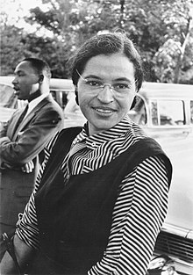
Rosa Parks
Mahatma Ghandi
Nelson Manndela
Martin Luther King Jr.
Dalai Lama
February 4th 1913
Divorced parents, racially unfair
Stood up to a bus driver
October 24th 2005
https://youtu.be/OjUfQFyqyf8
Slika 9

Slide 7
DISCRIMINATION TODAY
Wage gaps, security checks, homeless shelters
Change
Slika 10

Slide 8
sources
Slika 1: http://latinalista.com/columns/blogbeat-columns/will-airbnbs-policy-to-fight-discrimination-backfire
Slika 2: https://practiceindex.co.uk/gp/blog/recruitment/avoiding-discrimination-in-recruitment/
Slika 3: http://www.nj.com/opinion/index.ssf/2015/04/opinion_when_it_comes_to_inheritance_tax_--_new_je.html
Slika 4: http://conservativepapers.com/news/2015/12/24/israel-and-apartheid-in-the-middle-east-part-2/
Slika 5: https://mfi-miami.com/2016/07/bigot-andrew-buck-pmp/
Slika 6: http://www.bohmlaw.com/areas/gender-discrimination/
Slika 7: http://whisper.sh/whisper/05197195a0db578992239bc0e4feb4dafceb6b/In-29-states-you-can-still-get-fired-kicked-out-of-your-house-or-apart
Slika 8: https://www.thestranger.com/features/feature/2015/12/09/23243178/when-a-mass-killer-is-a-white-christian-hes-a-lone-lunatic-but-when-hes-muslim-he-represents-all-muslims
Slika 9: https://en.wikipedia.org/wiki/Rosa_Parks
Slika 10: https://backthelight.wordpress.com/2014/01/16/stop-discrimination/
Rosa Parks. (b.d.) Pridobljeno 28.1.2018, iz http://www.history.com/topics/black-history/rosa-parks
Examples of discrimination in society today. (b.d.) Pridobljeno 28.1.2018, iz https://www.khanacademy.org/test-prep/mcat/individuals-and-society/discrimination/a/examples-of-discrimination-in-society-today
8 great heroes of human rights. (1.12.2017) . Pridobljeno 28.1.2018, iz https://www.mnn.com/earth-matters/politics/stories/8-great-heroes-of-human-rights
Types of discrimination – workplace. (b.d.). Pridobljeno 25.1.2018, iz https://www.humanrightscommission.vic.gov.au/the-workplace/workplace-discrimination/type-of-discrimination
Disability discrimination (julij 2017). Pridobljeno 25.1.2018, iz https://www.mind.org.uk/information-support/legal-rights/disability-discrimination/types-of-discrimination/#direct
Attacks on LGBT people surge almost 80% in UK over last four years. (6.9.2017). Pridobljeno 27.1.2018, iz http://www.independent.co.uk/news/uk/home-news/gay-lgbt-hate-crimes-stats-rise-four-year-physical-verbal-homophobic-abuse-community-a7933126.html

