Slide 1
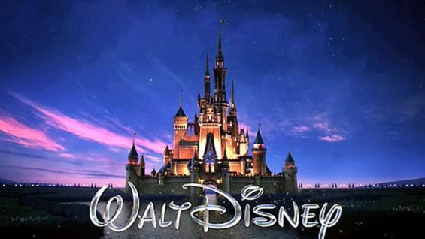

Slide 2
Walt Disney´s life
He was born 5. December, 1901 in Hermosa, Chicago.
He died 15. December, 1966 in Burbang, California.
He had 2 kids – Diane Marie Disney and Sharon Mae Disney.

Slide 3
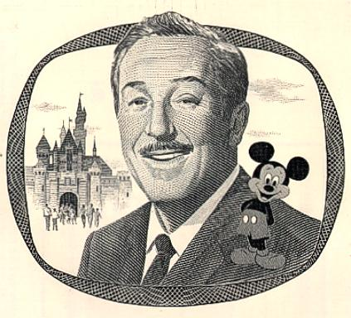
Walt Disney´s occupations
Film producer,
director,
screenwriter,
voice actor,
animator,
entrepreneur,
entertainer,
international icon and
philanthropist.

Slide 4
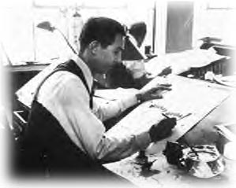
Walt Disney´s animation career
He becamed famous with short movies named Laugh - O Gram´s.
When he moved to Hollywood he succed with Alice Comedies.

Slide 5
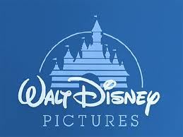
Walt Disney Pictures
Along with his brother Walt was a co-founder.
Later becamed the best known motion picture production´s
Now known as Walt Disney World.

Slide 6
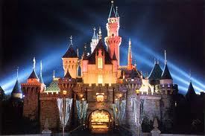
Is named after Walt Disney
The first one was oppened 17th July 1955
It was build exactly by the plans of Walt Disney.
Later they oppened
Disneylands in: Tokio,
Paris, Hong Kong and
Florida.

Slide 7
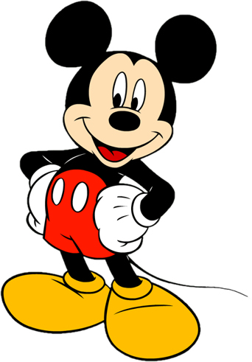
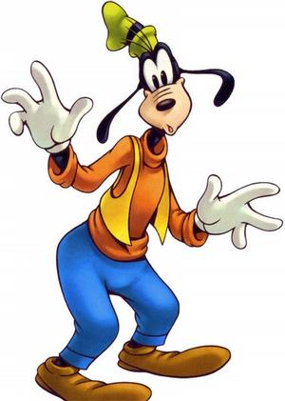
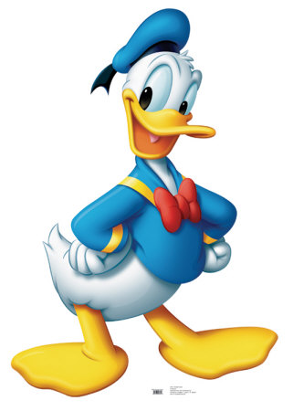
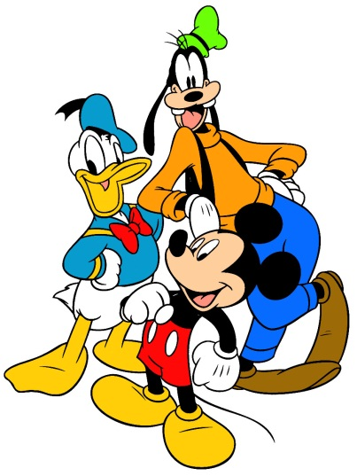
His most famous characters
Mickey Mouse,
Donald Duck and
Goofy Goof.
Mickey mouse
Goofy Goof
Donald duck

Slide 8
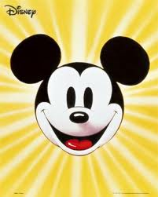
Mickey Mouse
It is Walt Disneys most famous character
Created in 1928
His first name was Oswald the Lucky Rabbit, his second name was Steamboath Willie and than he was renamed in Mickey Mouse.

Slide 9
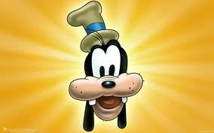
Goofy Goof
Walt Disney´s second most famous character,
Created in 1932
First name was: Mickey´s Revue

Slide 10
Donald Duck
His third most famous character
Created in 1934
First name was: The Wise Little Hen

Slide 11
Walt Disney´s works
Magazine Mickey Mouse
Animated Snow White and the seven Dwarfs, Pinocchio, Fantasia, Dumbo, Bambi and more than 100 other movies.

Slide 12
Walt Disney´s awards
4 honorary Academy Awards,
22 Academy Awards,
7 Emmy awards and
59 nominations.

Slide 13
Viri:
Internet:
-http://www.justdisney.com/walt_disney/
-http://en.wikipedia.org/wiki/Walt_Disney
Knjige:
-Film - Ronald Bergan;
-Svetovna zgodovina filma – Kristen Thompson, David Bordwell;
-Film - David Parkinson

