Slide 1
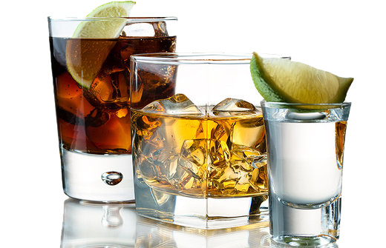
DISTILLATION OF SPIRITS

Slide 2
Contents
Pre-distillation procedures
Distillation equipment
Distillation of spirits

Slide 3
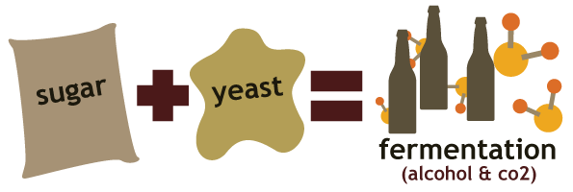
Distillation prodcedures
From the field to the fermentation process
Fermentation
Distillation of the fermented mixture
Picture 1: Fermentation process

Slide 4
Distillation equipment
Simple pot
Condenser joint – swan‘s neck
Condenser
Output joint or tank

Slide 5
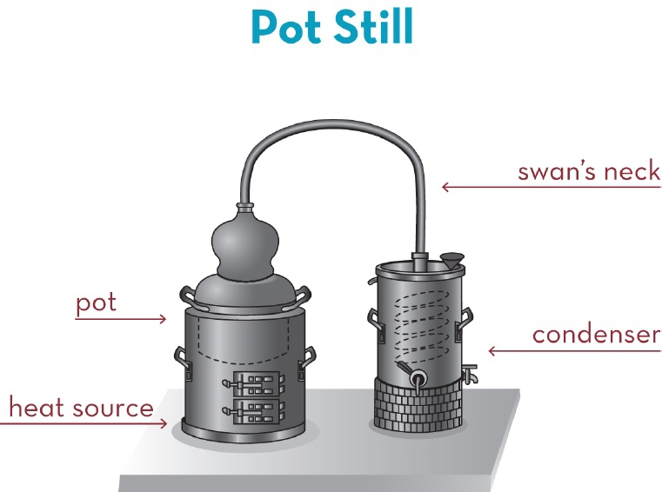
Distillation equipment
Picture 2: Distillation equipment of a simple spirit distillation apparatus

Slide 6
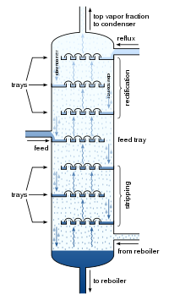
Distillation equipment
Modern advanced distillation column
Reflux & fractional distillation

Slide 7
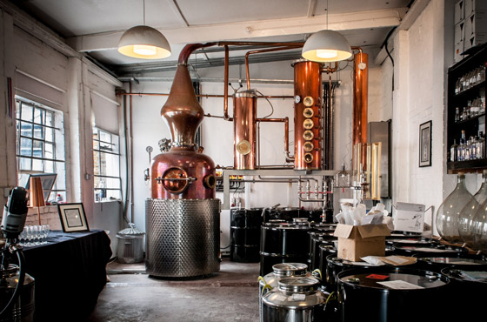
Distillation equipment
Picture 1: Modern small vodka distillation column

Slide 8
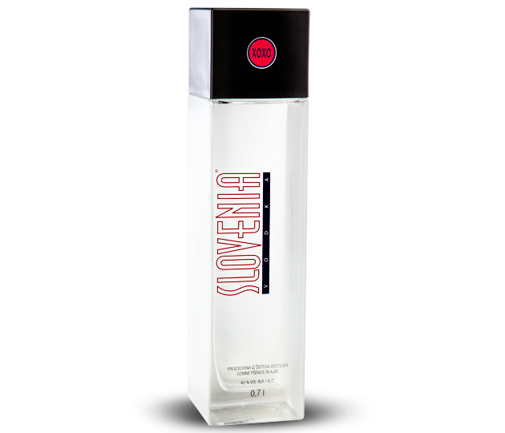
Distillation of spirits
Whisky or whiskey
Vodka
Rum
Schnapps
Slivovica or Slivovka
Picture 1: Slovenia vodka

Slide 9
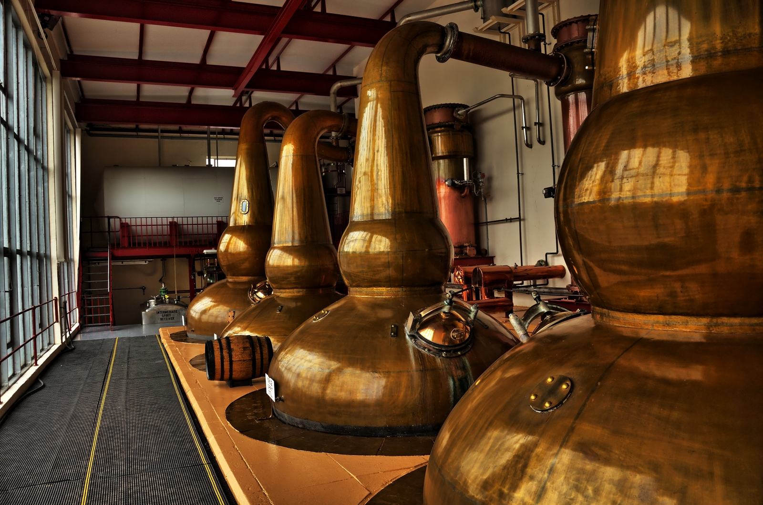
Distillation of spirits
Picture 6: Whisky distillery

Slide 10
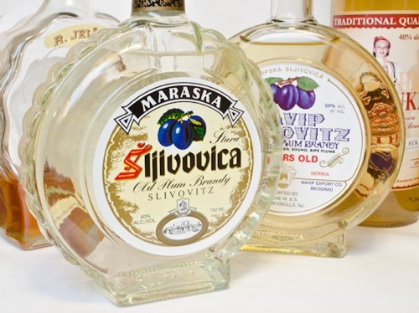
Distillation of spirits
Picture 7: Slivovka

Slide 11
Summary
Pre-distillation process
Distillation equipment
Distillation of spirits

Slide 12
Sources
https://en.wikipedia.org/wiki/Distilled_beverage
https://en.wikipedia.org/wiki/Alcoholic_beverage
https://en.wikipedia.org/wiki/Distillation
https://en.wikipedia.org/wiki/Fermentation
https://en.wikipedia.org/wiki/Alcohol
http://blog.beeriety.com/wp-content/uploads/fermented.png
http://www.whiskyintelligence.com/wp-content/uploads/2012/12/aa179.jpg
http://liquor.s3.amazonaws.com/wp-content/uploads/2014/07/Stolichnaya-80.jpg

Slide 13
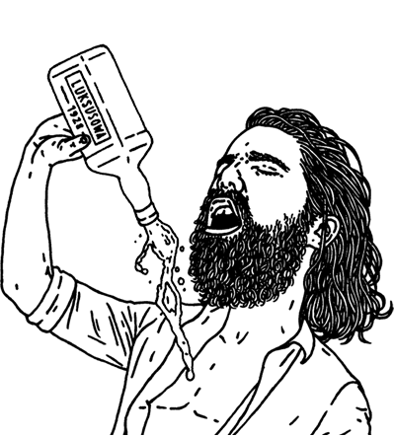
Thank you!

