Slide 1
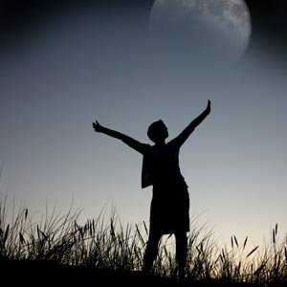
DREAMS

Slide 2
Do you know that we sometimes have more than 5 different dreams in the night and the shortest can be just 2 seconds long? I am really interested in the meaning of dreams, so I’ve decided to present you some interesting facts about dreaming.

Slide 3
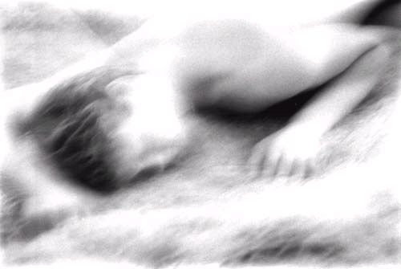
We often don’t remember our dreams and that show us that we had a great sleep. But sometimes we remember all the scary details; we are even so scared that we don’t want sleep back.

Slide 4
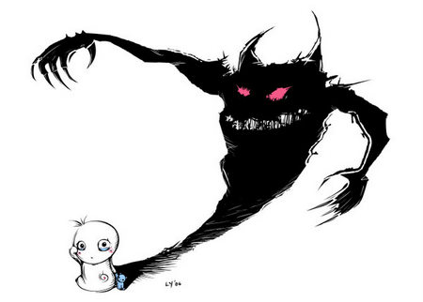
Some experts think that we should keep a diary of our dreams. That would help us to find the meaning, say goodbye to our biggest fears and maybe even see in the future. Experts get even so far that they invented ‘DreamLight’. That’s a mask worn over your eyes, and when you start to dream it recognizes your eye movements and a light inside the mask starts to flash. You became aware of your dreaming.

Slide 5
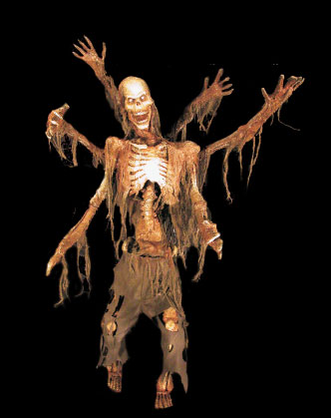
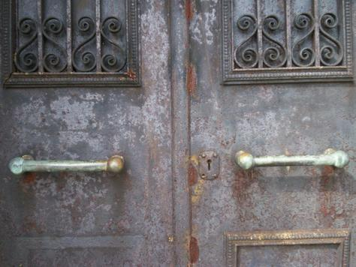
The dreams that appear the most often are: locked doors, blocked passageways, river you can’t swim, disappearing teeth and hair, weakness in your body, flying and escaping from a dangerous man. This dreams mean a wish to escape and a fear of growing old.

Slide 6
Do you sometimes feel tired when you wake up? Experts think that after bad dreams, which are important for our lives, we often feel tired, without happiness and we would like to sleep back.

Slide 7
We have many books that describe us what do dreams mean, but often we don’t find our dreams in it. So I think we should all keep a diary and find the meaning of our dreams!

Slide 8
Let’s go dreaming!

