Slide 1
DREAMS

Slide 2
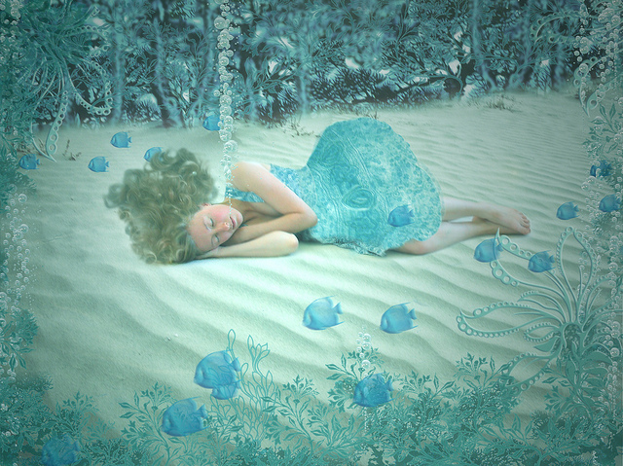
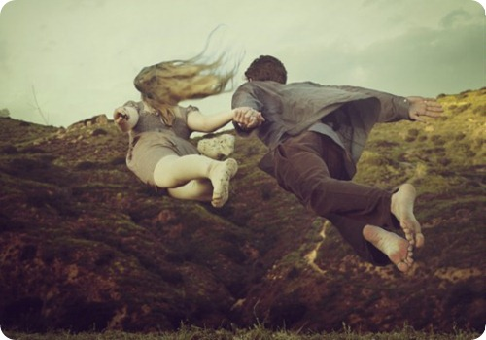
WHAT DO WE DREAM ABOUT?
Our brain take pieces of memories and put them together into a dream
Most dreams don‘t make any sense
We can fly, jump off a building, or breathe under water

Slide 3
SUPERSTITIONS
Deep meaning or pile of thoughts
Some people believe dreams can predict the future
It was once thought if a person was falling in a dream and hit the ground, they would die This is not true

Slide 4
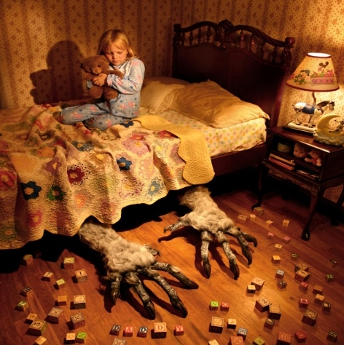
NIGHTMARES
ADVICE:
Say "Hey! Get out of here and leave me alone! This is MY dream and I'm waking up now!" It may just work for you!
For good dreams: While falling asleep, start thinking about a happy situation.
Caused by stress, traumatic events or worries
Everyone has nightmares.

Slide 5
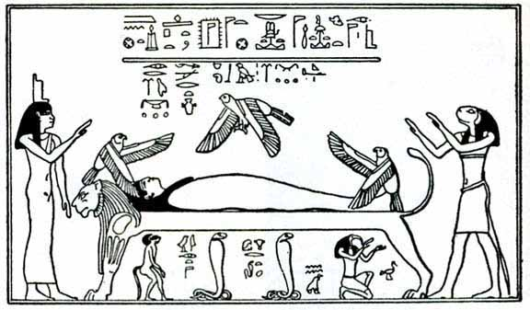
THE BIGINING OF DREAMS
Ancient Egyptian Theories
Supernatural world.
Messages from the gods sent as an early warning device.
Egyptians were the first dreamers
They published a book

Slide 6
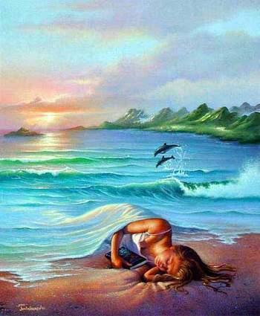
LUCID DREAMING
Dreams in which the person is aware of everything that he does
Instructions :
-Lay on your back
-Arms at your side and eyes closed
-You must be awake
-Your brain will send signals: itchiness, changing your body position...
-Ignore all of these impulses
-After that you can open your eyes and you will start hallucinating.

Slide 7
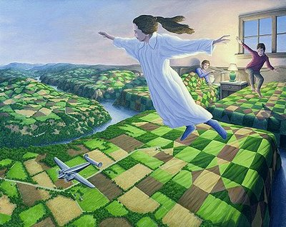
INTERESTING FACTS:

Slide 8
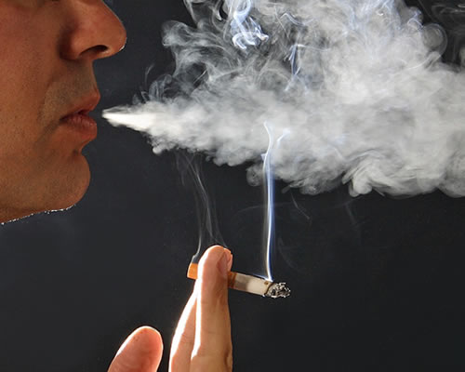
1. Smoke quitters have more vivid dreams
Among 293 smokers who quitted, 33% reported having at least 1 dream about vivid smoking.
In most dreams, subjects caught themselves smoking and felt panic and guilt

Slide 9
2. Not everyone dreams in color
13% of people dream in black and white
It’s unknown why
Scientist think that the color is dependent of our emotions
People who dream in black and white are more violent than others

Slide 10
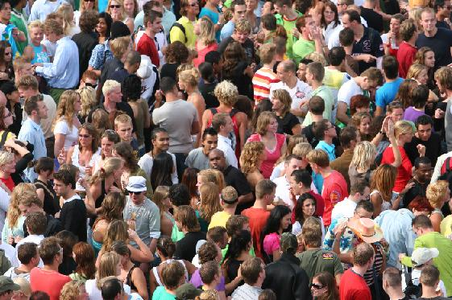
3. We only dream of what we know
Our dreams are full of complete strangers.
Example:
-If you saw a person you could still have a dream about him although you can’t even remember his face.
In our dreams can also be items
Example:
-your dad’s old car can be your transport,
-oldest sister’s teddy bear could chase your in dreams.

Slide 11
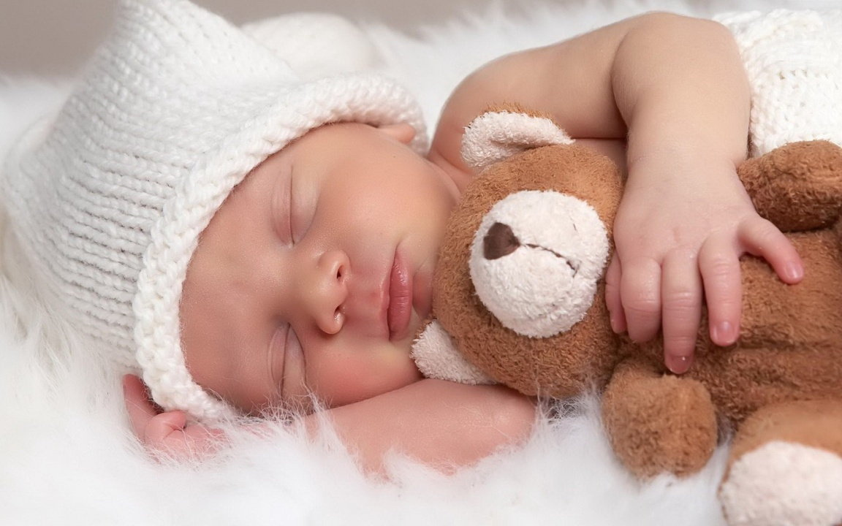
4. Everybody dreams
Every human being dreams, even babies
Man and women have different dreams and reactions
Men dream more about other men
Women tend to dream equally about men and women

Slide 12
5. Blind people dream
Blind People
After birth: can see images in their dreams
Born blind: don’t see any images, but have equally amount of involving their other senses and emotions

Slide 13
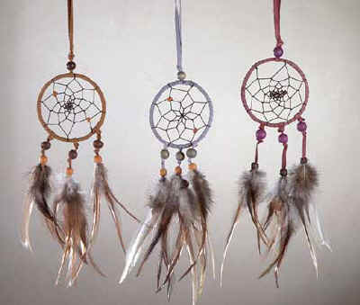
DREAMCATCHERS
Native American cultures believe in catching their bad dreams with a handmade amulet
Willow hoop, on which is woven a loose web.
The dreamcatcher is then decorated with personal items such as feathers and beads.

