Slide 1
Drug addiction

Slide 2
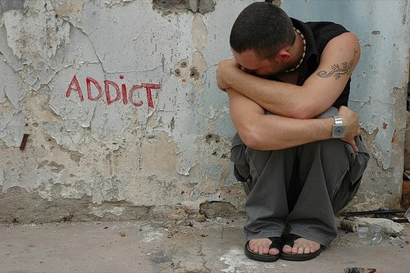
What is an addiction?
Psychological dependence
Compulsive need for a drug (craving)
Drug tolerance (need for increased amounts)
No power to stop
taking drugs
Important social
activities are given up

Slide 3
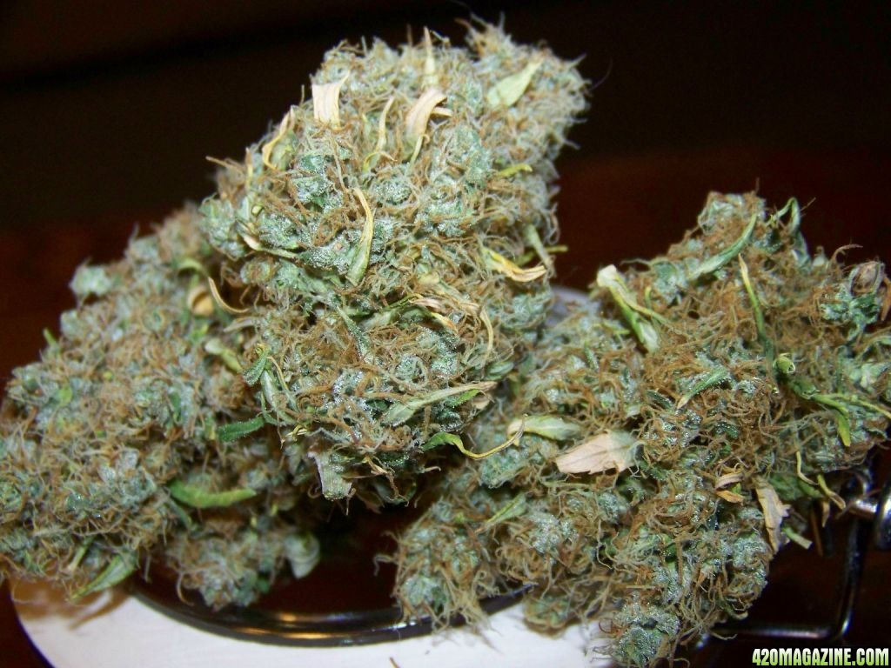
What are drugs?
Substances which have an psychedelic or narcotic effect
They are prohibited by law

Slide 4
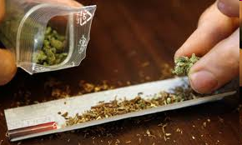
Drugs with narcotic effects
Cocaine, cannabis, heroin, opium

Slide 5
Drugs with psyhedelic effects
Meth, ecstasy, LSD

Slide 6
The addicts
http://video.nationalgeographic.com/video/national-geographic-channel/shows/drugs-inc/ngc-heroin-city/

Slide 7
Why are they so tempting?
Pleasurable and relaxing effect
Relieving tension
Euphoric effect
Oppurtunity to escape reality

Slide 8
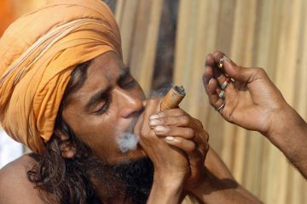
Causes of addiction
Fun, enjoyment, curiosity
To get rid of stress, family problems, miseries, failures, tension
Heighten sexual experience
Lack of parental care and control
Religious
approvals

Slide 9
Bad effects of drug addiction
Health problems
Poverty
Law violation
Reduction in economic production
Alienation

Slide 10
Measures to control addiction
De-addiction and rehabilitation programms
Psychotherapy

Slide 11
Questionnaire
Have you ever taken drugs?
Yes 37%
Have you ever taken drugs more than once?
Yes 13%
Would you say you are a drug addict?
No 100%

Slide 12
SOURCES
http://en.wikipedia.org/wiki/Substance_dependence
http://www.drugaddiction.net/
http://www.drugabuse.gov/publications/infofacts/understanding-drug-abuse-addiction
www.natgeo.com

