Slide 1
E
L
i
c
L
o
o
a
c
g
A
R
i
c
L
t
U
E
g
U
r

Slide 2
What is Ecological Agriculture?
Its definition is understood as an
agricultural system that is based on
ecological principles and applying
ecological practices to maintain soil
fertility, to manage crop and animal
health, and to keep soil and water in a
good condition.

Slide 3
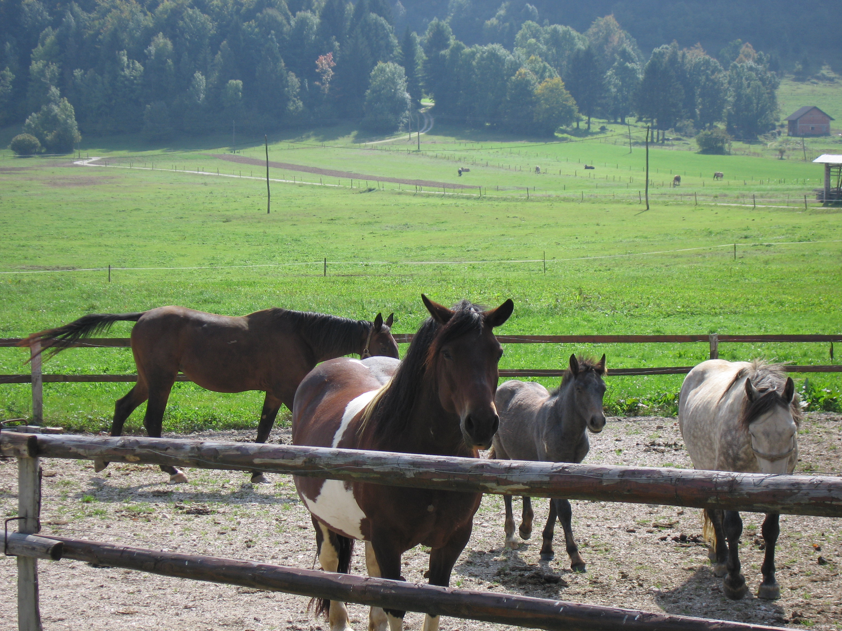

Slide 4
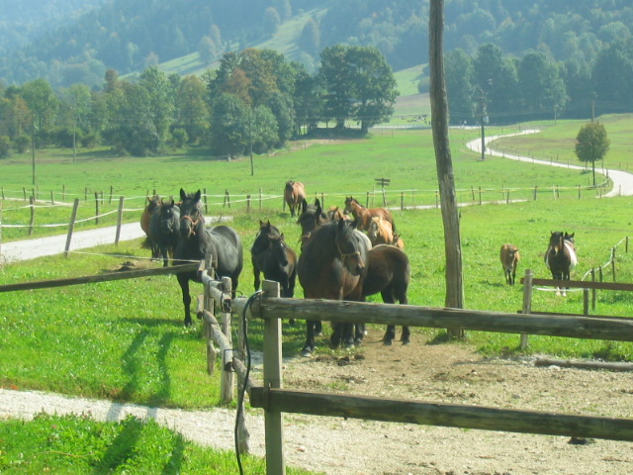

Slide 5
Agriculture in Slovenia
Slovenia has an agricultural area of 785,000 h. (1998), 38.7 total area.
The agricultural sector accounts for 6% of total employment.
late 1980s, early 1990s, garden plot holders started an organic gardening movement.
1991, people interested in bio-dynamic farming formed a club.

Slide 6
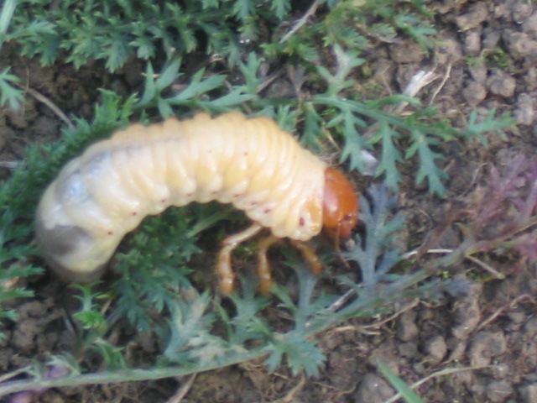

Slide 7
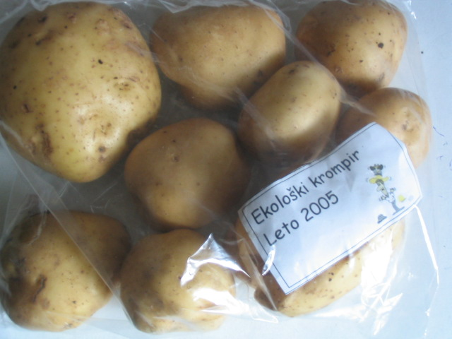

Slide 8
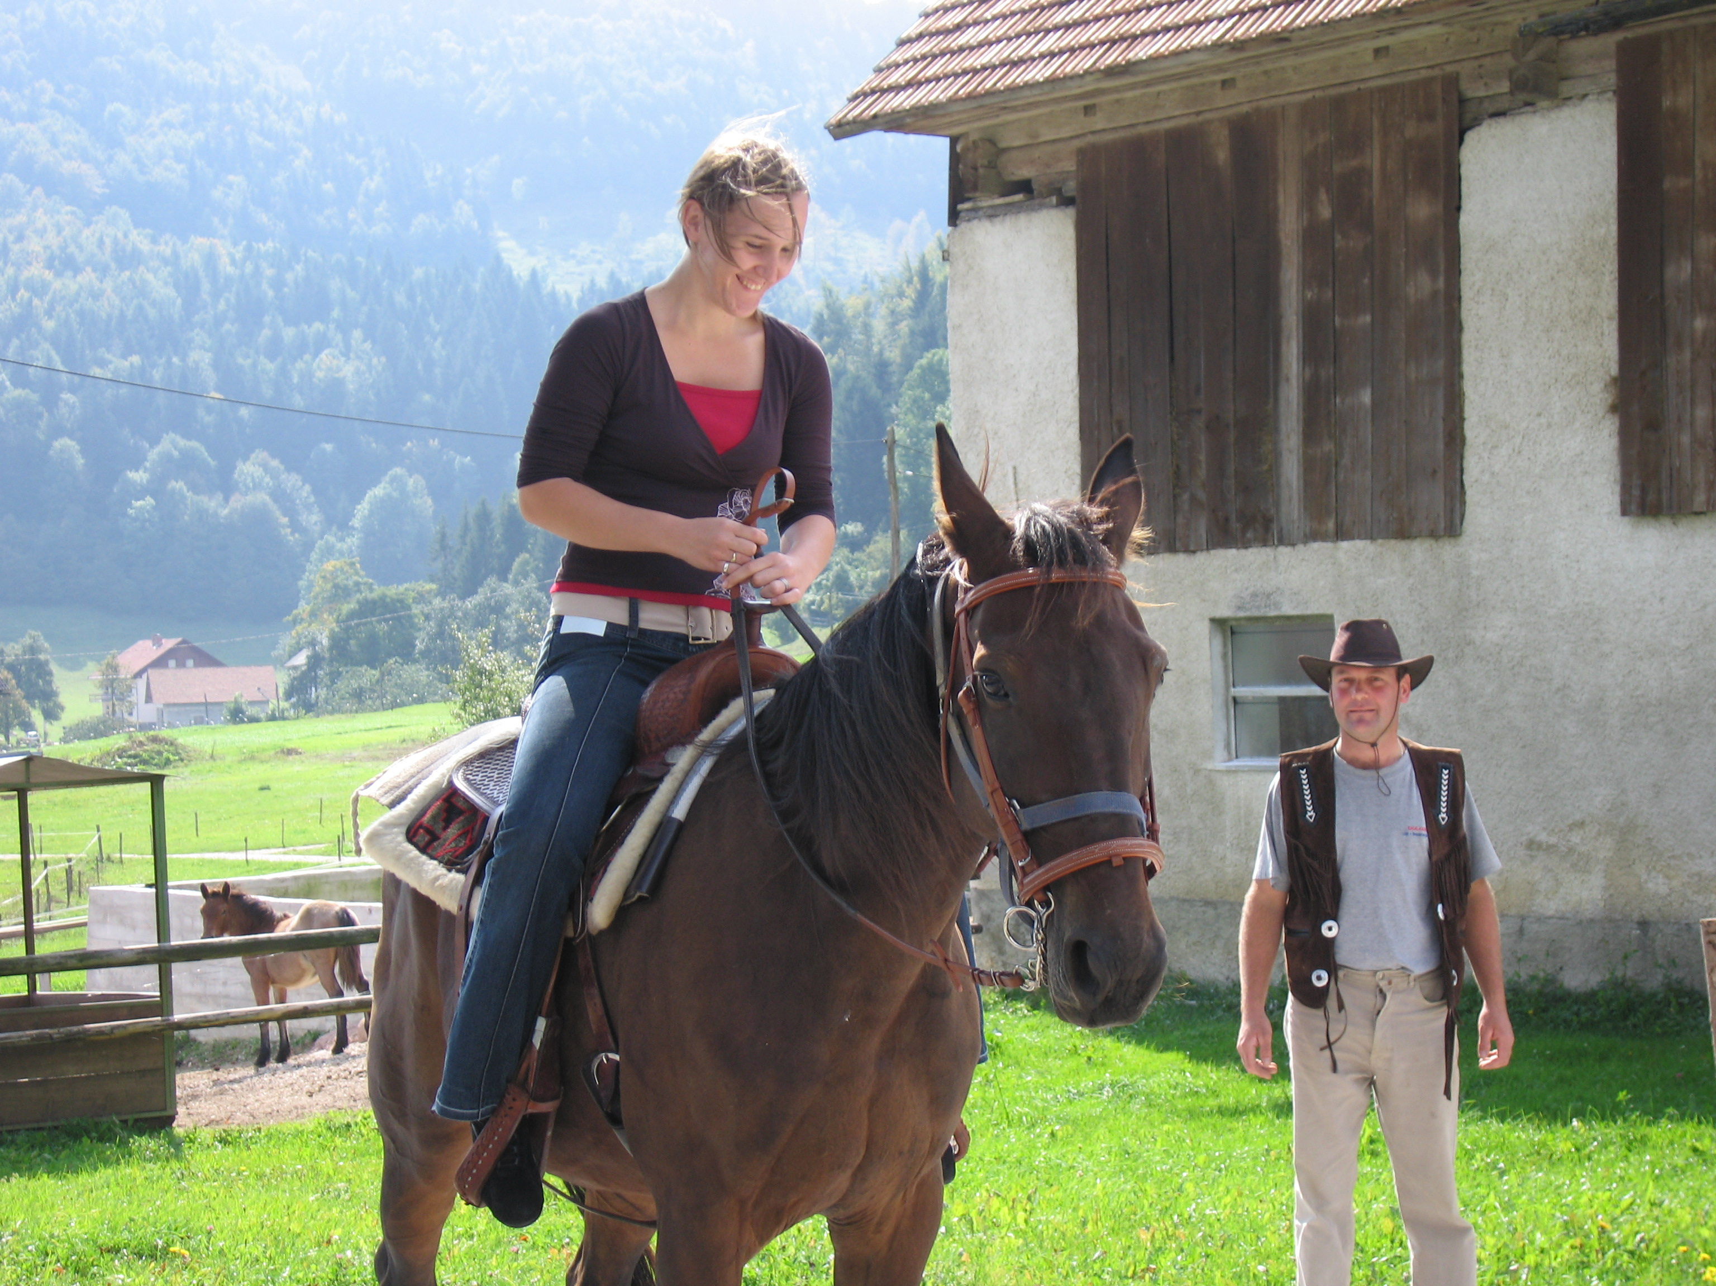

Slide 9
Agriculture in Hungary
The potential agricultural area is 9.3 m. h. (the total agriculturally area is around 5.8 m.h.)
Organic agriculture started in the 1980s
Hungary has a high share of organic arable land and of organic grassland
Summer 2005 the Marketing Institut an der Szent István Universitat Gödöllő carried out a major survey on consumers of Organic food.

Slide 10
Organic Agriculture Organisations
SLOVENIA:
The Union of Slovenian Organic
Farmers’ Associations (USOFA)
Deteljica (an organic farmers’ and producers’ association)
The Association for Organic Farming in Dolenjska, Posavje and Bela krajina.

Slide 11
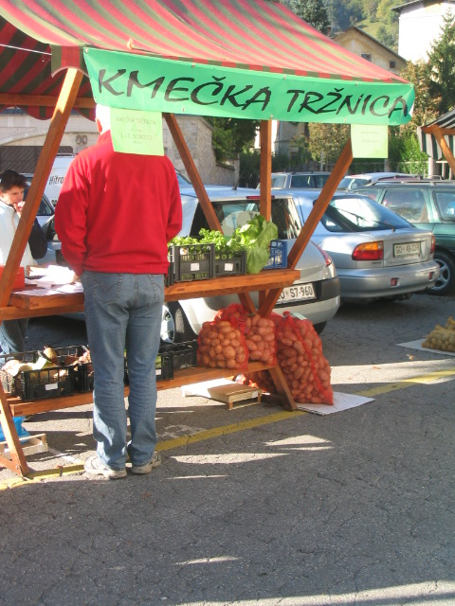

Slide 12
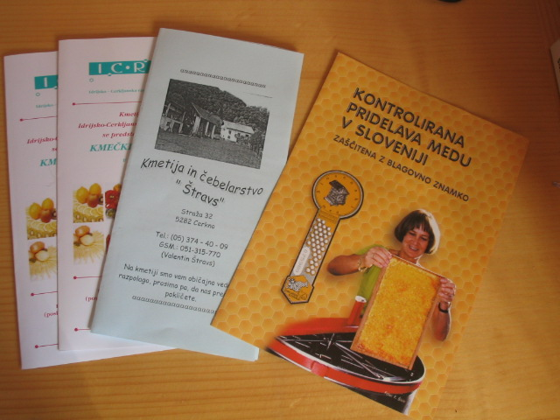

Slide 13
CONCLUSION
We are interested in this way of protection our nature and of corse our lives.
Let’s do something good for our health, lives and keep nature ready for other generations!
We know that we will manage this challenge, so let’s keep together and don’t forget that ecological agryculture is cool!

Slide 14
THANK YOU FOR YOUR ATTENTION!
WE WISH YOU A NICE DAY!
LOVE FROM SLOVENIA

Slide 15
