Slide 1
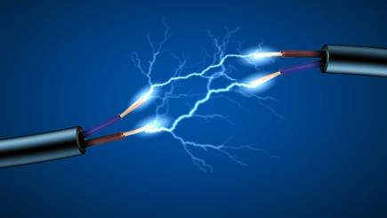
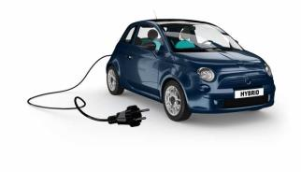
ELECTRIC CARS

Slide 2
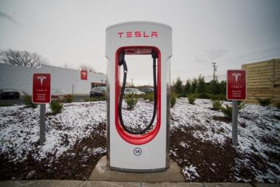
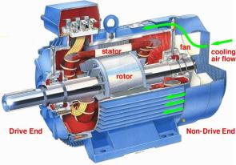
What is an electric car?
Rechargeable batteries
Electric motor (Better torque, smooth acceleration)
Range is very bad
Long charging

Slide 3
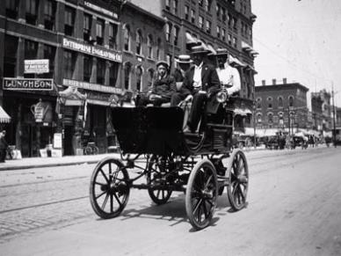
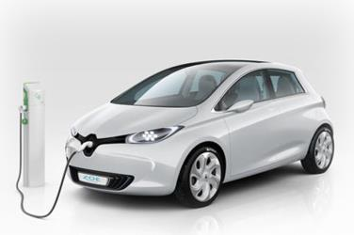
First electric car
The first electric cars were made 1880
Energy crises
Back in 21st

Slide 4
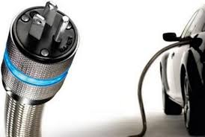
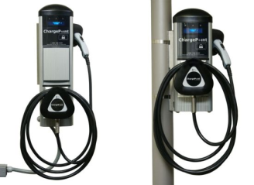
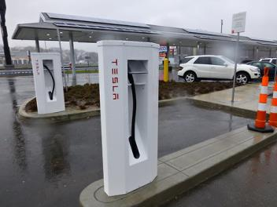
Power Station
2 types: - home
- fast (pluged in)

Slide 5
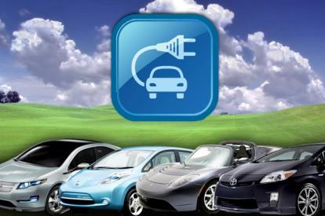
TYPES OF ELECTRIC CARS
Electric car
Hybrid
Electric car with petrol generator

Slide 6
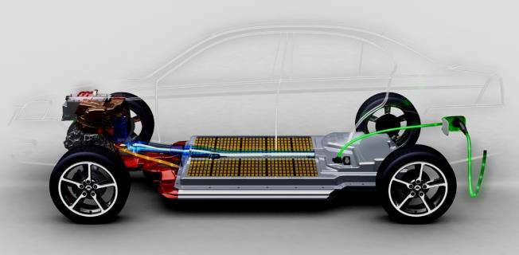
Electric car
+ : - no emmison
- cheap electricity
- smooth acceleration
- very quiet
: - short range
- long charrging
- expensive

Slide 7
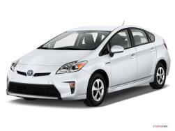
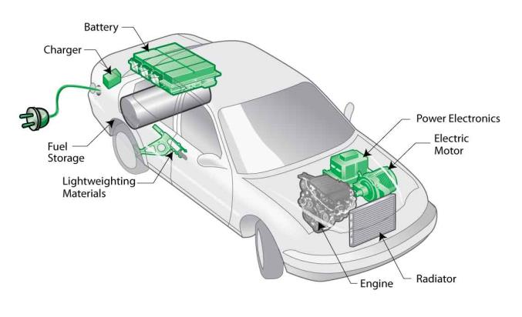
Hybrid

Slide 8
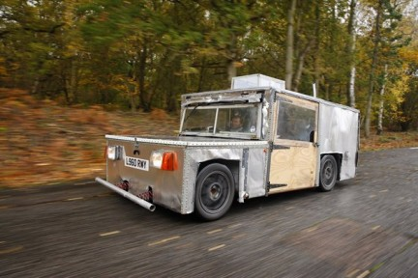
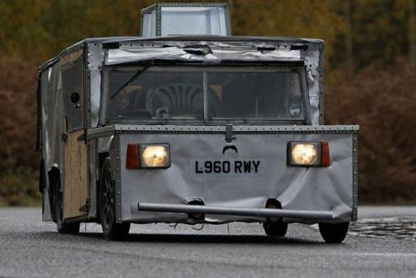
Electric car with petrol generator
Jeff hammerhead eagle i-thrust

Slide 9
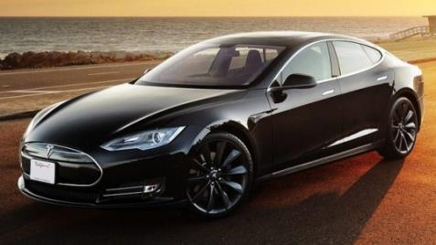
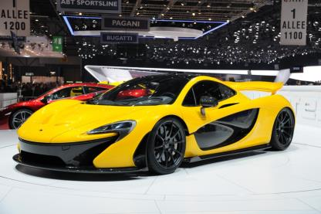
Best electric cars
Tesla S-model (electric)
270mpg
422hp
155mph
Cost: 100.000$
Mclaren P1 (hybrid)

Slide 10
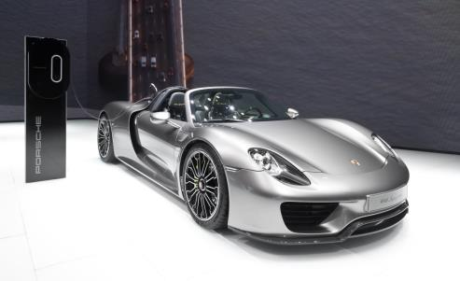
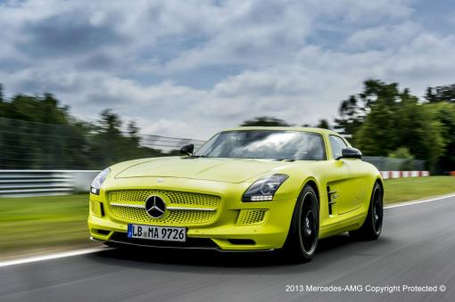
Porsche 918 (hybrid)
4.6 L V8 + 2 electric motors on front
850hp
420mpg
210mph
Cost: 890.000$
Mercedes SLS AMG (electric)
751hp
120mpg
155mph
Cost: 500.000$

Slide 11
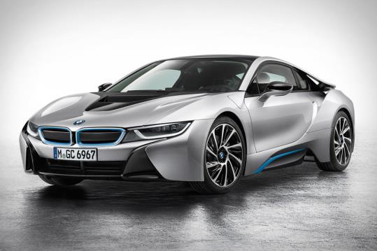
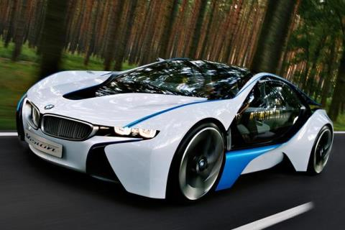
BMW i8 (hybrid)
159mph
380hp
Cost: 110.000$

