Slide 1
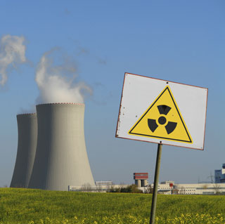
Electricity from
nuclear power-plant

Slide 2
Production electricity
Nuclear power-plant operates on the same simple principles as plants powered by coal or oil.
Heated water produces steam.
Steam drives a turbine that turns a generator produces electricity.

Slide 3
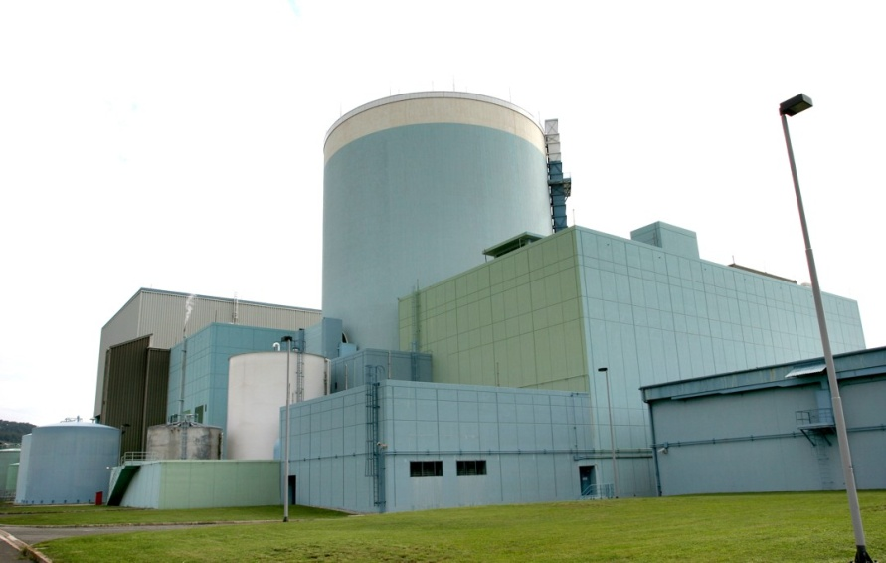
Krško power-plant
The heat source is the energy released by the fission, or splitting of nuclei of fissionable materials, (U-235).
A neutron collides with U-235 nucleus splitting the nucleus in two.
Part of the energy that held the nucleus together is released as heat.

Slide 4
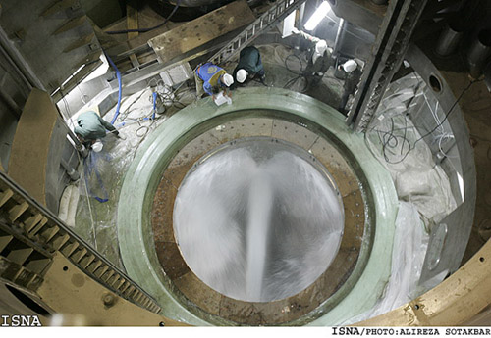
Cold water for cooling system
Other neutrons are ejected. These bombard other U-235 nuclei, thus setting up a chain reaction.
The energy produced by the chain reaction in the reactor core heats the water and turns it into steam.
The steam is then used to drive the turbines.

Slide 5
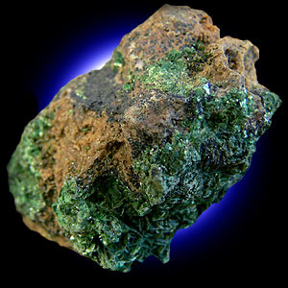
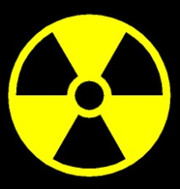
URANIUM
The importance of uranium today is as a producer of nuclear power.
Uranium was first discovered by the German chemist, Martin Klaproth in 1789. But for a century and a half afterwards few uses could be found for the new metallic element.

Slide 6
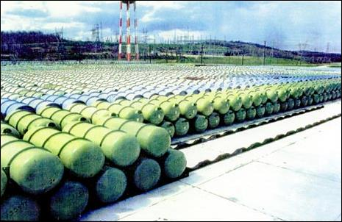
Depleted uranium
In 1938, two scientists, Hahn and Strassmann, discovered that uranium could yield nuclear energy.
One pound of uranium would give as much energy as three million pounds of coal. The first nuclear chain reaction was made by Enrico Fermi in 1942.
This made possible the exploding of the first atomic bomb in 1945.

Slide 7
Common words and expressions
Power-plant => elektrarna
Fission => cepitev
Split (the atom) => razbiti (atom)
Collide => trčiti
Chain reaction => verižna reakcija
Reactor core => reaktorsko jedro

