Slide 1
ENGLISH
a world of language

Slide 2
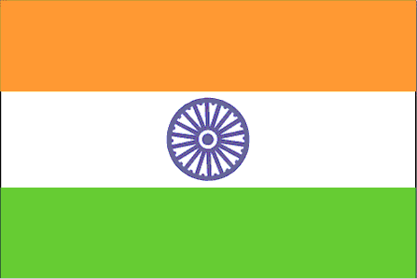
United Kingdom United States of America and 103 other countries
402 million + may be between 350 million and one billion

Slide 3
A Few Interesting Facts
No word in the English language rhymes with month, orange, silver or purple
"Underground" is the only word in the English language that begins and ends with the letters "und"
On reversing the words they spell the same: “Malayalam”, “Liril” and “Madam”
The only 15 letter word that can be spelled without repeating a letter is "uncopyrightable“
"Almost" is the longest word in the English language with all the letters in alphabetical order

Slide 4
Indo-European
language
Baltic Slavic
language
Germanic
language
…for example:
Italic languages

Slide 5
Germanic
language
North
East
West
High
Low
Saxondom
English

Slide 6
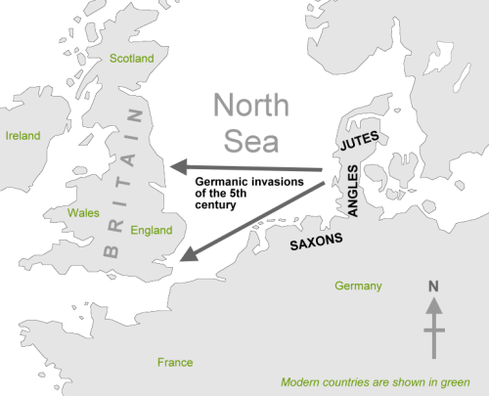
History
the migration of the Jutes, the Angles, and the Saxons in 5th and 6th centuries,
the inhabitants
of Britain spoke
a Celtic language
Celtic speakers
were pushed
west and north

Slide 7
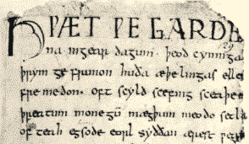
OLD ENGLISH
Old English - similar languages of The Germanic tribes
did not sound or look
like English today
be, strong, water - derive from Old English
Spoken until 1100

Slide 8
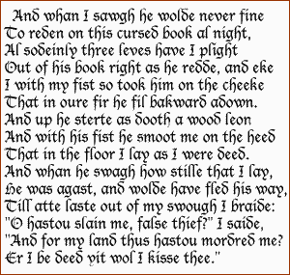
MIDDLE ENGLISH
William the Conqueror
invaded and conquered
England
kind of French, which
became the language of
the Royal Court
lower classes spoke English and the upper classes spoke French
14th century English became dominant in Britain with many French words

Slide 9
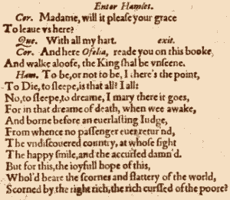
Early Modern English
change in pronunciation
new words and phrases
entered the language
The invention of
printing
Books became cheaper and more people learnt to read
1604 the first English dictionary

Slide 10
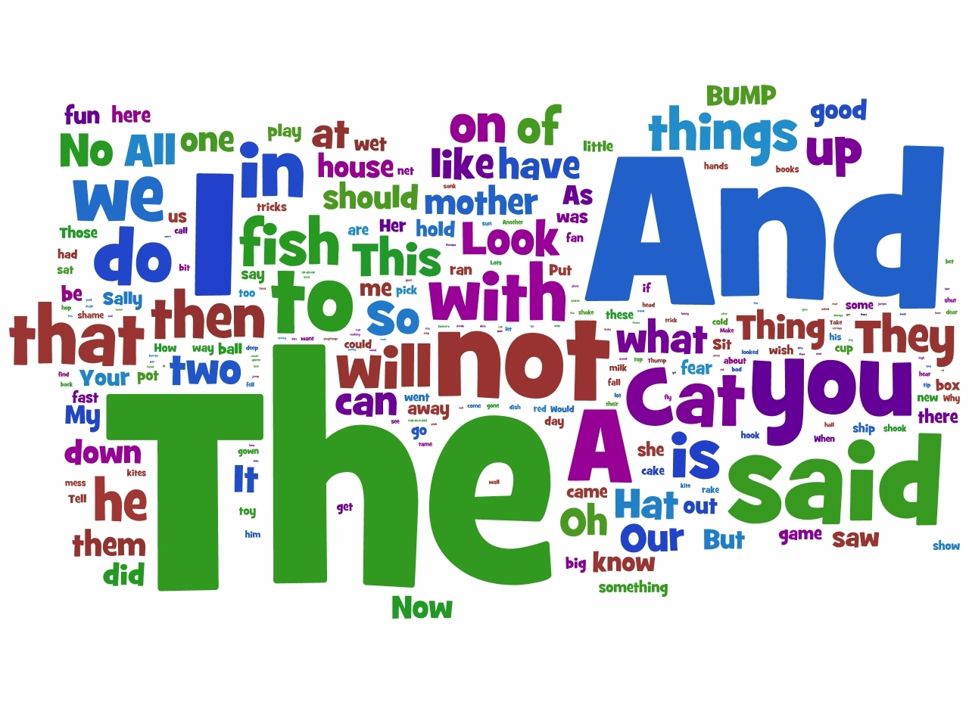
Late Modern English
difference between Early Modern English vs. Late Modern English - vocabulary
Firs - the Industrial Revolution and technology
Second - English language adopted foreign words from many countries - the British Empire

Slide 11
OLD vs. MODERN ENGLISH
Key to Pronunciation þ - pronounced "th" ð - pronounced "th" æ - pronounced as a flat "a" (as in "cat") ȝ - pronounced "y" or "g"
Soþlice on þam dagum wæs geworden gebod fram þam casere augusto. þæt eall ymbehwyrft wære tomearcod. Forsoþe it is don, in þo daȝis a maundement wente out fro cesar august, þat al þe world shulde ben discriued. And it came to passe in those dayes, that there went out a decree from Caesar Augustus, that all the world should be taxed.

Slide 12
Beowulf lines 1 to 11, approximately AD 900
Hwæt! Wē Gār-Denain geārdagum,þēodcyninga,þrym gefrūnon,hū ðā æþelingasellen fremedon.Oft Scyld Scēfingsceaþena þrēatum,monegum mǣgþum,meodosetla oftēah,egsode eorlas.Syððan ǣrest wearðfēasceaft funden,hē þæs frōfre gebād,wēox under wolcnum,weorðmyndum þāh,oðþæt him ǣghwylcþāra ymbsittendraofer hronrādehȳran scolde,gomban gyldan.Þæt wæs gōdcyning!
Which, as translated by Francis Gummere, reads:
Lo, praise of the prowess of people-kings of spear-armed Danes, in days long sped, we have heard, and what honor the athelings won! Oft Scyld the Scefing from squadroned foes, from many a tribe, the mead-bench tore, awing the earls. Since erst he lay friendless, a foundling, fate repaid him: for he waxed under welkin, in wealth he throve, till before him the folk, both far and near, who house by the whale-path, heard his mandate, gave him gifts: a good king he!

Slide 13
English in our language
we learn it in schools
it is very practical
more and more titles of restaurants, shops, ... in English

Slide 14
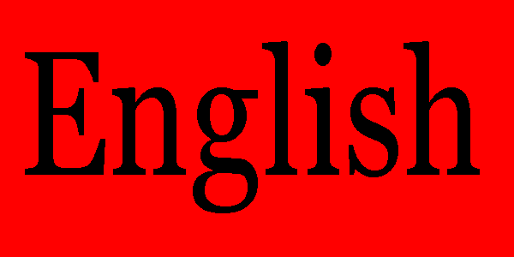
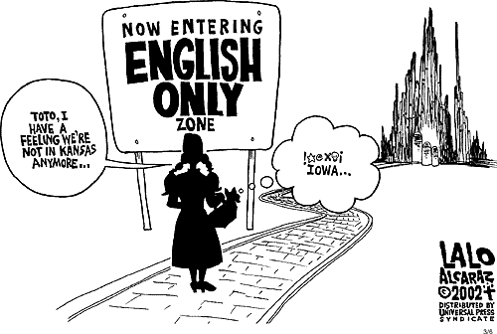
WHAT DO I THINK?

Slide 15
QUIZ
What language did spoke the inhabitants of Britain ?
a) Celtic b) Gaulish c) Britannic
English was spoken until
a)1500 b) 1100 c) 1060

Slide 16
What was invented in late modern
english?
a)print b)telephone c)car
4. What was the difference between Early Modern English vs. Late Modern English ? a)vocabulary b)grammar c) structure
of words

Slide 17
Resources
http://www.bible-researcher.com/engchange.html
http://en.wikipedia.org/wiki/English_language
http://www.answers.com/topic/english-language
http://www.anglik.net/englishlanguagehistory.htm
http://www.englishclub.com/english-language-history.htm
http://www.indiastudychannel.com/resources/29731-INTERESTING-FACTS-ABOUT-ENGLISH-LANGUAGE.aspx
Google Pictures

Slide 18
Thank you for your attention !

