Slide 1
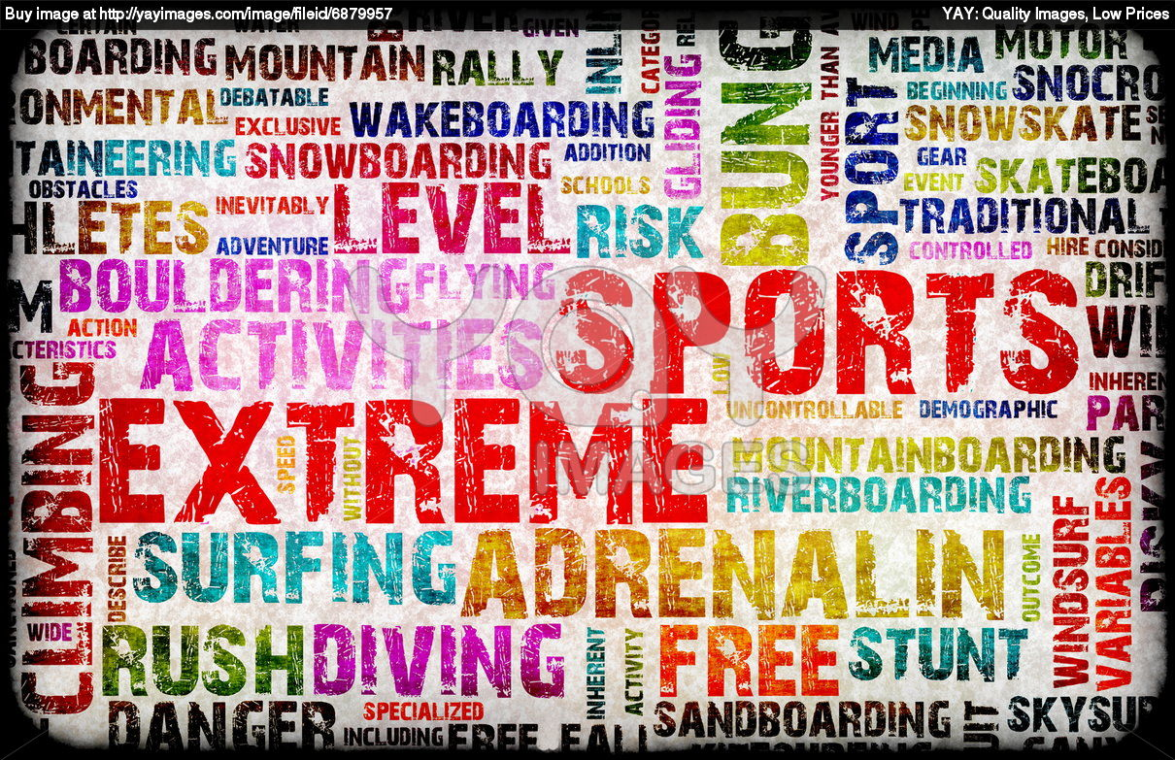

Slide 2

UNKNOWN WORDS:
TO ENHANCE – to improve the quality, amount or strenght of something
SURFACE AREA – the total area on the surface of a three-dimensional figure
SIGNIFICANT – important

Slide 3
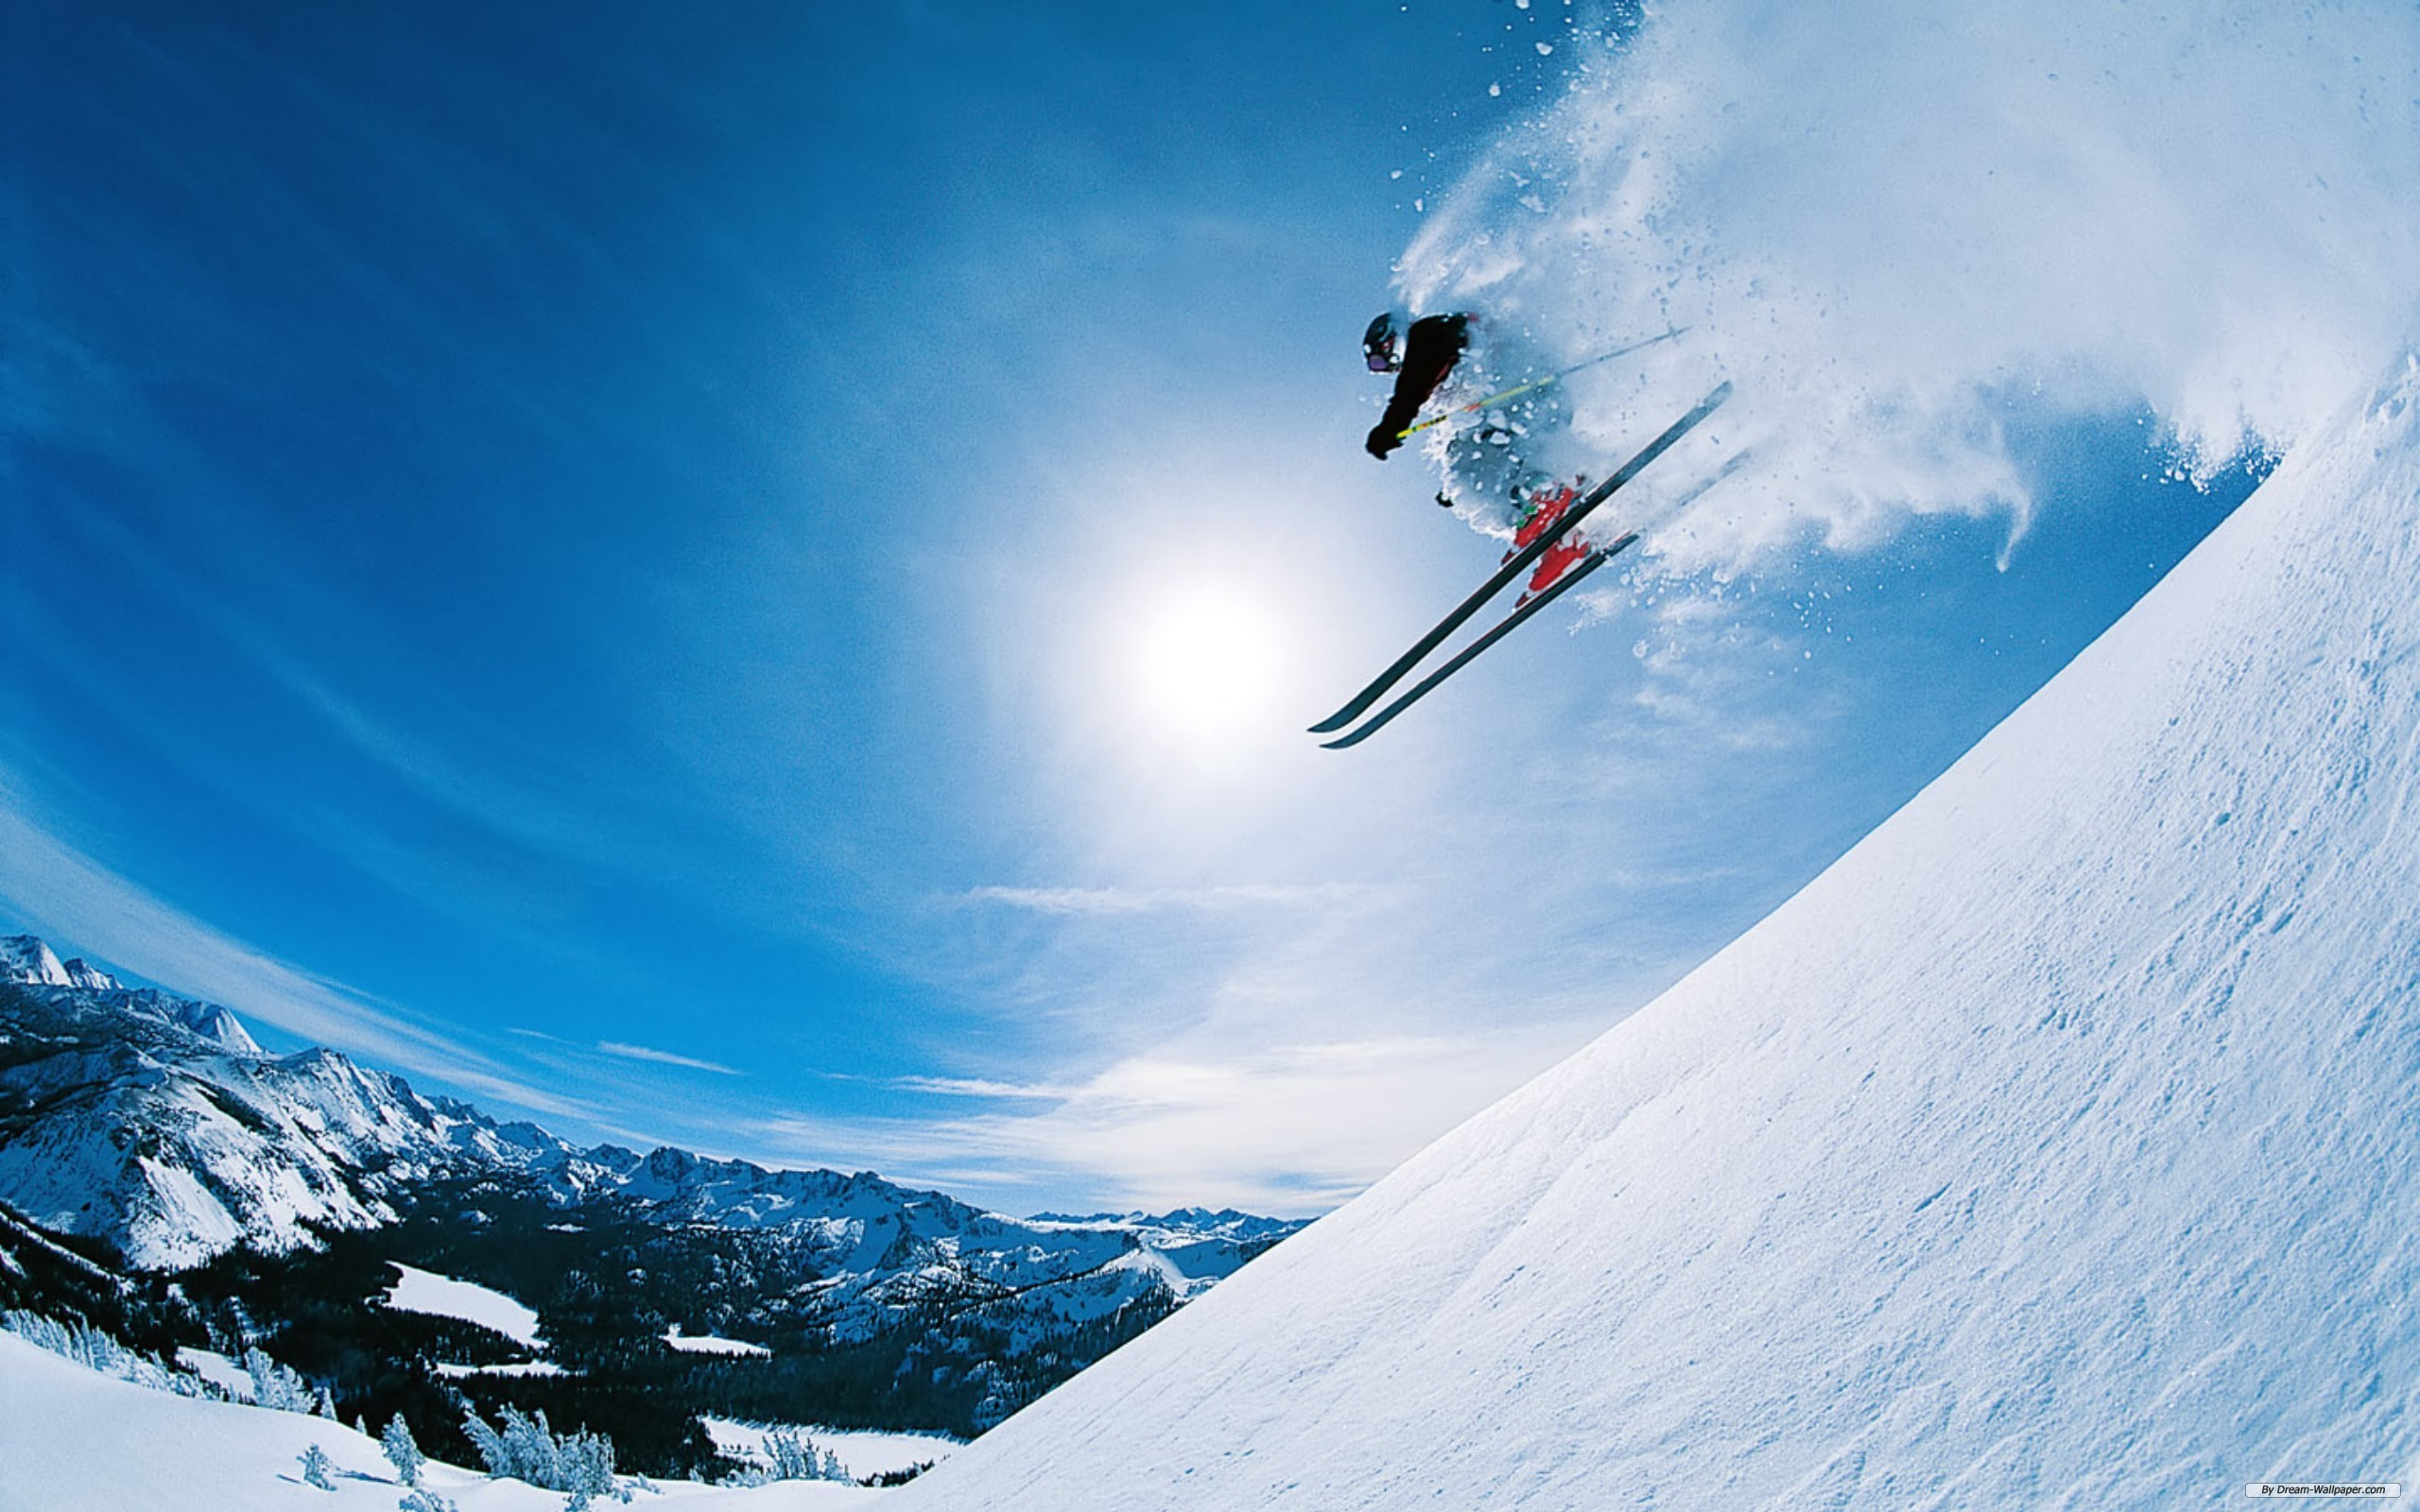
List of extreme sports:
Land:
Skateboarding, BMX, motocross, FMX, mountain biking, rock climbing, free cimbing, zorbing
Water:
Surfing (long/short board), waterskiing, wakeboarding, kitesurfing, windsurfing, cave diving, rafting, cliff jumping, jet skiing
Snow and Ice:
Snowboarding, freestyle/extreme skiing, ice climbing, snowmobiling, snow kiting
Air:
Wingsuiting, bungee jumping, high-lining, hang gliding, paragliding

Slide 4
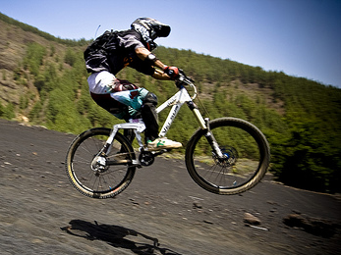
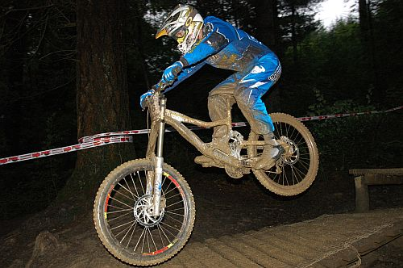
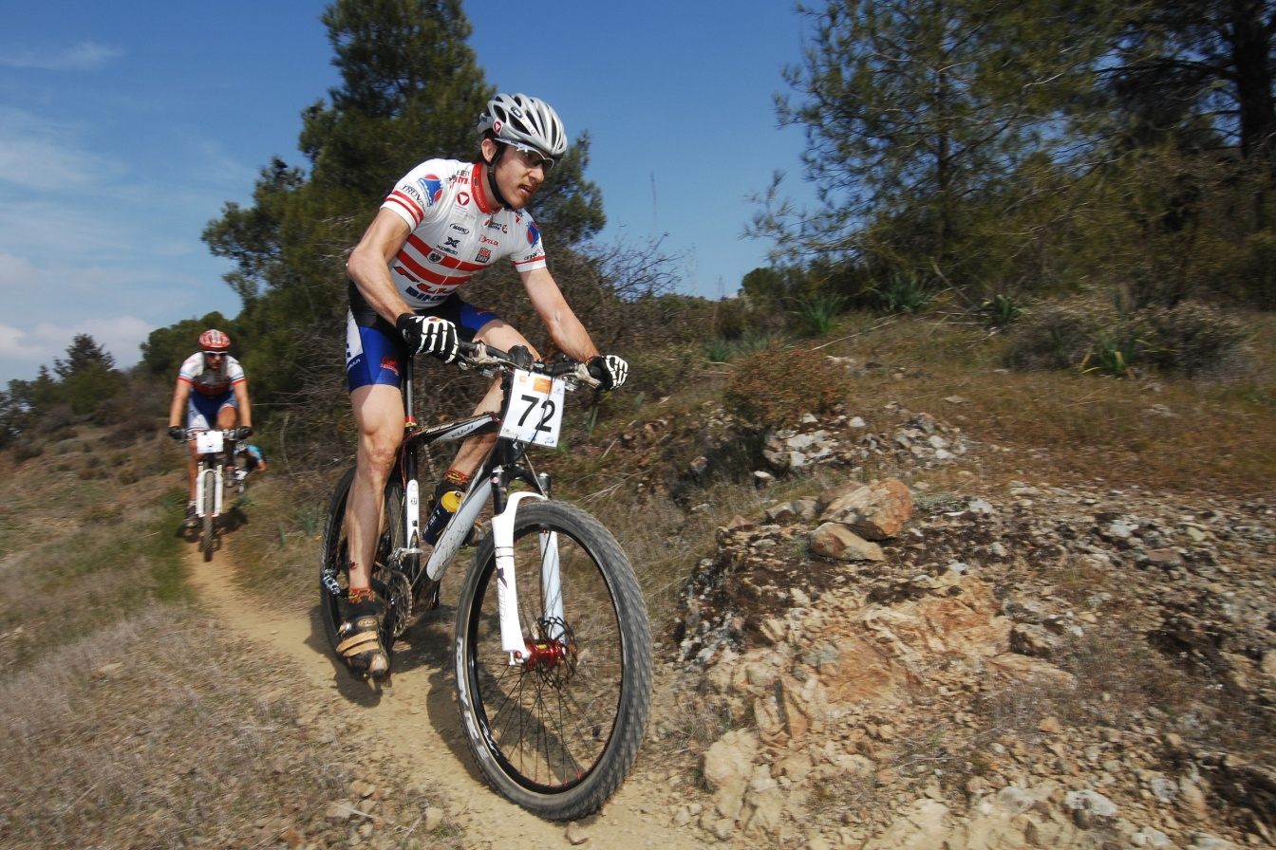
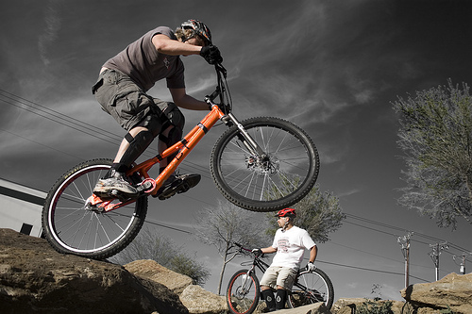
MOUNTAIN BIKING
Rough terrain
Specially designed bikes
Designed to enhance durability and performance
Very expensive bikes
Cross – country, downhill, freeride, trial

Slide 5
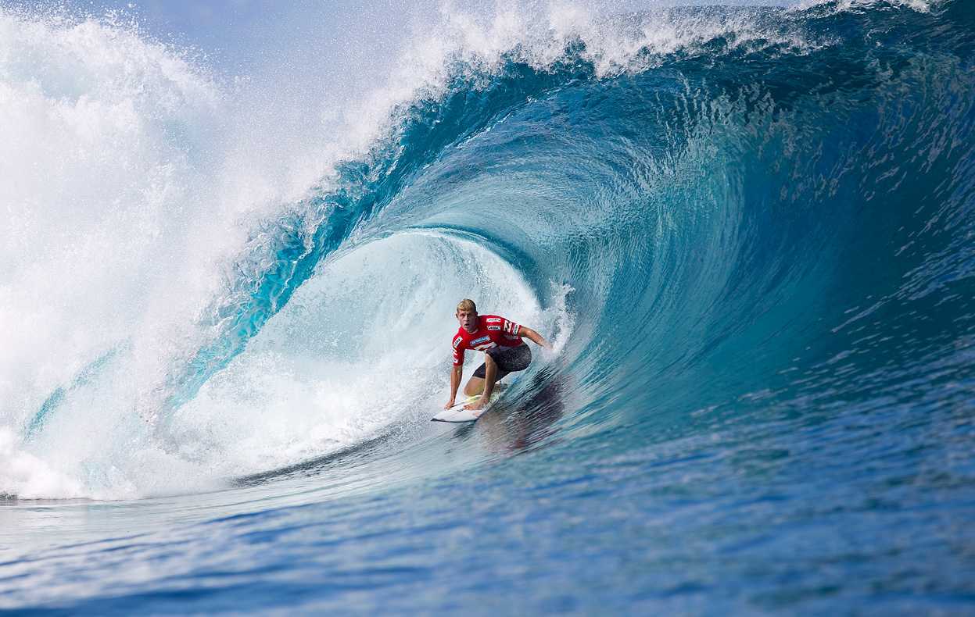
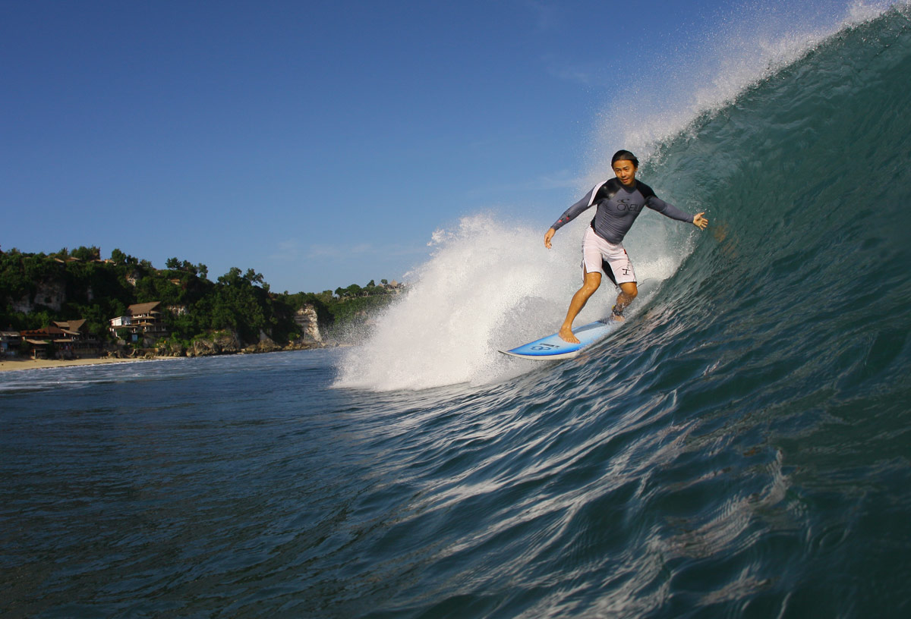
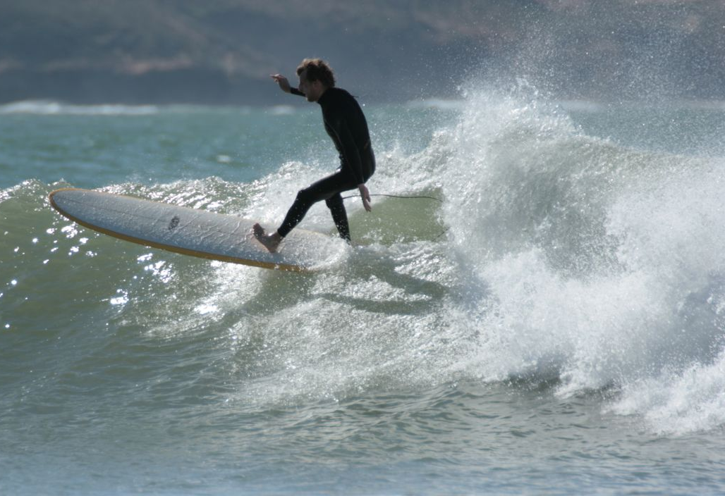
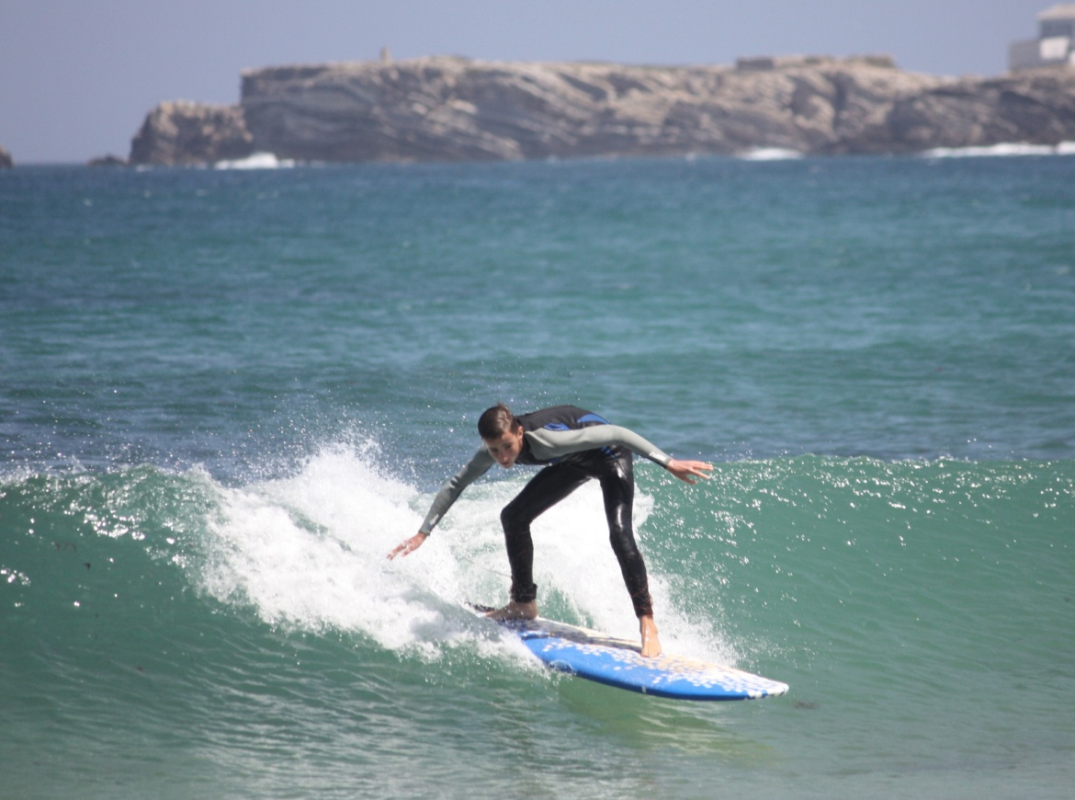
SURFING
Surfrer stands on board
Rides a wave
On the sea, in surfing pools
Long or short board

Slide 6
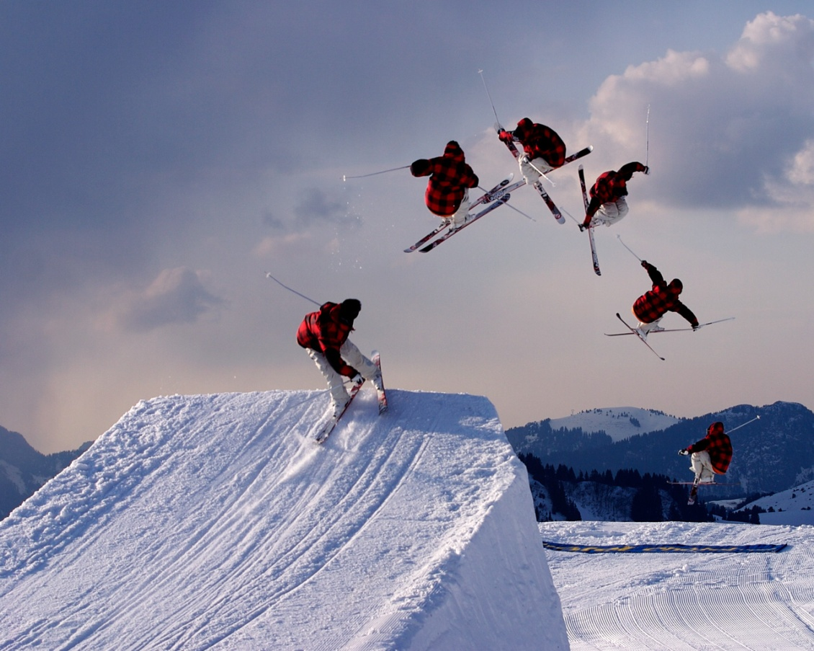
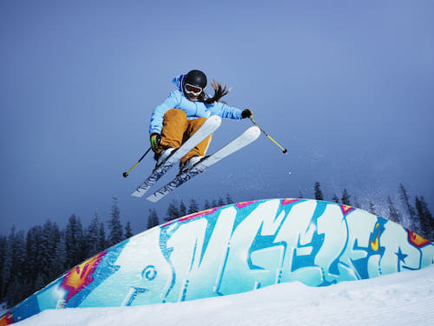
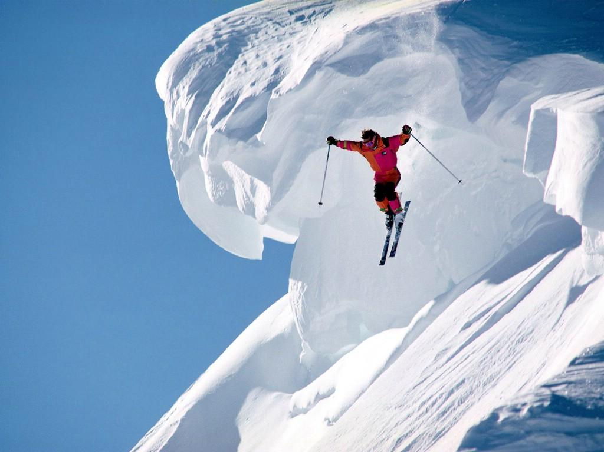
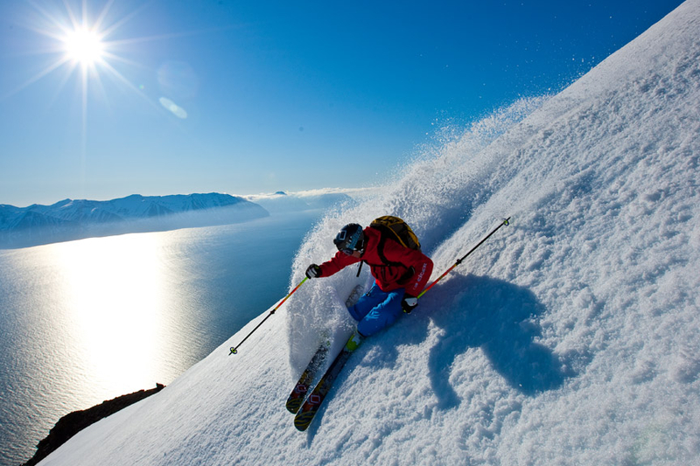
FREESTYLE/EXTREME skiing
EXTREME – performed on long,steep slopes in mountainous terrain, outside the lines
FREESTYLE – on the lines, on jumps, on the arranged ski slopes

Slide 7
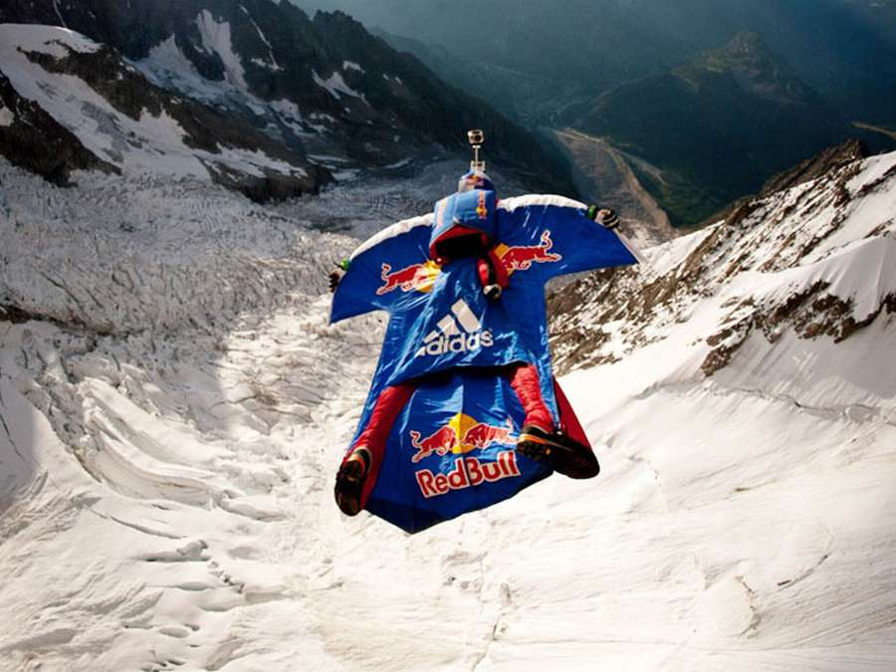
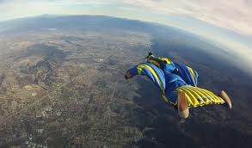
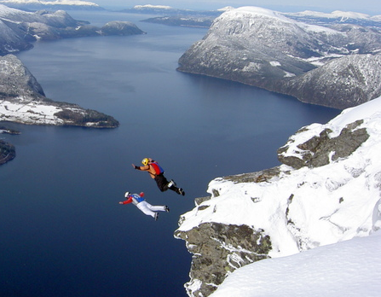
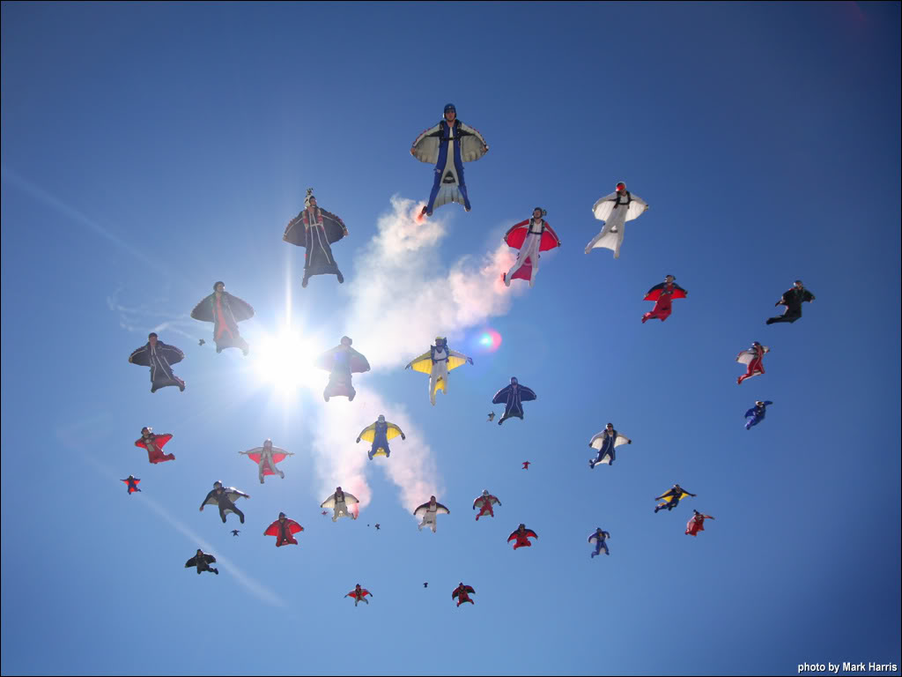
WINGSUITING
Flying the human body through the air using a sprcial jumpsuit – wingsuit
Wingsuit adds surface area to the human body to enable a significant increase in lift
From mountains, from plane, from the buildings

Slide 8

THANK YOU FOR YOUR ATTENTION
☺

