Slide 1
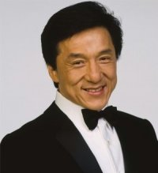
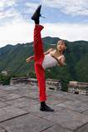
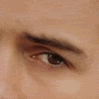
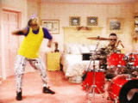
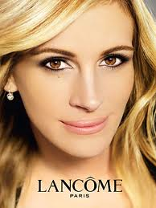
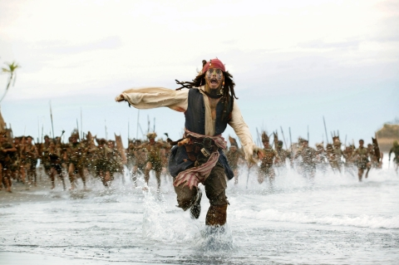
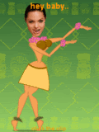
Famous actors

Slide 2
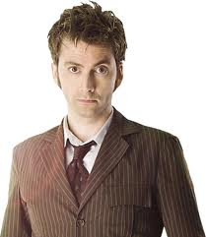
DAVID TENNAT
He has a short brown hair, brown eys, he is womenizer, he is cute and he is good acter.
I watch serial Dr. WHO?

Slide 3
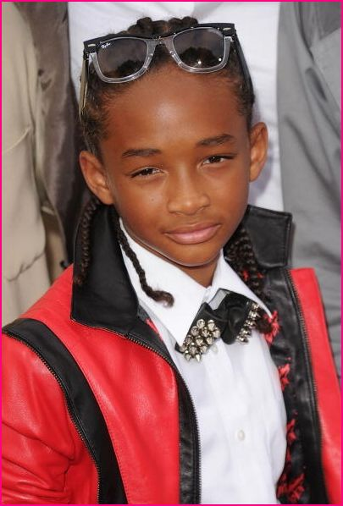
Jaden Smith
He´s Will Smith´s son, he´s good actor, he played in Karate kid movie.
http://www.youtube.com/watch?v=XY8amUImEu0

Slide 4
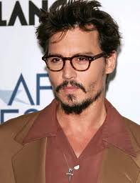
Johnny Deapp
He´s strange in good way but theath makes him a good actor. He played in pirrats of the carribian.
http://www.youtube.com/watch?v=DUswEgDCHUs

Slide 5
Jacki Chan
He´s my favorite actor, he´s chinese, i like his action movies , he´s good fighter, he played in movie the next door spie.
http://www.youtube.com/watch?v=uNz2yKtKKGA

Slide 6
Angelina Jolie
She´s cute, she´s got big lips, she played in Lara Croft.

Slide 7
Julia Roberts
She´s redhead, she played in romantic films, she´s got a lot of kids.

Slide 8
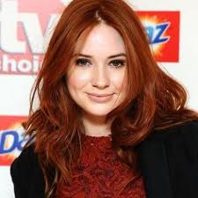
Karen Gillan
She´s redhad too, she playes in Doctor who? Too.

Slide 9
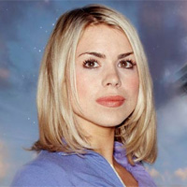
Billie Piper
She´s natural blond, she´s wery famus in Great Britain but not in Slovenia.

Slide 10
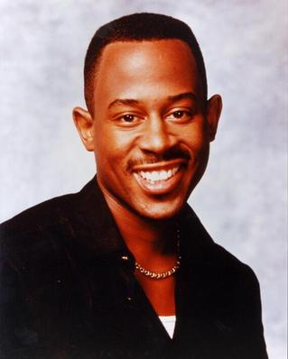
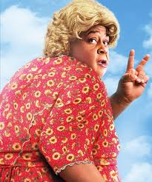
Martin Lawrence
He´s playing in movie big mommas house where is he secret agent disguise in fat lady.

