Slide 1
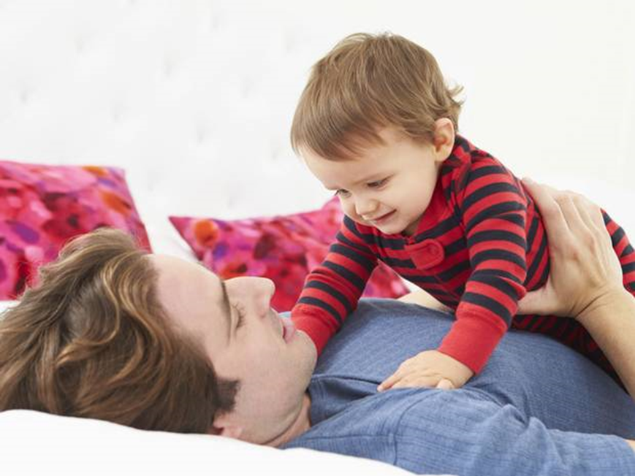
Fathers’ brains change when they are the primary caregiver

Slide 2
TYPICAL FAMILY
father, mother and kids
important role in up-bringing
patterns they get-hand to their own children
father: strict, tough, head of a family
mother: caring, sensitive, gentle
both have instinct for taking care
mothers-privilege of special connection (pregnancy, childbirth, lactation)

Slide 3
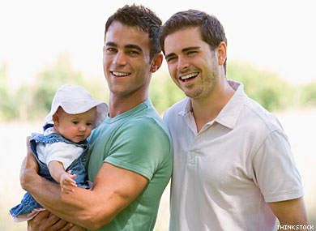
family nowadays can also be…
two man and children
IS THAT TYPE OF FAMILY GOOD FOR A CHILD?

Slide 4
THE STUDY
100 first-time parents
divided to 3 groups:
heterosexual primary-caregiving mothers
heterosexual fathers
primary-caregiving homosexual fathers
shown videos spending time with children

Slide 5
neural network
made of 2 systems: (connected)
an emotional… women
a mentalising… men
gay fathers: both higly developed + skills
spending more time…will grow and improve
happens mainly-women absence

Slide 6
findings…
gay fathers almost as good as mothers
study – an influence on the global debate on same-sex adoption
http://www.youtube.com/watch?v=FY9e8OGqWLs ☺
http://www.independent.co.uk/news/science/gay-fathers-brains-change-when-they-are-the-primary-caregiver-9442757.html (article)

