Slide 1
F.B.I.

Slide 2
Contents
History
What is FBI
Headquarters
What do they do
Science

Slide 3
History
Existing since 1908
At the beginning only 40 agents
Now 30.000 agents
Captured Al Capone, John Dillinger and more

Slide 4
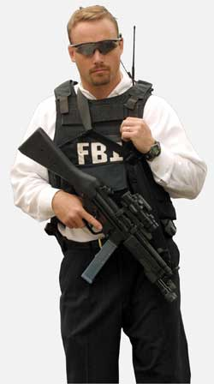
FBI
American organization
Keeping America safe

Slide 5
Priorities of members:
Protecting from terrorist attack
Protecting against foreign intelligence operations and espionage,
Combat public corruption at all levels,
Protecting civil rights,
And more…

Slide 6
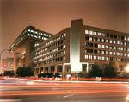
Headquarters
Called F.B.I base
Lying in Edgar Hoover building in Washington
Special agents and people who supports F.B.I.
45 offices known as Legats
All around the world
American first defence

Slide 7
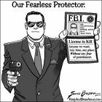
What do they do
NOT blowing the place up
Using tactics
Protecting hostages
Trying to get informations

Slide 8
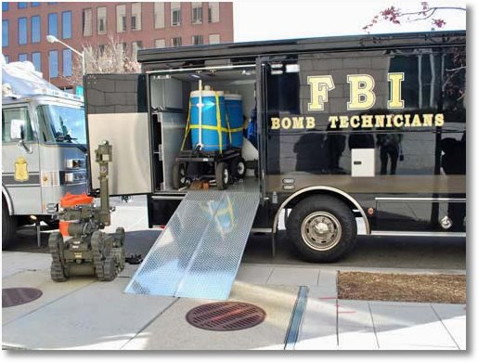
Science
Using over 200 computer programs
Listening secretly to the phone calls
Owning industry of weapons
Using robots

Slide 9
Thank you for listening
Any questions?

