Slide 1
FIFA WORLD CUP 2010
South Africa 2010

Slide 2
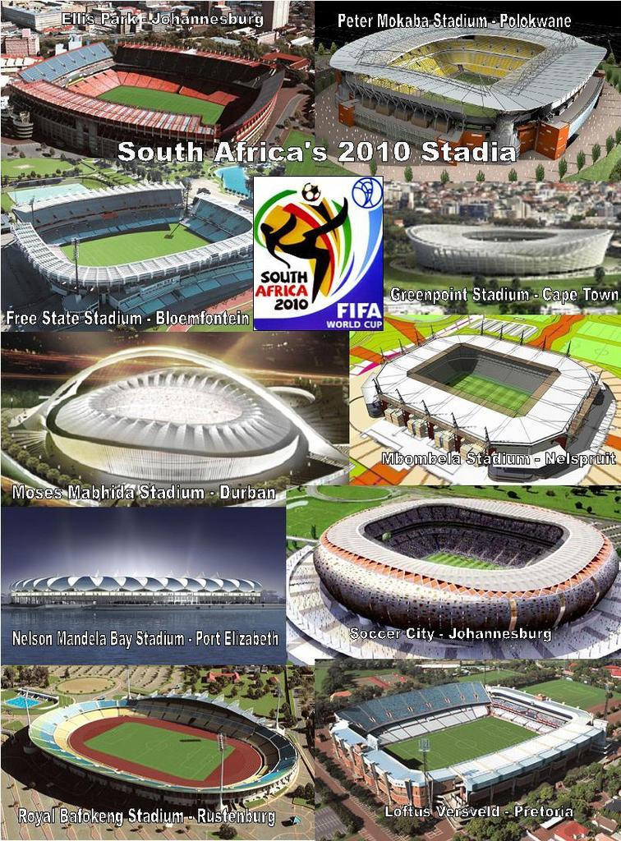
WHERE WILL BE WORLD CUP
The World Cup will be play in South Africa in the 10 stadiums : Cape Town, Durban, Johannesburg Ellis Park, Johannesburg Soccer City stadium, Mangaung,Nelson Mandela Bay , Nelsprut , Polokwane , Rustenburg and Pretoria.

Slide 3
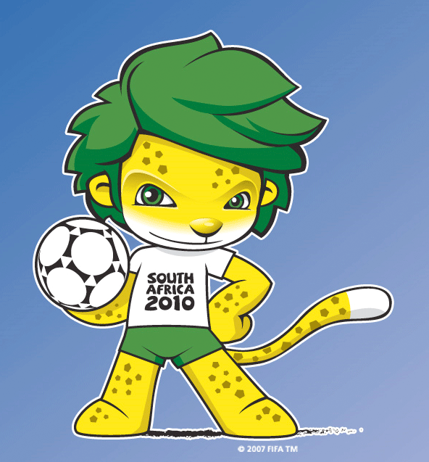
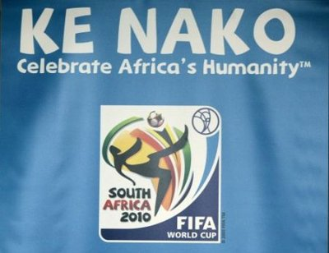
OFFICIAL SYMBOLS
Official mascot is Zakumi. Zakumi is lion.
Official slogan is KE NAKO. Celebrate Africa’s Humanity
Official emblem.

Slide 4
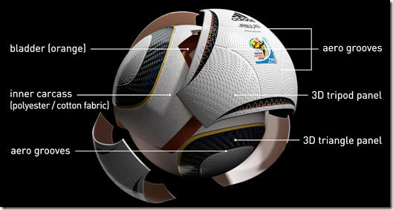
OFFICIAL BALL
Official ball is JABULANI. Made by Adidas. Ball is very advanced and developed with technology .
The ball is constructed using a new design, consisting of eight (down from 14 in the last World Cup) thermally-bonded, three-dimensional panels.
The surface of the ball is textured with grooves, a technology developed by Adidas called GripnGroove that is intended to improve the ball's aerodynamics.

Slide 5
PARTICIPANTS IN WORLD CUP
In the world cup is 32 country, who were qualified for this contest .
These country are razporejene po skupinah (A,B,C,D,E,F,G,H).
From the groups two best country included in the next round of W.C.

Slide 6
HISTORY OF WORLD CUP
The first world cup was in Uruguay. In the final in Centenario (Uruguay) is win Uruguay they were win Argentina.
Winner list:
5X Brasil 2X Argentina 1X France
4X Italia 2X Uruguay
3X Deutschland 1X England

Slide 7
WHEN WILL BE WORLD CUP?
Fifa WORLD CUP will be from 11. June to 11. July.
Group match will be finish on 25.6. 2010.
During the time the finals will be play eighth-finals match quarter-finals and semi-finals match.
The final match will be on 11. July

Slide 8
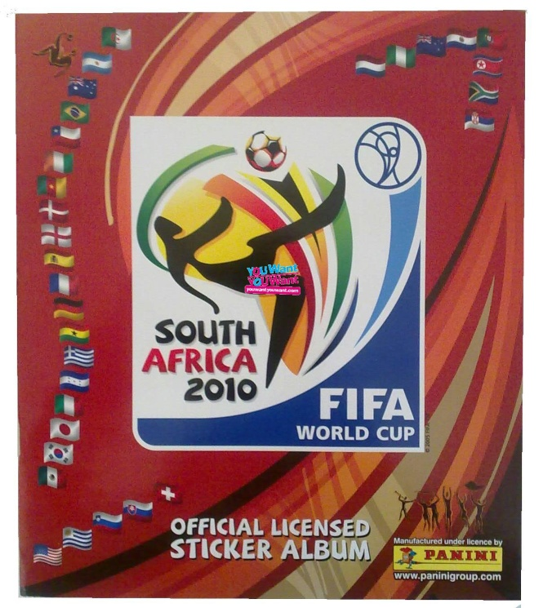
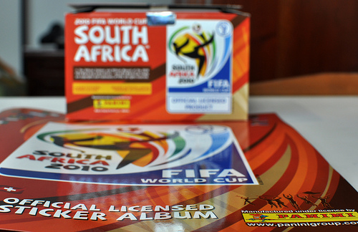
FOR COLLECTOR STICKER
For all collectors stickers is OFFICIAL LICENSED STICKER ALBUM by PANINI.

Slide 9
THIS IS IT
THE END!!!
http://www.youtube.com/watch?v=jOY70ps8a5E
Support our footballer in WORLD CUP!!

