Slide 1
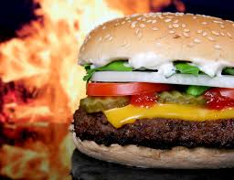
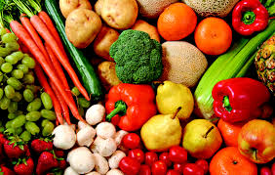
FOOD
Naredil:
Profesor:

Slide 2
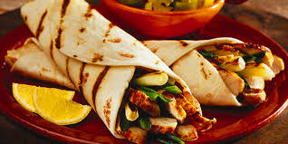
Food is any substance consumed to provide nutritional support for the body.
It is usually plant or animal origin.
Every food contains essential nutrients, such as fats, proteins, vitamins, or minerals.

Slide 3
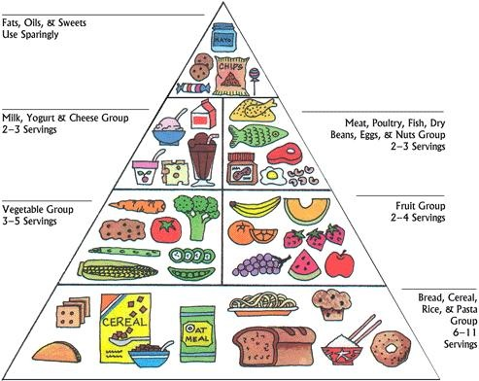
FOOD PYRAMID

Slide 4
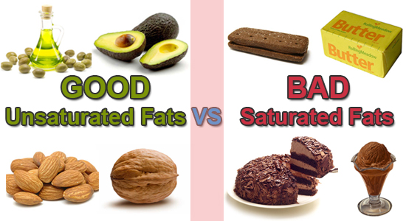
FATS
Fats are important for proper body building and for metabolism.
Fat-free body could not accept vitamins
Fats are in animal food, vegatables (oil) and nuts

Slide 5
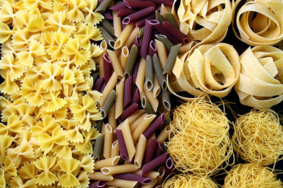
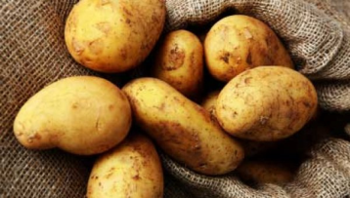
CARBOHYDRATES
Carbohydrates are the main source of energy for our body
Carbohydrates are the main culprit for excess weight
Carbohydrates are in bread, rice,..

Slide 6
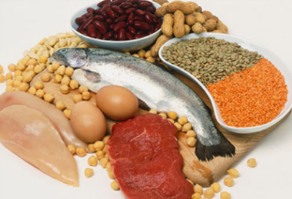
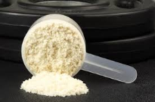
Proteins
Protein prevents entry of bacteria in our body
Proteins are important for building muscles
Proteins are in milk, meat, cheese,…

Slide 7
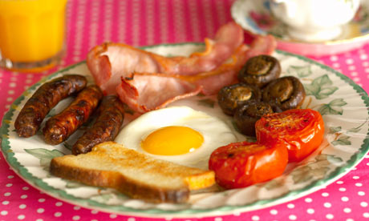
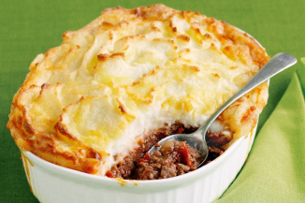
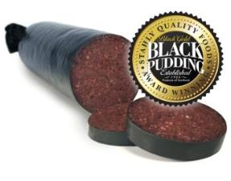
ENGLISH FOOD

Slide 8
ENGLISH DRINKS

Slide 9
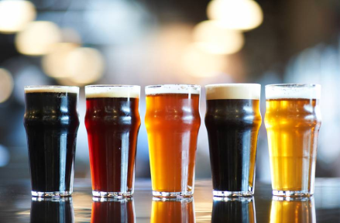
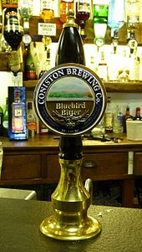
ENGLISH BEER
Beer in England has been brewed for hundreds of years. As a beer brewing country, England is known
English beer styles include bitter, mild, brown ale, old ale, Stout, porter and India Pale Ale were also originally brewed in London.

